Slide 1
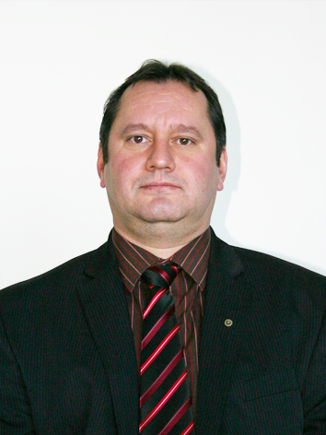
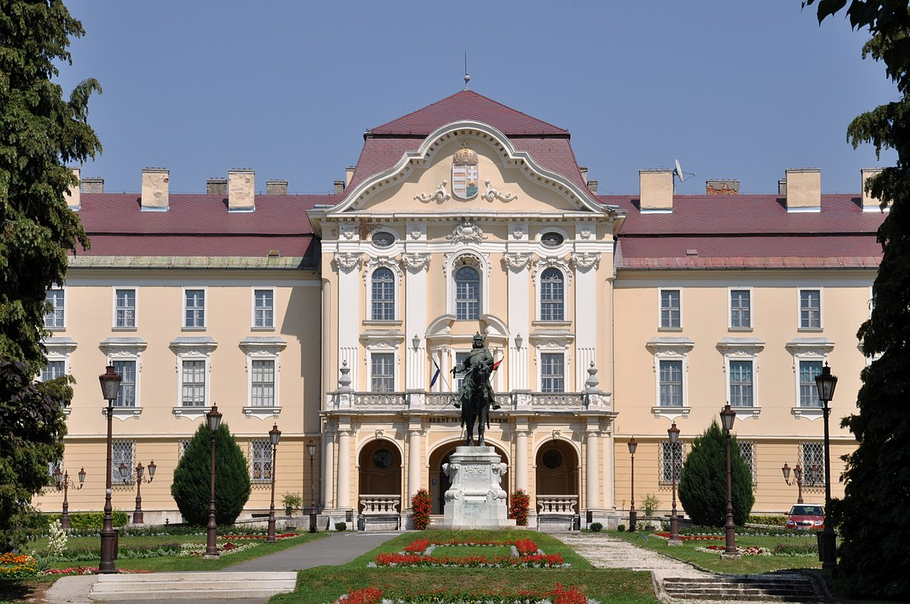
Dr. Bártfai Zoltán Ph.D
associate professor, head
Hungarian University of Agriculture and Life Sciences
Institute of Technology
Dept. of Agricultural and Food Industrial Machines
bartfai.zoltan@uni-mate.hu
Research area:
Agricultural mechanization and machinery management
Systems engineering
Vehicle technologies
Agricultural precision technologies
Agricultural robotics
Engineering in urban management
Course development, management
https://archive.uni-mate.hu/en

