Slide 1
ILL-Circular Economy
How to make E-Mobility sustainable by applying the principles of circular economy?

Slide 2
Target of the course
Within the frame of the course I Living Lab-Circular Economy participants will get practical knowledge on the field of:
concept making,
machine and system design,
manufacturing design,
assembly technologies and the
logistics aspects of a production system.
Basics of planning a technical system also will be covered focusing the up to date technologies that a complex mechatronic system contains.
Aim of the course is to motivate student working in teams with colleagues coming from national and international environment.

Slide 3
Intended outcomes
Engaged in an I-LL, students are encouraged to:
think independently, critically and creatively
learn various methods for analyzing and solving socially relevant problems
develop interdisciplinary cooperation skills, promoted through dialogue orientation and self-determined learning
develop future skills, such as the skills promoted by the E³UDRES² concepts and methods, as follows

Slide 4
Intended outcomes
Students will be able to:
understand the functions and operation of a complex system
determine, design/choose the main technical elements for creating the desired system,
present ideas in adequate form (e.g.: flow diagram, technical drawing)
understand the production, and assembly technology to create the physical system
act as a member of a professional team,
be responsible as an individual professional.

Slide 5
Main future skills
Creativity
Computational Thinking and Digital Literacy
New Media Literacy
Social Intelligence
Design Mindset
Novel and Adaptive Thinking
Sense Making
(Virtual) Collaboration
Cognitive Load Management
Cooperation skills
Future mindset

Slide 6
Main project steps (getting up a project)
Literature review
Engineering challenges in product/service design, development. Environment and supporting system of engineering: Up to date knowledge, equipments to apply in the engineering activity.
Project design, project management in practice.
Conception of the e-car development/reconstruction
Plan for realisation: Detailed plan of the developing process.
Presentation: Introduction of an e-car conception.
Evaluation, assessment

Slide 7
E-car development-I.
Reconstruction

Slide 8
Target of the development
Converting an internal combustion engined car -VW Beetle- to an electric vehicle.
The rebuilt vehicle can be used in road traffic, so it is technically safe to operate and complies with current regulations.
The vehicle is suitable for urban transport despite the weather conditions in Europe.
The vehicle shall be capable of being charged at charging stations

Slide 9
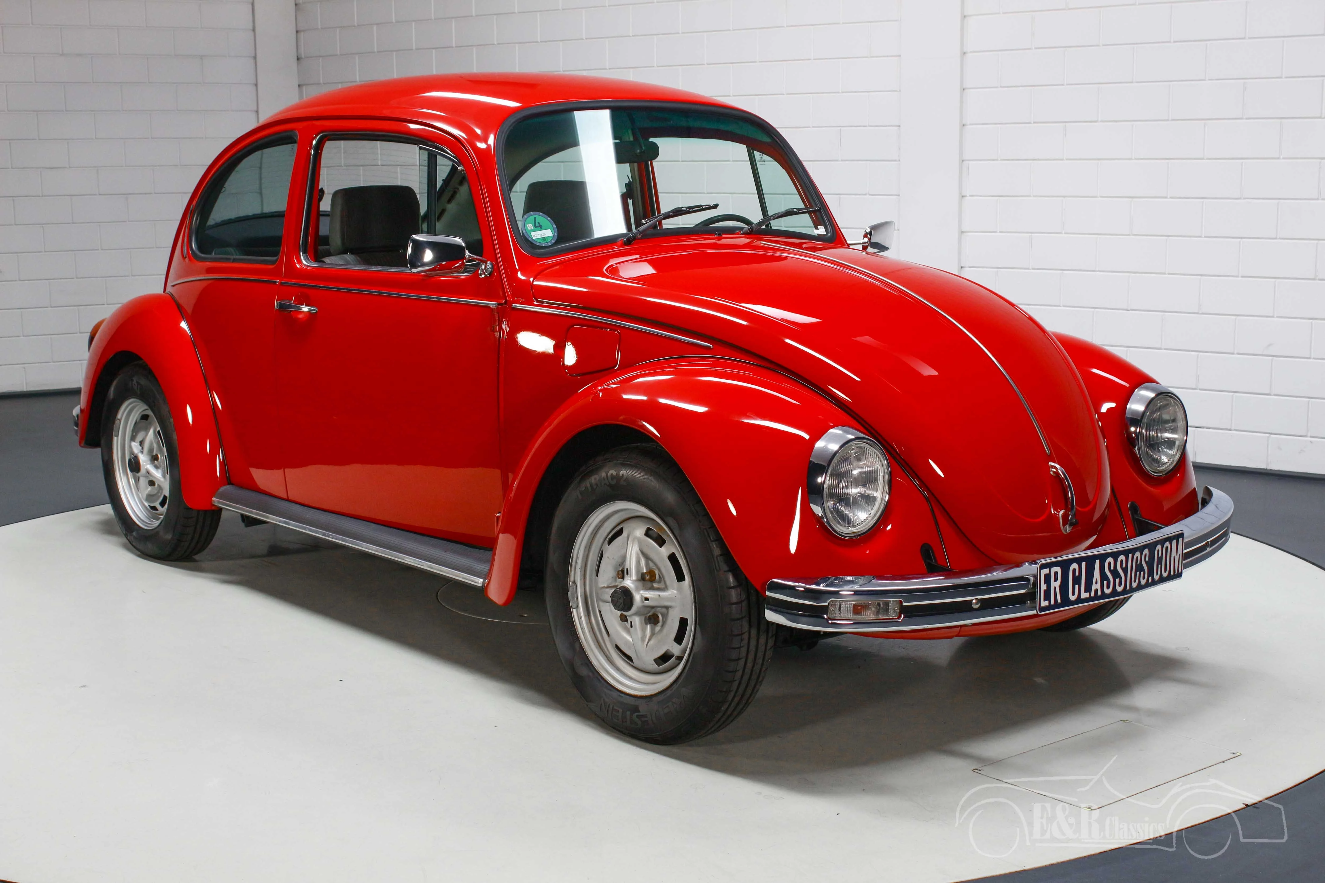

Slide 10
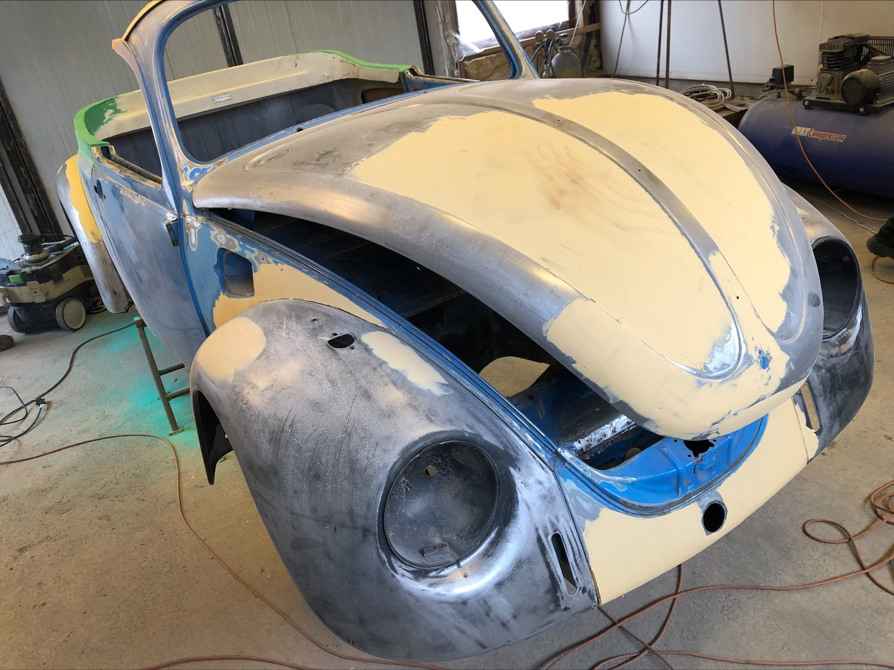

Slide 11
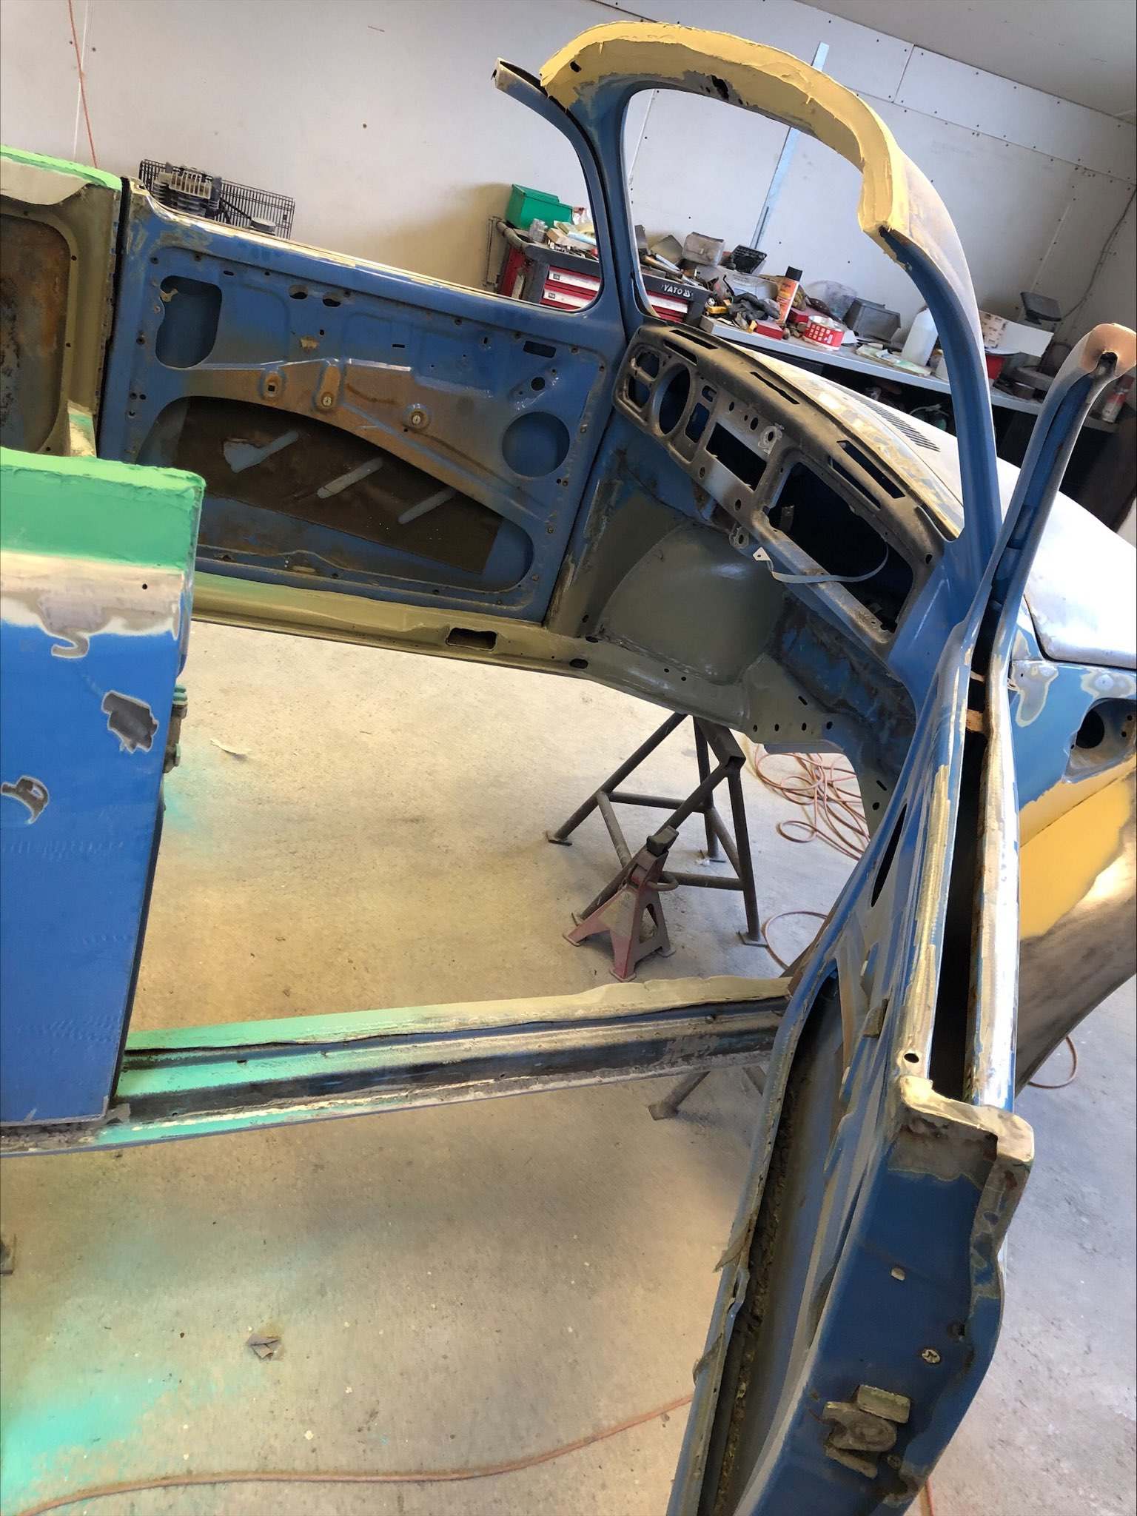

Slide 12
System requirements
The vehicle must meet the following requirements:
It must be able to pick up the rhythm of city traffic, so the speed that can be reached with it is atleast 50 km/h
In terms of range, it must cover a minimum of 50 km on a single charge for average urban use
The vehicle must be equipped with safety systems, such as a main power switch

Slide 13
E-car development-II.
Cooling-heating system development

Slide 14
System description
During the project, a cooling-heating system will be designed and manufactured, that will be able to air-condition an electric vehicle used in road traffic with minimal influence on the range.
This system consists of a central tank with heat exchanger tubes inside.
The heat transfer fluid is located in the tank and the energy storage fluid is located in the heat exchange tubes.
The heat energy from this tank is transferred to the passenger compartment heat exchanger by means of a circulating pump.
The desired heat energy will be trasfered to the passanger cab.

Slide 15
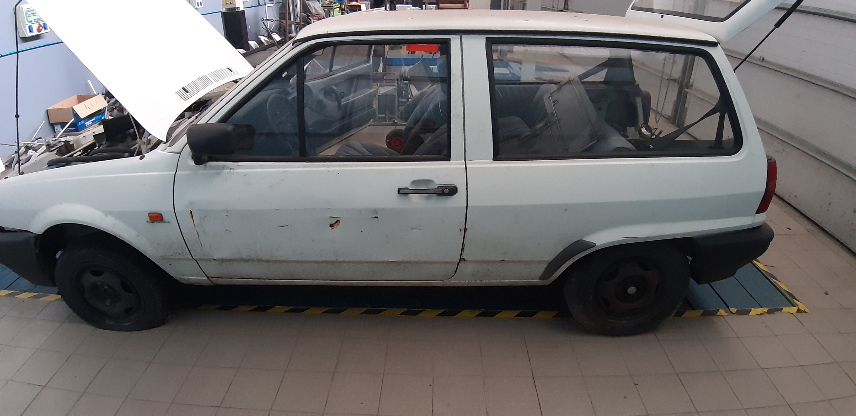
Just before painting….

Slide 16
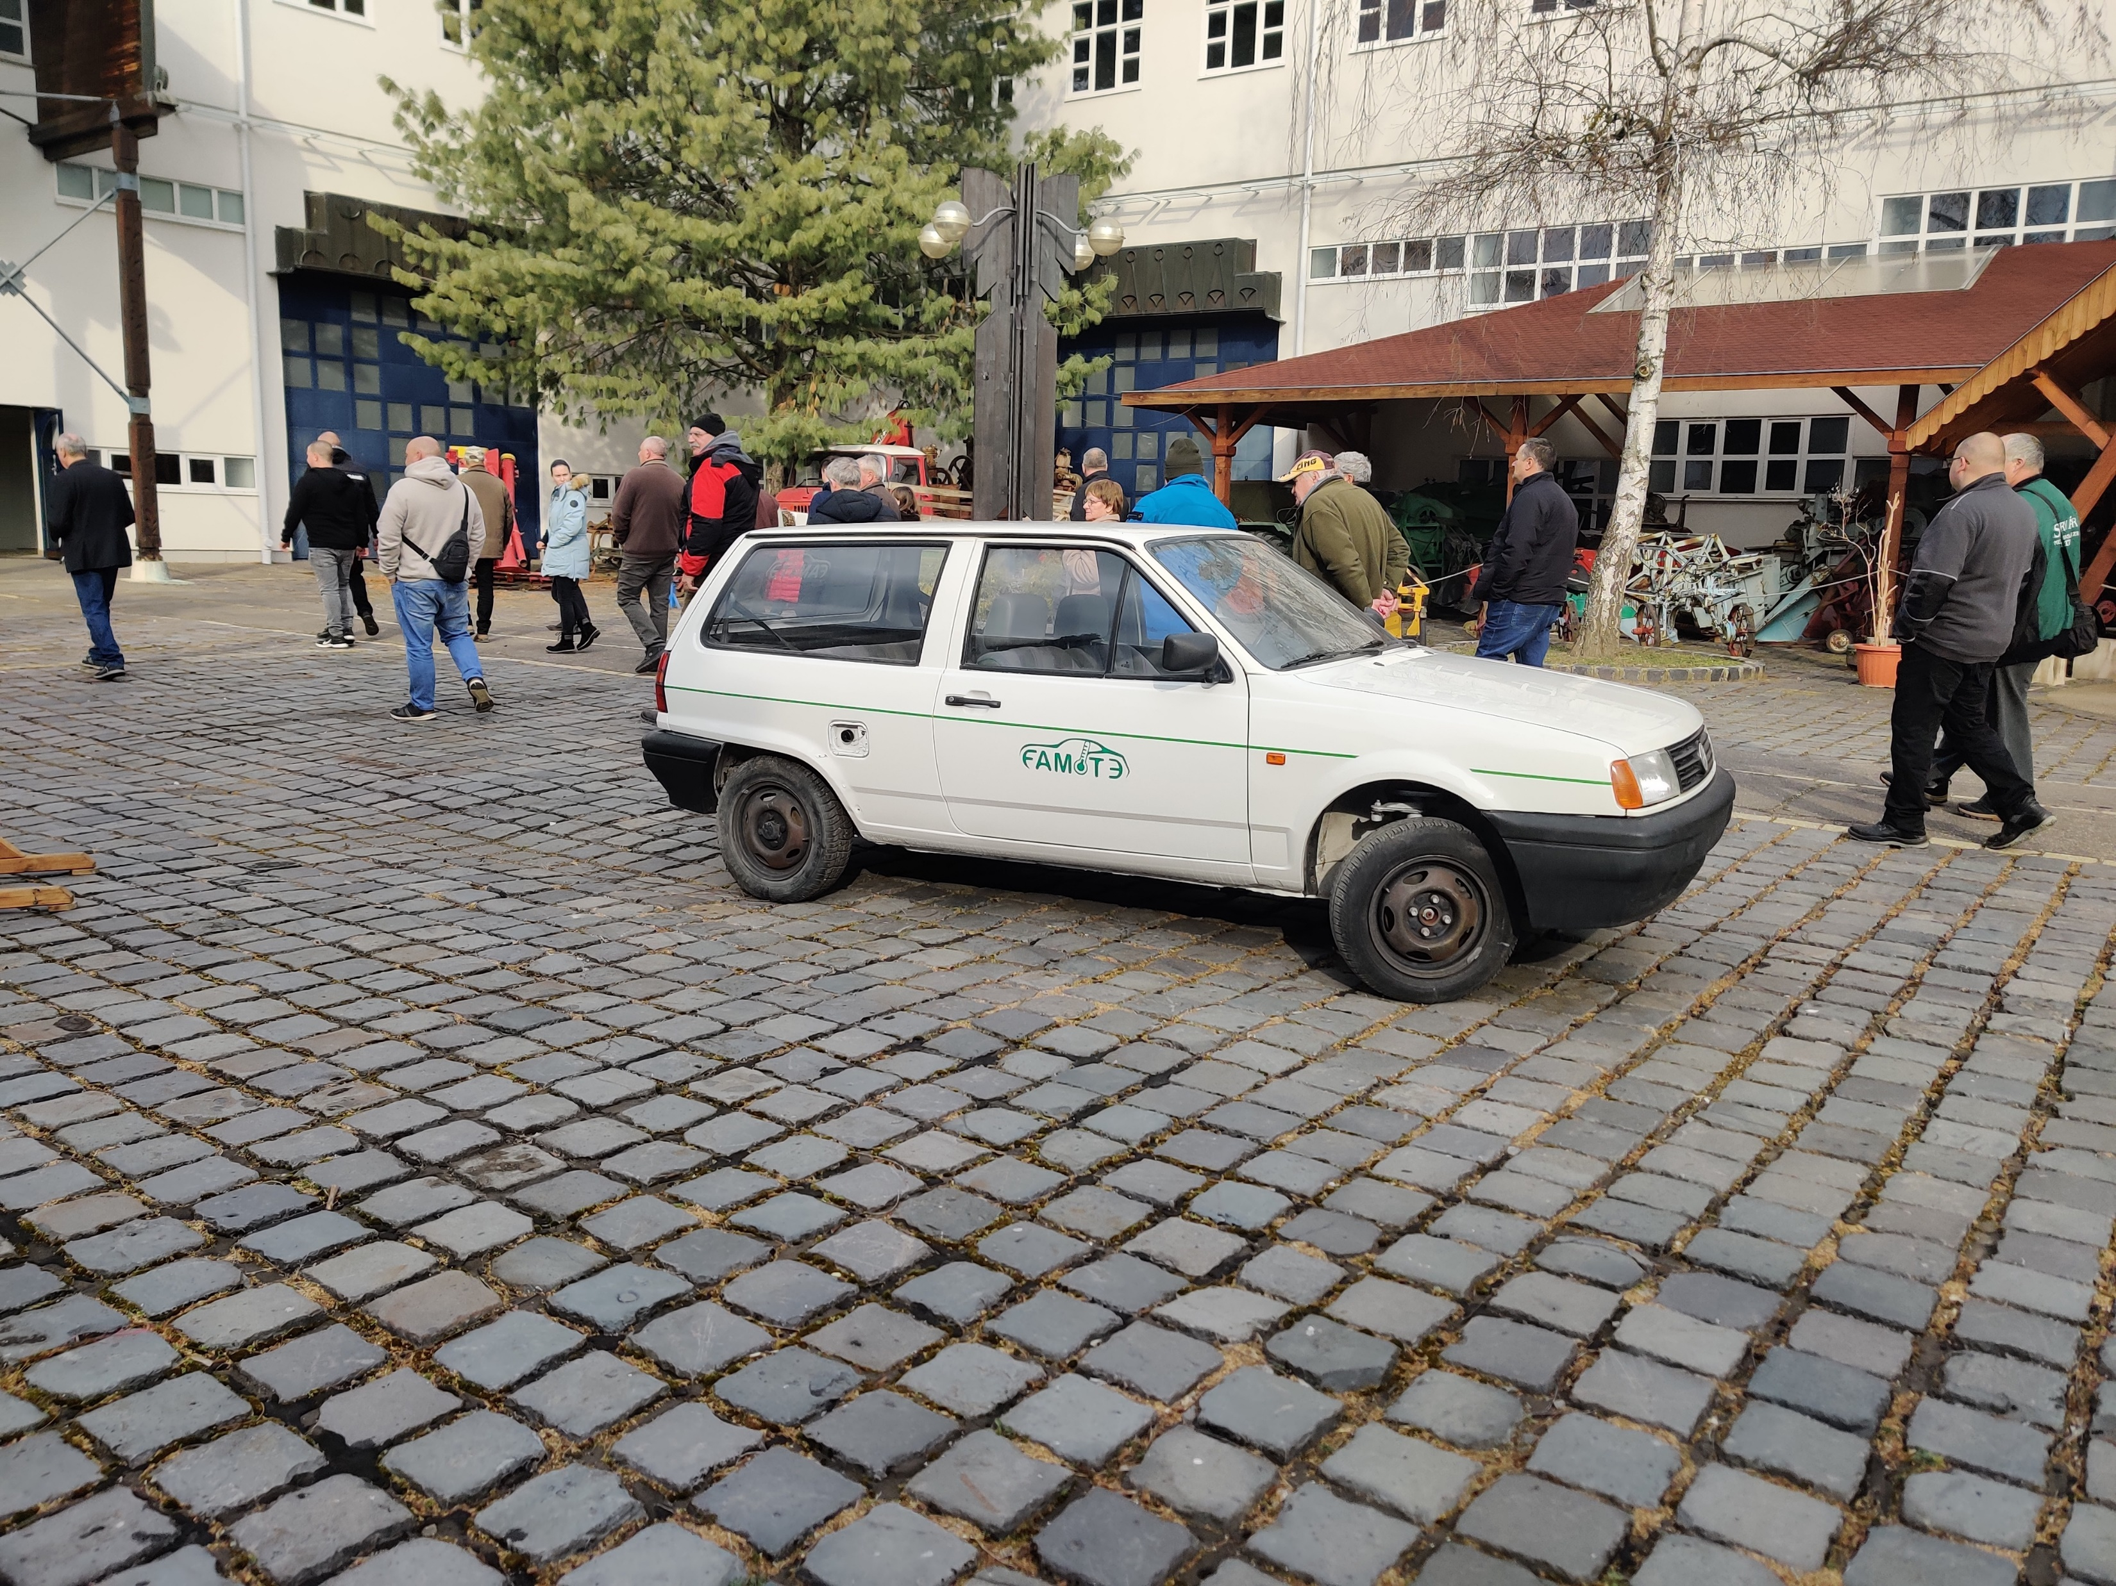
Exhibited
after painting

Slide 17
System requirements
Creating a sufficiently comfortable constant temperature in the passenger compartment (20-25 ℃)
Fluid of adequate heat capacity
Proper thermal insulation of the system
Proper heat exchange
Energy efficient air conditioning system
System integration

Slide 18
Tasks to be performed
Literature review - new driving concepts:
Megatrends determining the engineering activity. Technology changing and its effects.
New energy sources. E-mobility in the vehicle industry and the transportation.
Conceptions, solutions for new driving (hydrogen, gas, fuel-cell, electricity etc.)
Construction, operation of the main subassemblies
Economical issues
Sustainability, environment concern of the new driving alternatives

Slide 19
Tasks to be performed
Literature review – cooling and heating systems:
Investigation of current solutions for cooling and heating of the electric vehicles
Non-conductive fluids for storing large amounts of energy
On-site heating and cooling of liquids
Controlling of a system
Economical issues

Slide 20
Tasks to be performed
Reconstruction plan (VW Beetle):
Review: which components are required for electrical operation (old parts to sale, new parts to buy)
Availability of the new parts (markets, online markets)
Preliminary estimation of the budget
Environmental effects of the rebuilding
Busines plan of the reconstruction
New vehicle charging options.
Modeling the space already in the vehicle for storing batteries with a CAD program.
Design the battery storage „cage”.
Determine the performance of the electric motor to be installed based on the expectations.
Determination of required batteries (in terms of type, energy density, required quantity)
Battery fire protection solution
Research on range extension systems

Slide 21
Let’s start, hurry-up !

