Slide 1
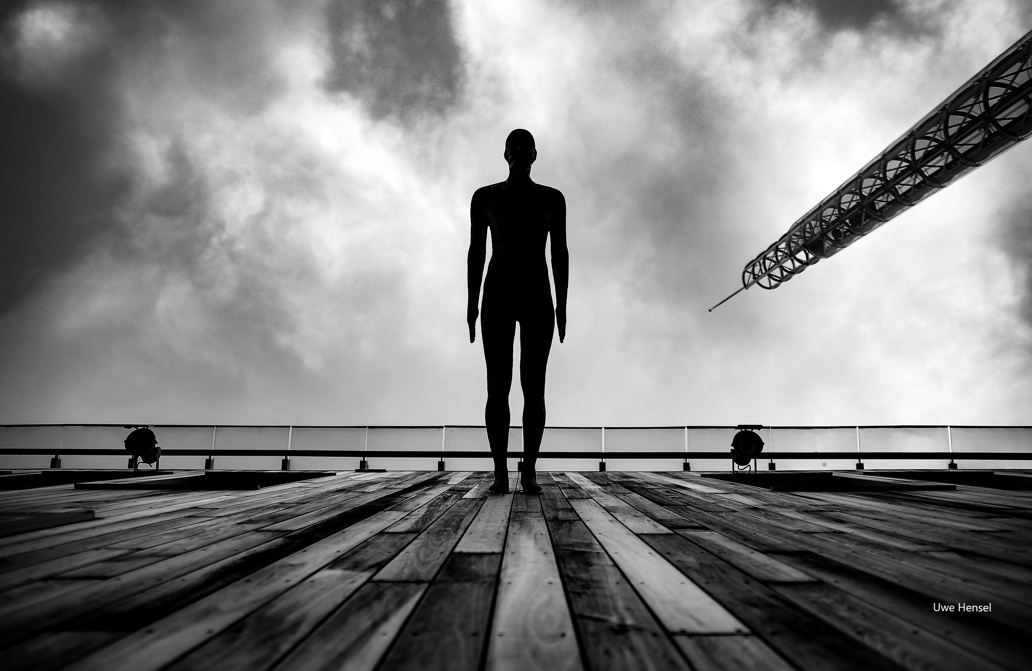
Build and strengthen communities
-
How to use public space to empower participation and collectiveness
I Living Lab 08

Slide 2
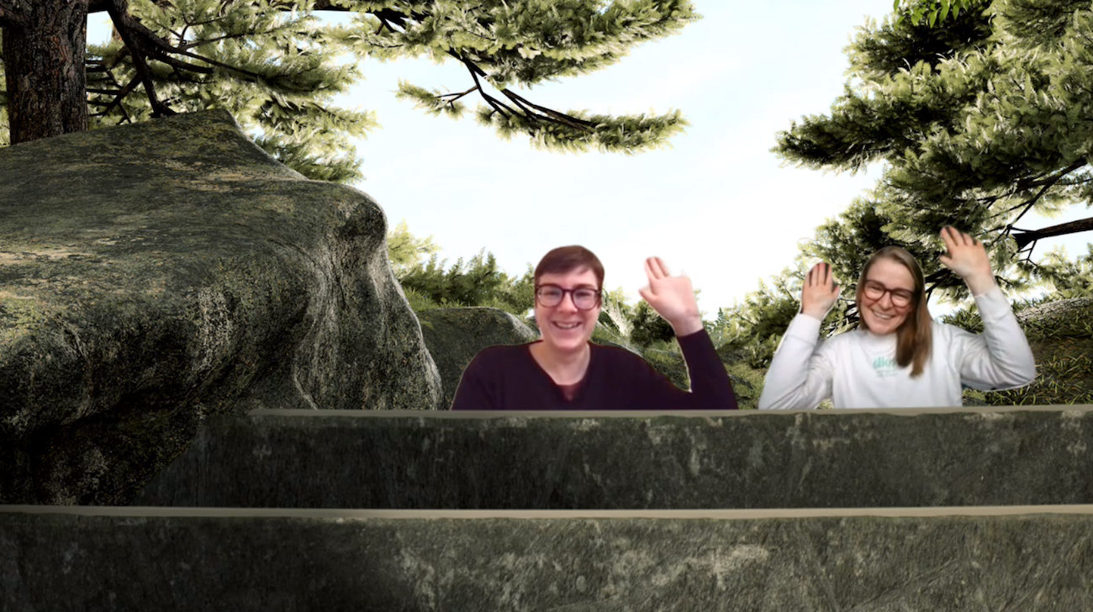
Who are we?
Marina
Lena

Slide 3
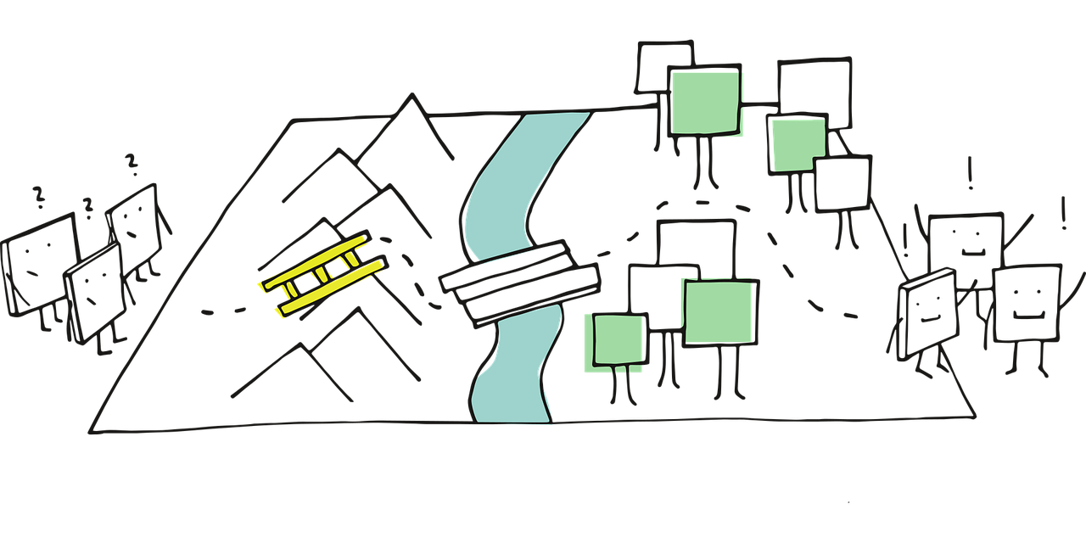
Plan for todays session – Session 1
Introducing the group
Organizational Topics
  Unicampus
  Mail
  Portfolio (Thalento test / future skills)
  Grading
  Outcome (Pitch / Poster)
Introducing the design thinking methodology
Introducing the challenge
Our next session: dates, tasks,…

Slide 4

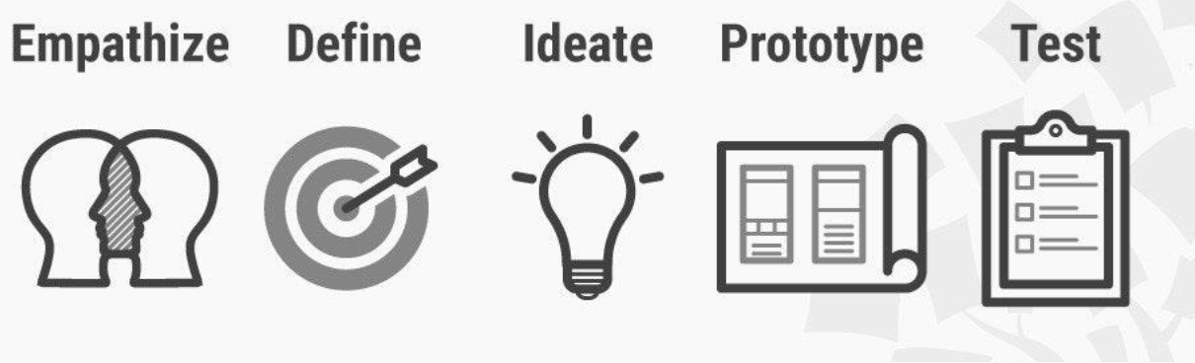
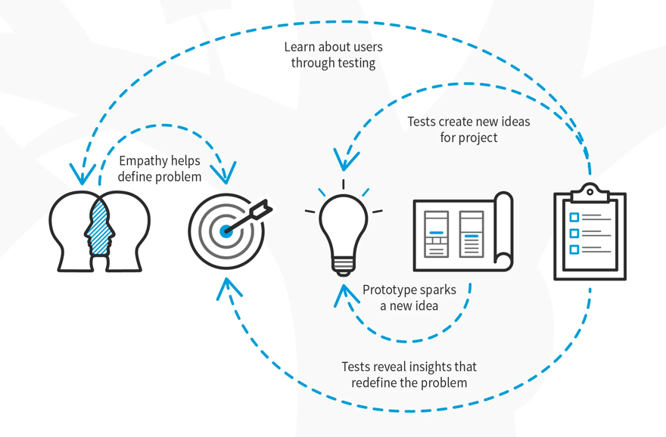
The 5 steps in Stanford’s Design Thinking Model
Empathize: Connect with and understand the users
Define: Identify (reframe?) the core problems
Ideate: Brainstorm lots of ideas
Prototype: Narrow down the ideas and build prototypes
Test: Use the results to support decision making
Process of creative problem solving
non-linear process
user- / human-centered
challenge assumptions
Check out the learners camp on unicampus!

Slide 5
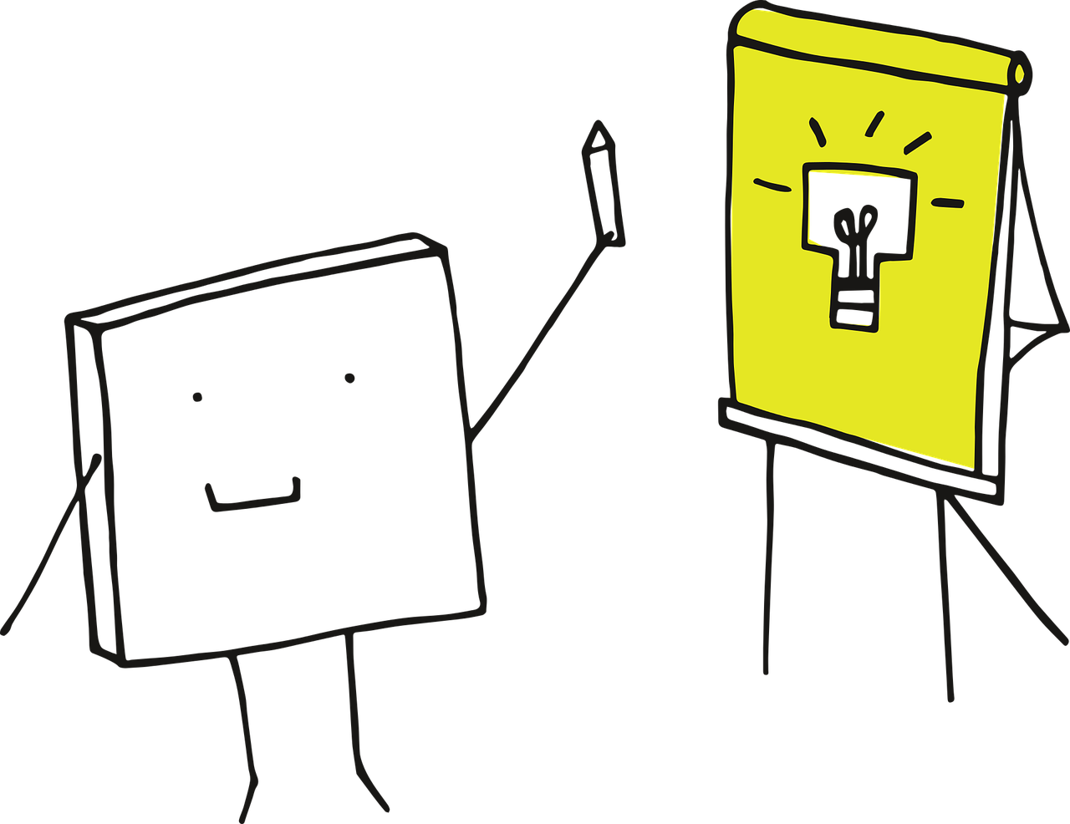
What is this challenge about?
How is public space used / could be used?
What brings people together? And why is that important?
Come up with an idea that reflect the users needs
Find ways for people to meet, connect and participate
In setting of public space
Collaborating as a team
Work self-sufficiant
Bring your own interests & skills to the group

Slide 6
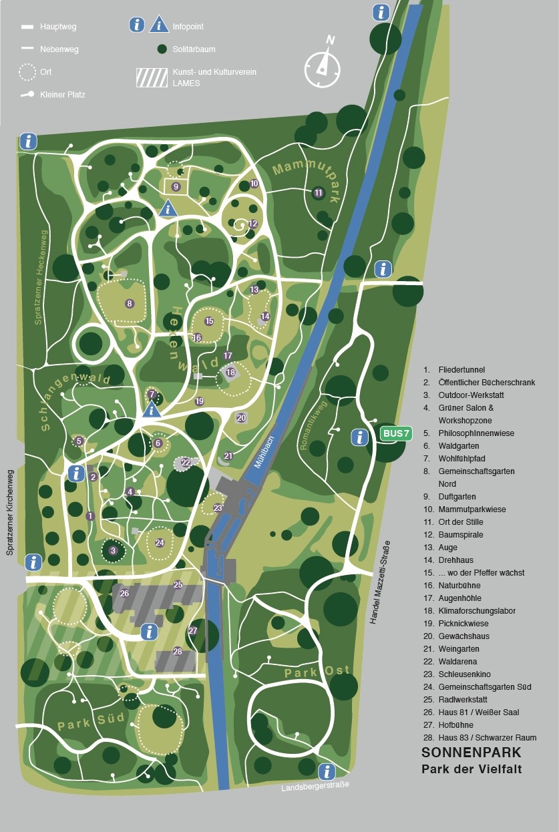
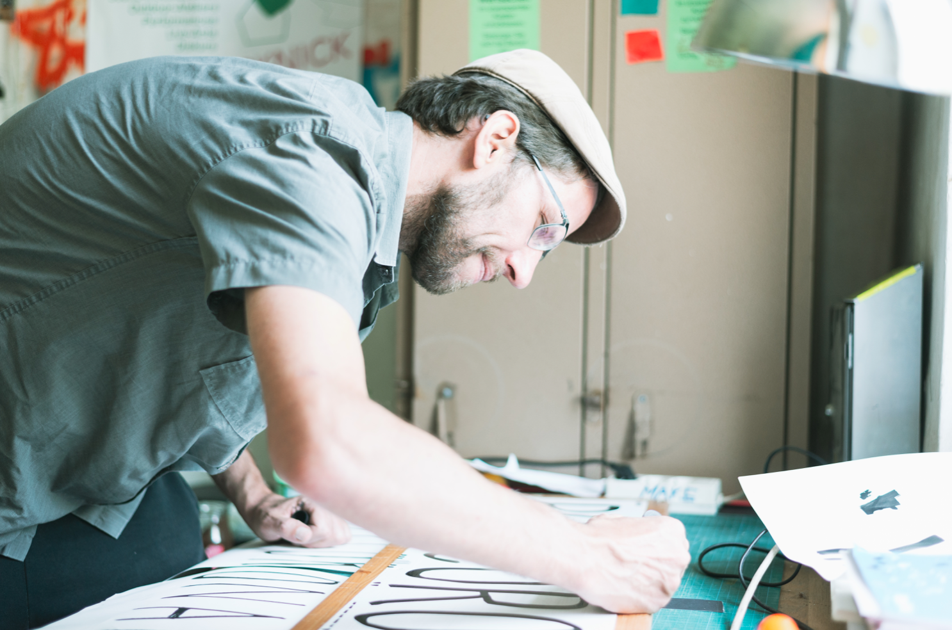

Our partner
Andi Fränzl
Lames – located in the Sonnenpark St. Pölten (Lower Austria)
https://lames.at
https://www.sonnenpark-stp.at

Slide 7
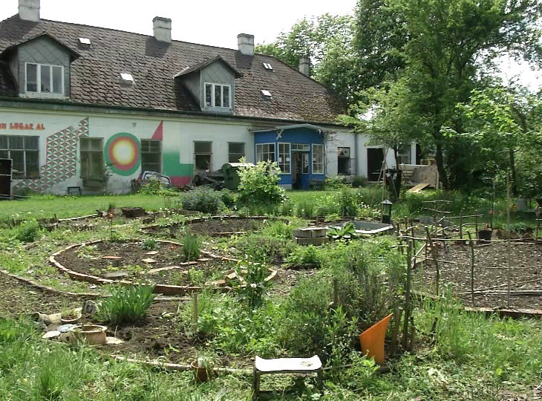
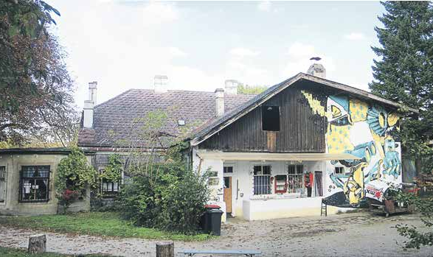
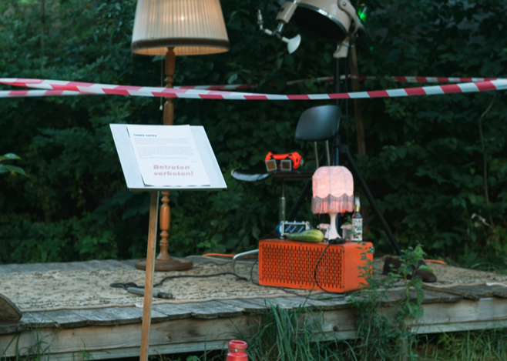
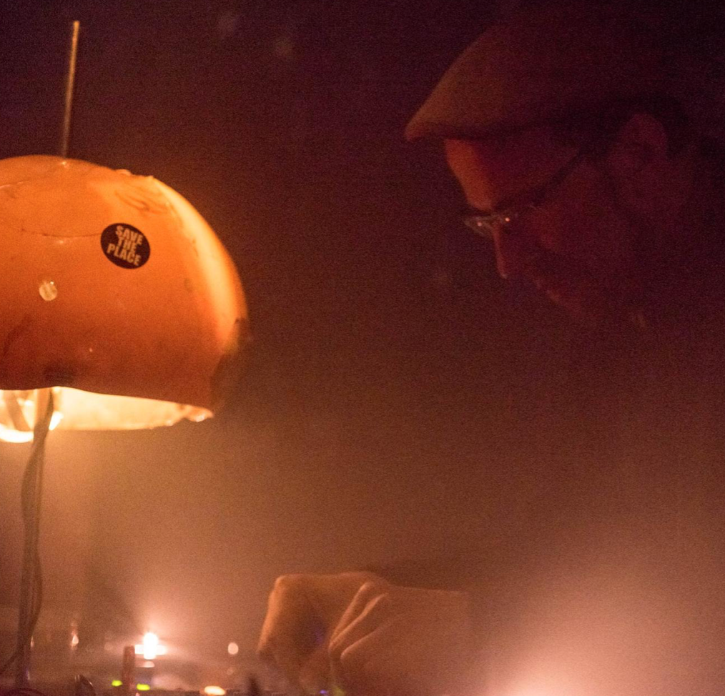
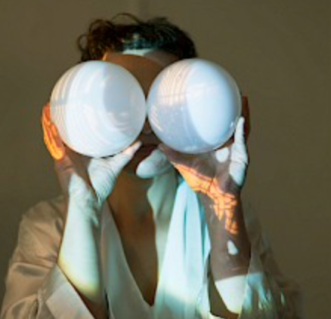
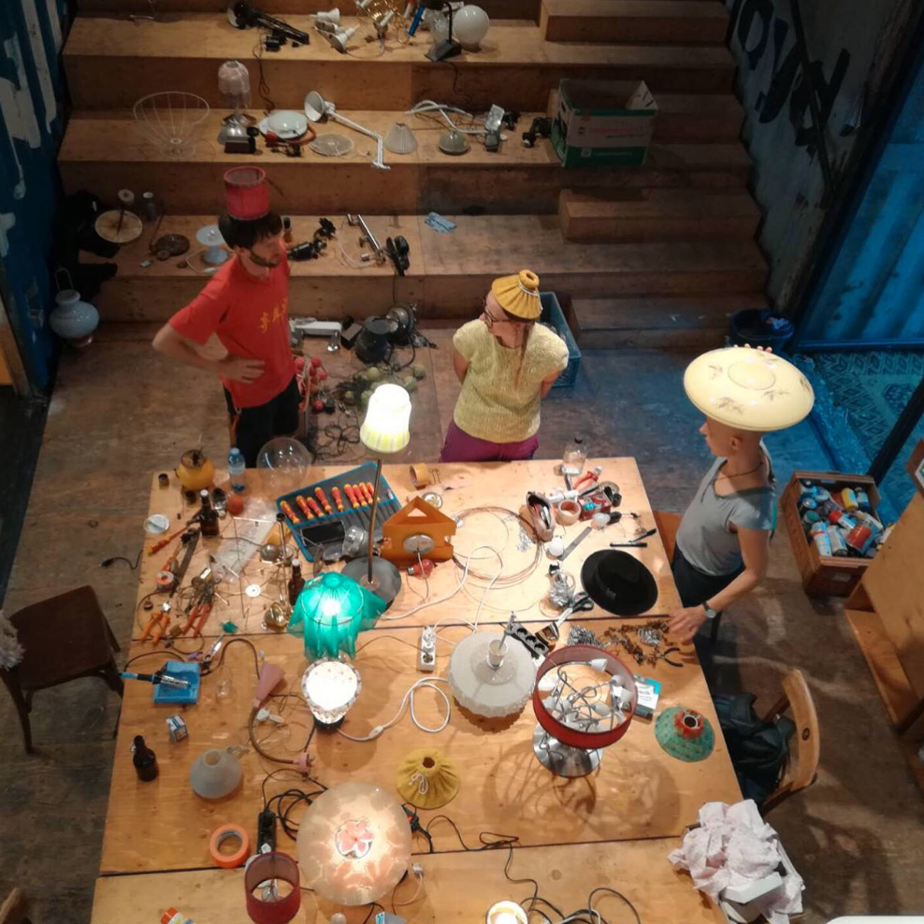

Slide 8

Meeting structure general
Tuesdays 18:00 – 19:30 CET
Sometimes until 20:00 CET – when the collaborationpartner visits ex.g.
Online via Teams
We can add sessions if needed
Check out the exact dates on unicampus!
Organize yourself as a team & collaborate -
set up your own intern meetings!

Slide 9
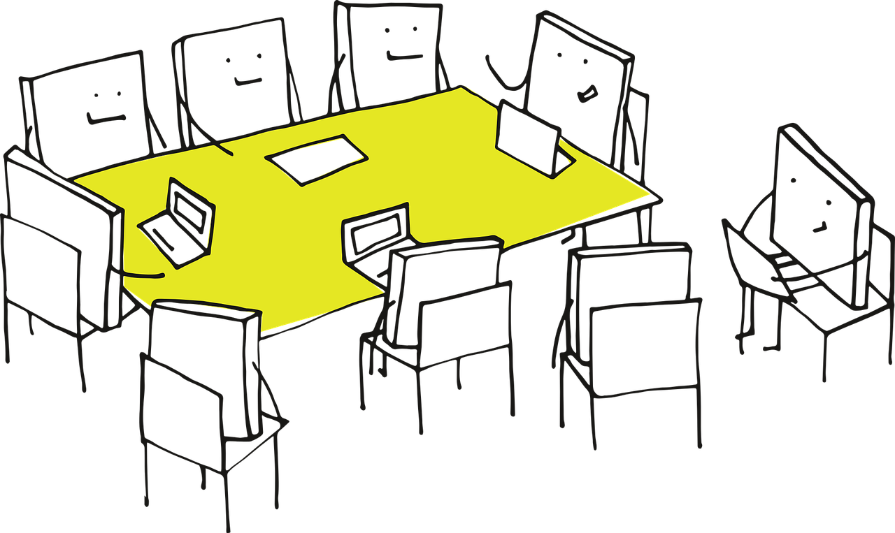
Our next meeting
Tuesday 28th of March 18:30 – 20:30 CET
→ Meeting our collarborationpartner Andi Fränzl
Insights in the project Lames / Sonnenpark
Questions for Andi are welcome! ☺

Slide 10
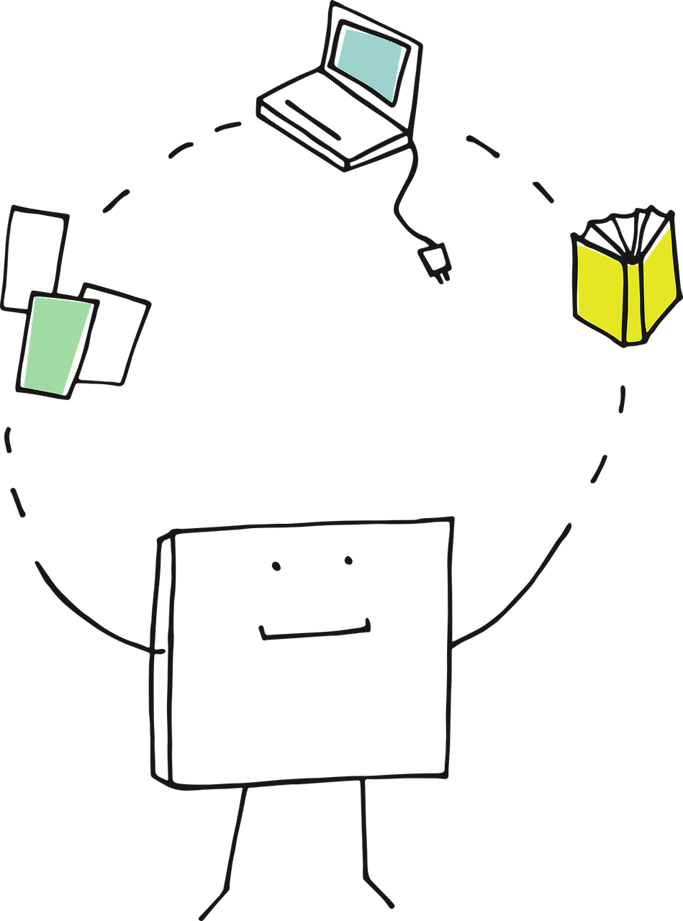
Tasks until next week
Check out unicampus / our lab-space!
I Living Lab preaprations / learners camp
Check out the dates for our sessions
Start your portfolio!
→ Reflect the onboarding week (kick-off, Session 0)
→ Reflect on Thalento test, future skills
Write about our first session
Organize yourself!
Use the chatroom
Create groupchat

Slide 11
https://pixabay.com/vectors/idea-visualization-line-art-3976295/
https://pixabay.com/vectors/pixel-cells-video-recording-3976293/
https://pixabay.com/vectors/pixel-cells-tutor-master-3974190/
https://pixabay.com/vectors/pixel-cells-seminar-conference-3974170/
https://pixabay.com/vectors/pixel-pixel-cells-path-landscape-3699343/
https://www.interaction-design.org/literature/topics/design-thinking
https://augustin.or.at/lamesaleikum-im-hort-der-lameisen/
https://www.p3tv.at/webtv/10874-sanfte-sonnenpark-sanierung
https://www.sonnenpark-stp.at/downloads/
https://www.sonnenpark-stp.at/der-park/geholzbestande/sonnenpark_map_2015_1304-q/
https://lames.at/galleries/

