Slide 1
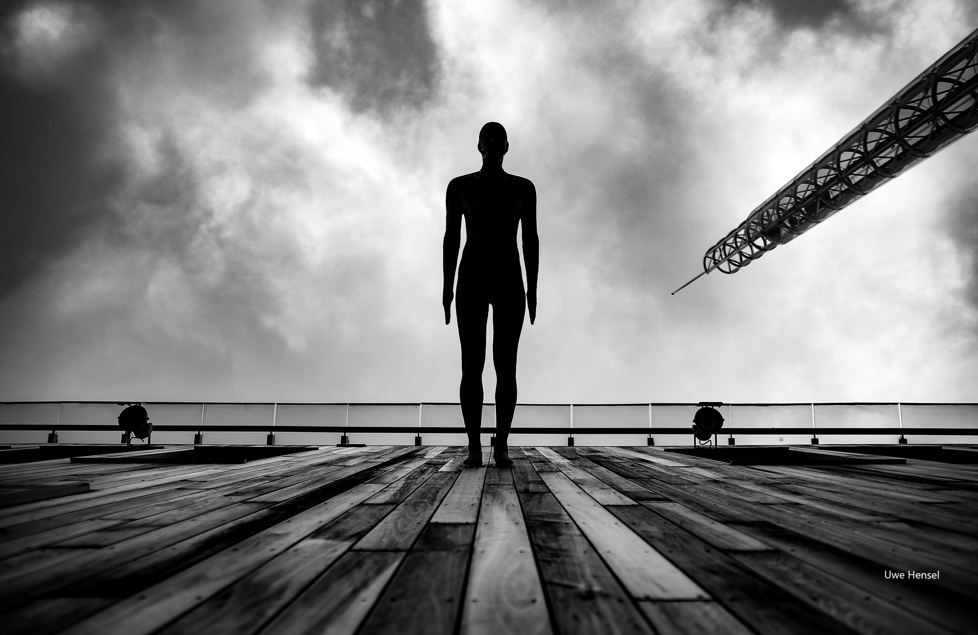
Build and strengthen communities
-
How to use public space to empower participation and collectiveness
I Living Lab 08

Slide 2
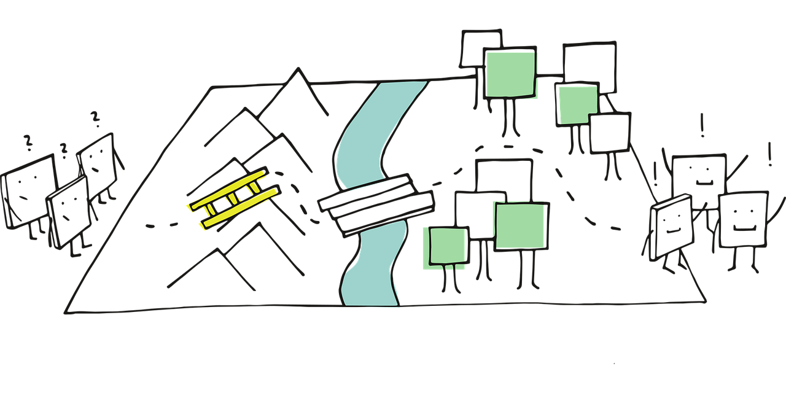
Plan for todays session – Session 2
Introducing Andi!
Our next session: dates, tasks,…

Slide 3
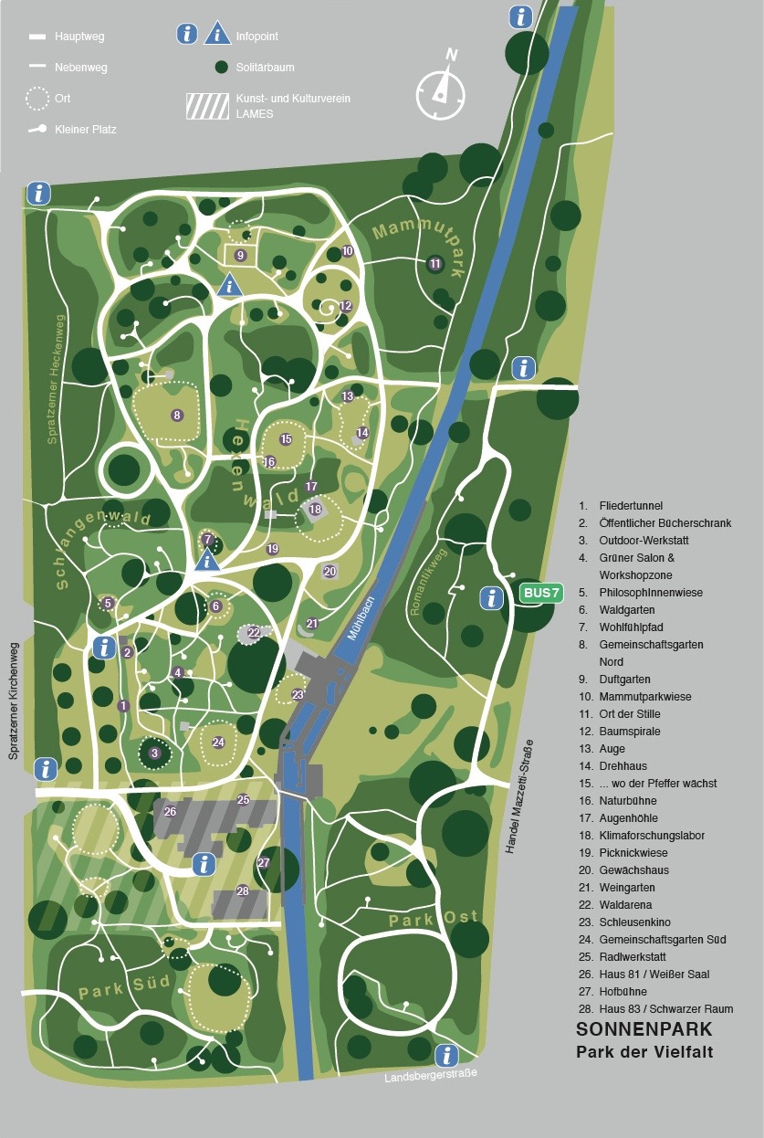
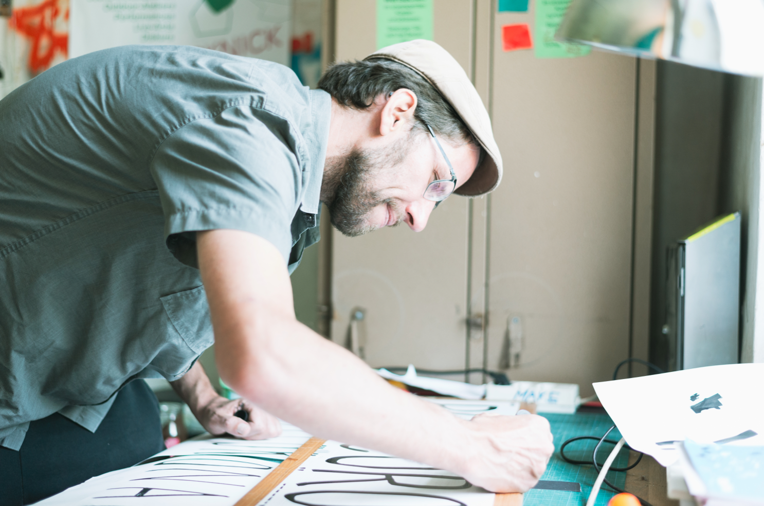

Our partner
Andi Fränzl
Lames – located in the Sonnenpark St. Pölten (Lower Austria)
https://lames.at
https://www.sonnenpark-stp.at

Slide 4
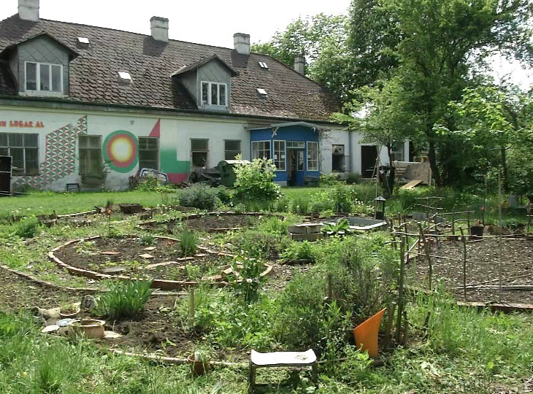
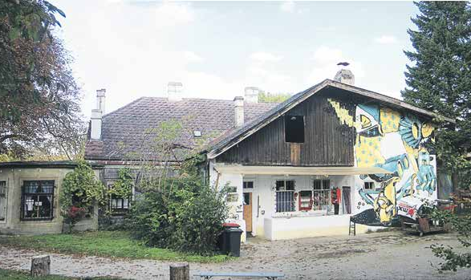
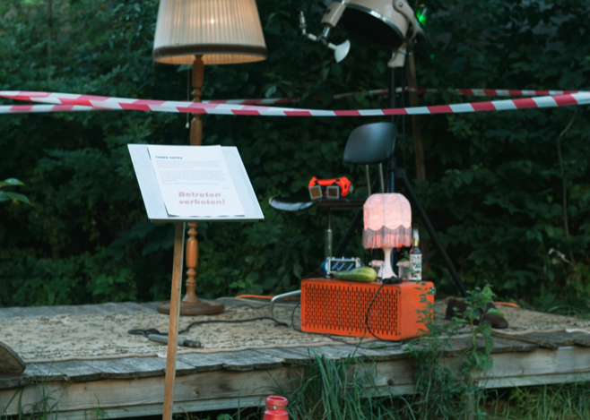
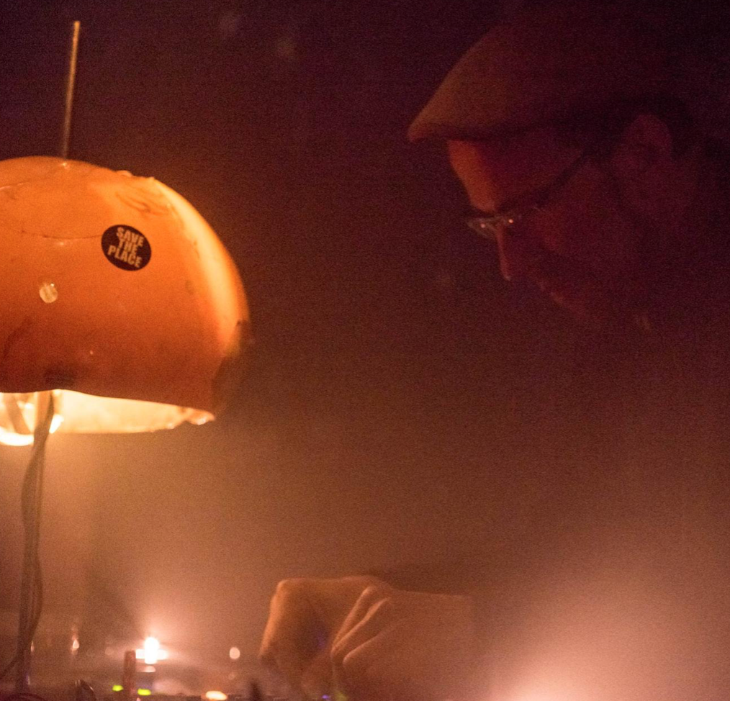
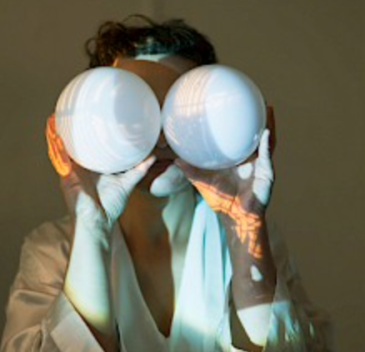
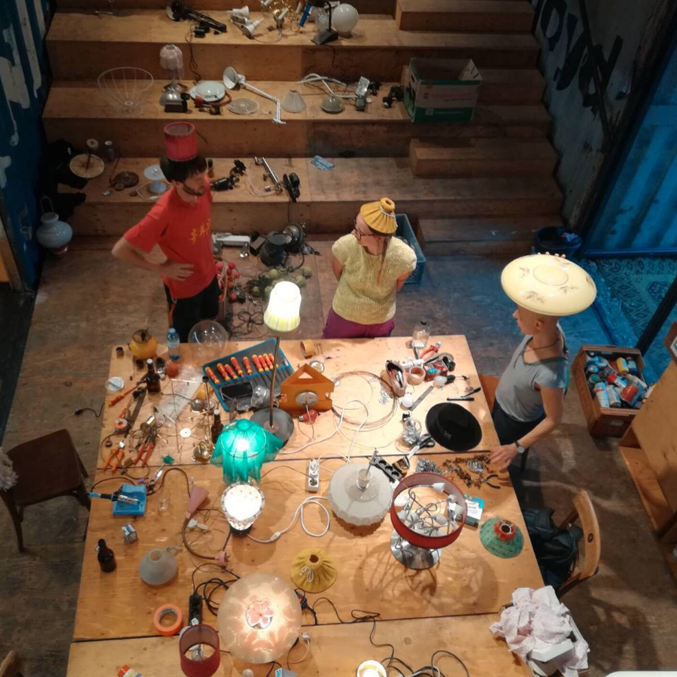

Slide 5
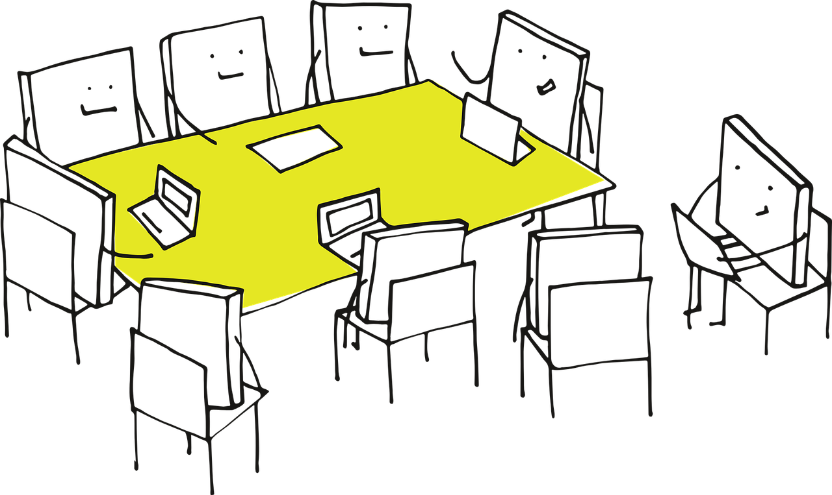
Our next meeting
Tuesday 18th of April 18:30 – 20:30 CET

Slide 6
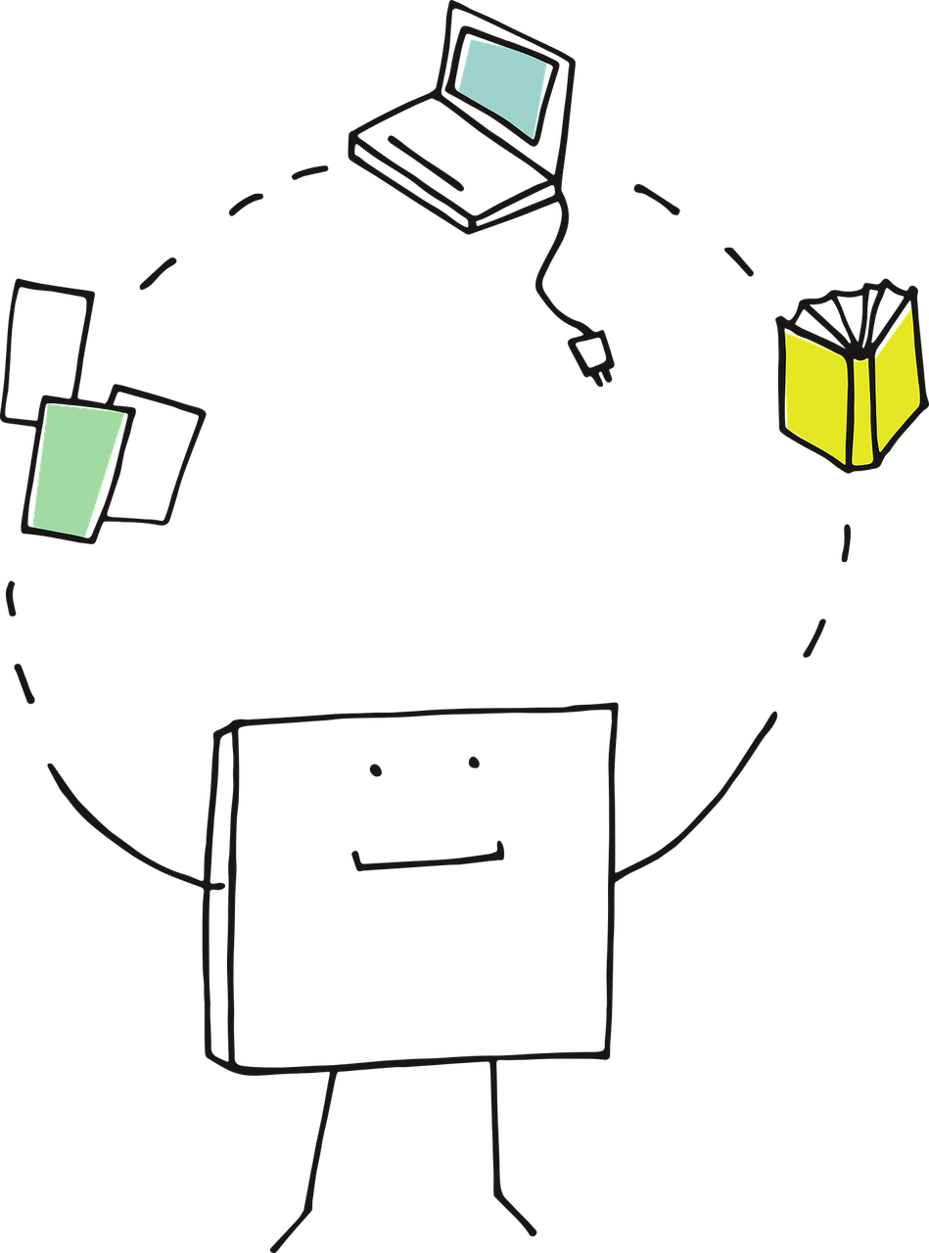

START to work on your portfolio!
→ mandatory to get credits
Thalento Test, future skills
Sessions
Document your observations
Document your research
Next deadline: 11/4
Tasks until Session 3
Discover your surrounding!
Find a public space in your surrounding
Observe!
Research
Find 2 sources (article, study,…)
Short summary (most important aspects)
Reflect & let us know your thoughts!
More detailed description on unicampus!

Slide 7
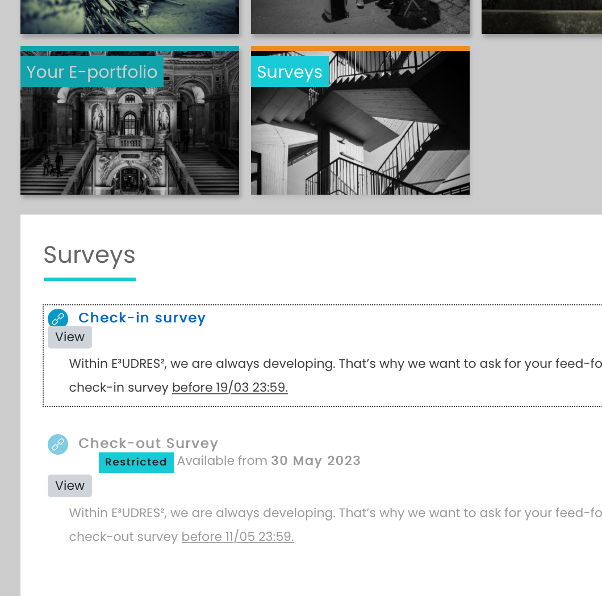

Additional task
Fill in the survey on unicampus!

Slide 8


Slide 9
https://pixabay.com/vectors/idea-visualization-line-art-3976295/
https://pixabay.com/vectors/pixel-cells-video-recording-3976293/
https://pixabay.com/vectors/pixel-cells-tutor-master-3974190/
https://pixabay.com/vectors/pixel-cells-seminar-conference-3974170/
https://pixabay.com/vectors/pixel-pixel-cells-path-landscape-3699343/
https://pixabay.com/photos/welsh-corgi-dog-pet-animal-beach-1581119/
https://www.interaction-design.org/literature/topics/design-thinking
https://augustin.or.at/lamesaleikum-im-hort-der-lameisen/
https://www.p3tv.at/webtv/10874-sanfte-sonnenpark-sanierung
https://www.sonnenpark-stp.at/downloads/
https://www.sonnenpark-stp.at/der-park/geholzbestande/sonnenpark_map_2015_1304-q/
https://lames.at/galleries/

