Slide 1

Build and strengthen communities
-
How to use public space to empower participation and collectiveness
I Living Lab 08

Slide 2
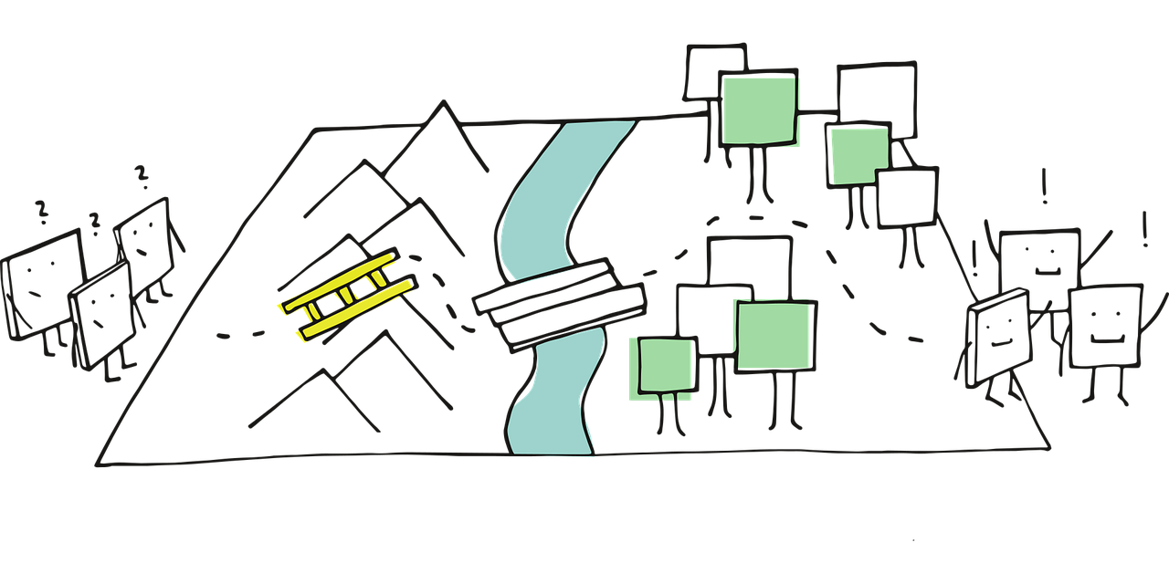
Plan for todays session – Session 3
Pitch
Portfolio: group exchange
Design thinking: Empathize stage
Tasks
Our next session

Slide 3
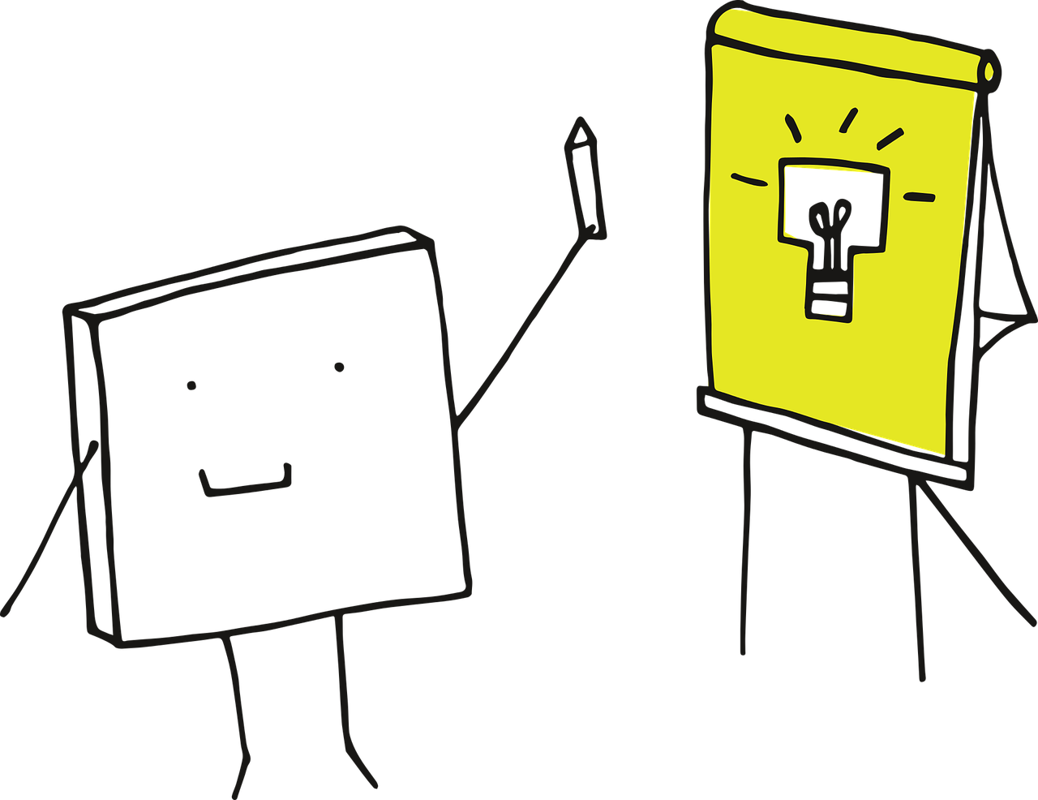
Tell us abour your research!
Reflexion of what you experienced during the observation task
What emotions did you experience (surprises, frustrations, motivations, decision making factors), and why?
What are peoples’ moving patterns in space?

Slide 4

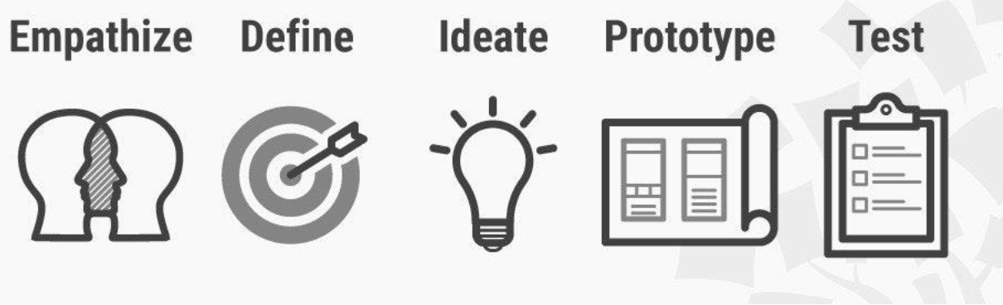
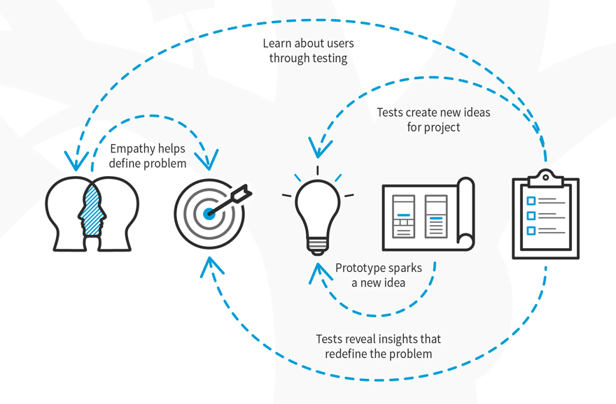
The 5 steps in Stanford’s Design Thinking Model
Empathize: Connect with and understand the users
Define: Identify (reframe?) the core problems
Ideate: Brainstorm lots of ideas
Prototype: Narrow down the ideas and build prototypes
Test: Use the results to support decision making
Process of creative problem solving
non-linear process
user- / human-centered
challenge assumptions
Check out the learners camp on unicampus!

Slide 5
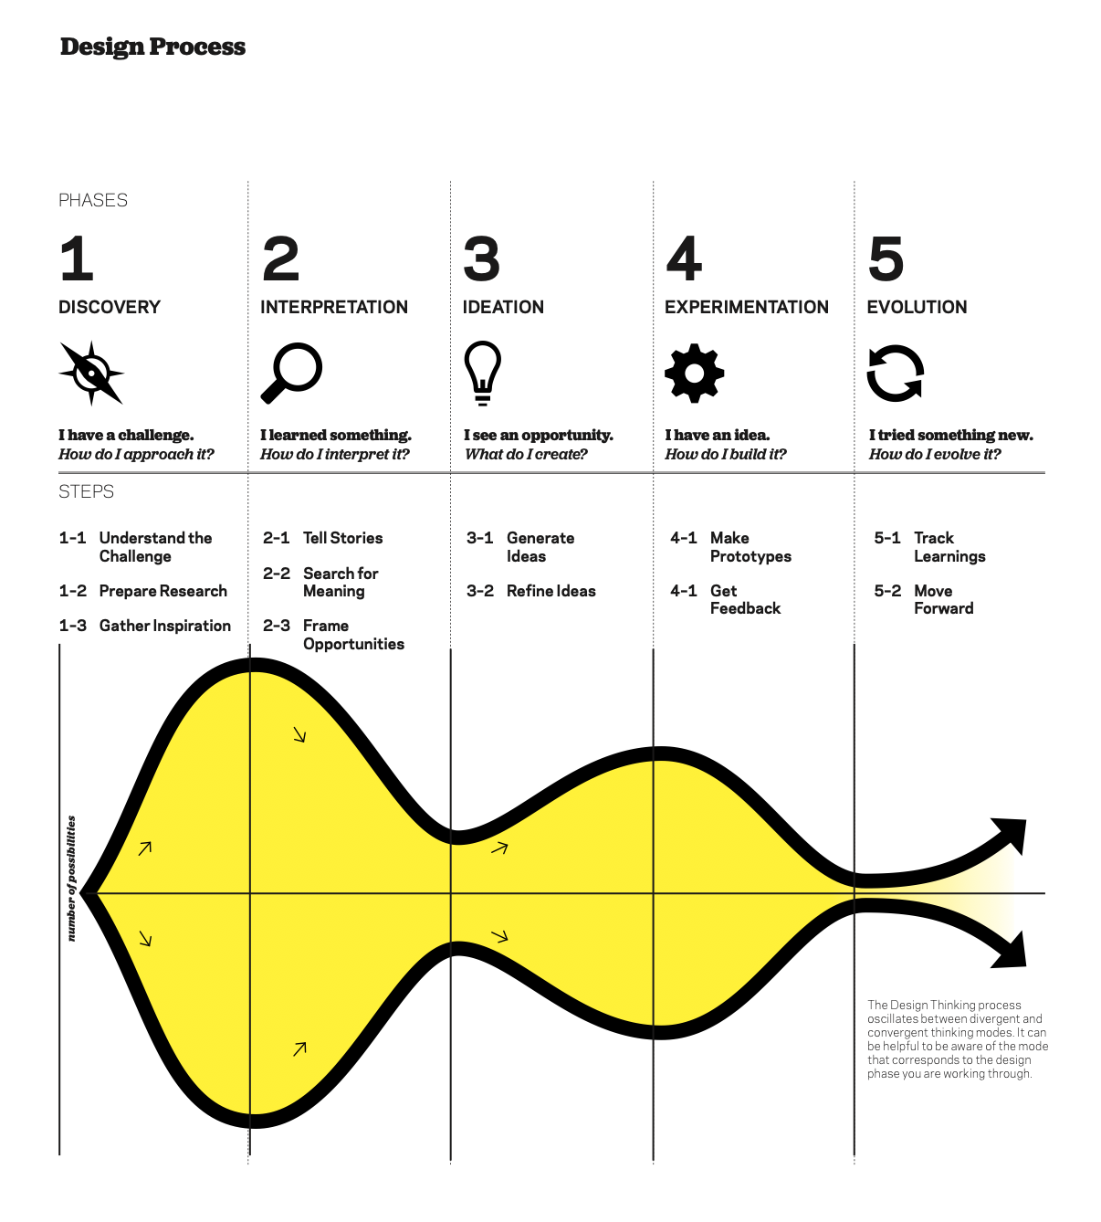
IDEO(2012): Design Thinking for Educators Toolkit
2012 IDEo LLC. All rights reserved. http:// designthinkingforeducators.com/

Slide 6

Empathize stage
Who are the potential users?
Who could be involved in the topic?
→ Ecosystem Mapping
https://jamboard.google.com/d/1jK3tpatfaHzMdHf9giSsqAvxpc0m0bOnA4S54OKPsdo/viewer?pli=1&f=0
https://www.designkit.org/methods/define-your-audience.html
How can we encourage people to talk with us and tell us their needs?
  interviews, survey
  avoid yes/no questions
  Cover variety of gender, age, experience, ethnicity,…

Slide 7
A quick question guide
Identify topics
Brainstorm themes you want to learn about in your conversations with research participants
What do you need to learn about your challenge?
What are you hoping to understand about people’s motivations and frustrations?
What do you want to learn about their activities?
Is the role they play in their network of importance?
Develop questions
Formulate questions that explore these topics. Frame them as open-ended questions, such as:
“Tell me about an experience...”
“What are the best/worst parts about...?”
“Can you help me understand more about...?”
Organize your questions
Start specific: begin with questions your participants are comfortable answering.
Go broad: ask more profound questions about hopes, fears and ambitions.
Probe deep: explore your challenge or any interesting theme you picked up on during the conversation in more depth. Consider prompting thoughts with “what if” scenarios.

Slide 8
Next step: Empathy map / user stories
Keep in mind that we are looking for qualitative data
Create / fill in the empathy map
How to: https://spin.atomicobject.com/2022/06/02/design-thinking-empathy-map/

Slide 9
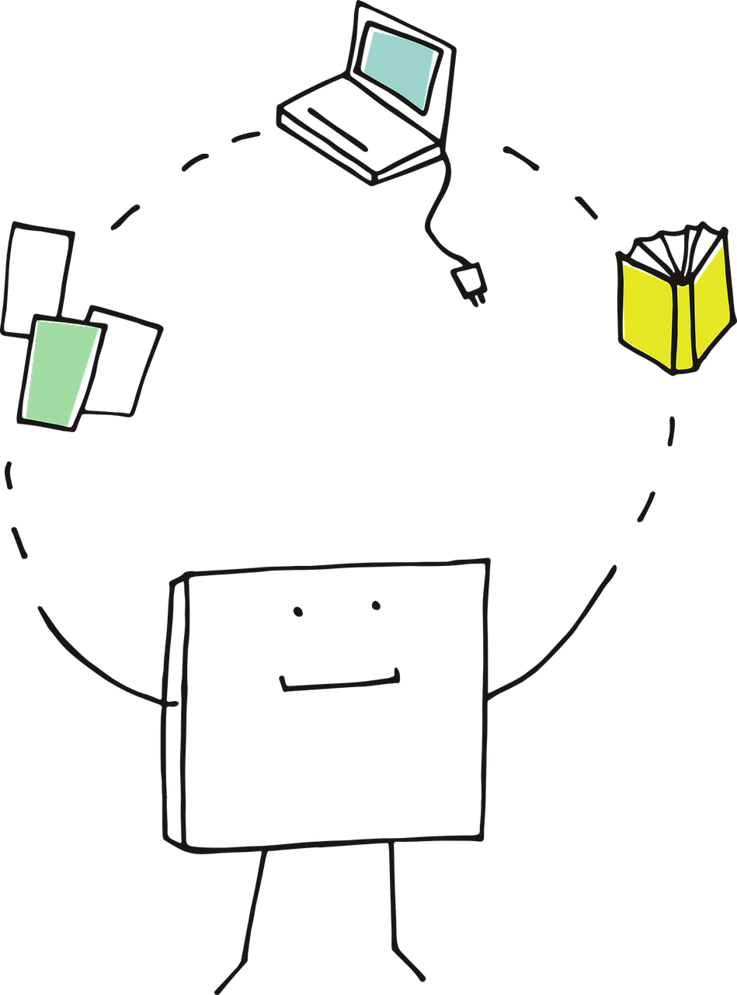
Tasks until next week
Build a question guide /create a questionnaire
Develope a questionnaire / guide together as a team
Meet up, collect questions, structure them
Decide the format / how to reach people
Apply
→ send out survey / start your interviews
Individual task
Analyze
Take a look at the results and create empathy maps!
https://spin.atomicobject.com/2022/06/02/design-thinking-empathy-map/

Slide 10
Portfolio
Let us know about (the process of developing) the survey!
→ what was your strategy?
→ what are the pros / cons about the survey you developed?
→ after the results of survey: improvements for next time (answers missing etc…)?
Capture your learnings / document your thoughts!
→ take a look at the outcome of the survey / interview
→ think about most important, surprising,…. aspects (for you)
and document these in the portfolio (ca be notes)
Aspects you could reflect on:
Personal details: who did you meet / send the survey to? (profession, age, location etc)
Interesting stories: what was the most memorable and surprising story?
Motivations: what did the participant care about the most? What motivates him/her?
Barriers: what frustrated him/her?
Interactions: what was interesting about the way he/she interacted with his/her environment?
Remaining Questions: what questions were not answered ?

Slide 11
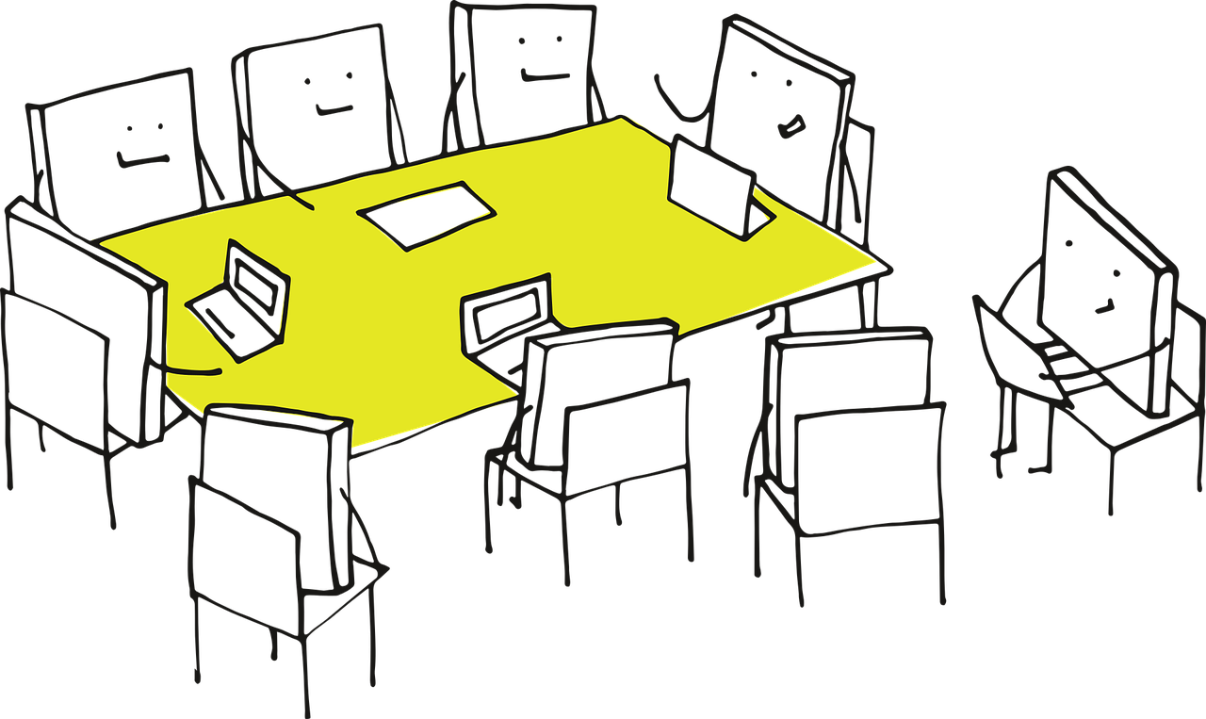
Our next meeting
Tuesday 18th of April 18:30 – 20:30 CET
Tell us about your desk research / observations
Show us you user stories / empathy maps!
We will enter the define stage and start the brainstorming ☺

Slide 12

Additional info / notes from the session:
- in case of conducting a survey including 2 target groups: link perspectives / assumtions! Ex.g. asking one group what they think, the other group needs and vice versa. (asking the joungsters what they think elderly need from them / the younger generation / how they can support)
Conduct 3-4 interviews (if you do interviews)
You can choose: if you work with 2 target groups you can either design one or two surveys / questionnaires

Slide 13
https://pixabay.com/vectors/idea-visualization-line-art-3976295/
https://pixabay.com/vectors/pixel-cells-video-recording-3976293/
https://pixabay.com/vectors/pixel-cells-tutor-master-3974190/
https://pixabay.com/vectors/pixel-cells-seminar-conference-3974170/
https://pixabay.com/vectors/pixel-pixel-cells-path-landscape-3699343/
https://pixabay.com/vectors/pixel-cells-pixel-to-learn-3674122/
https://www.interaction-design.org/literature/topics/design-thinking
IDEO(2012): Design Thinking for Educators Toolkit
2012 IDEo LLC. All rights reserved. http:// designthinkingforeducators.com/

