Slide 1

Build and strengthen communities
-
How to use public space to empower participation and collectiveness
I Living Lab 08

Slide 2

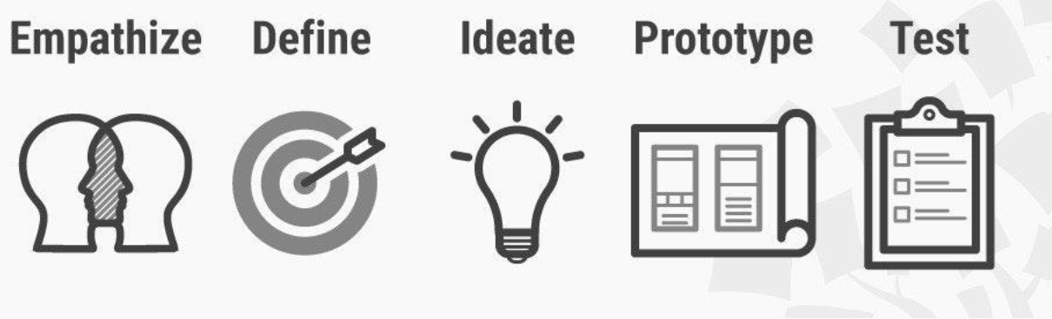
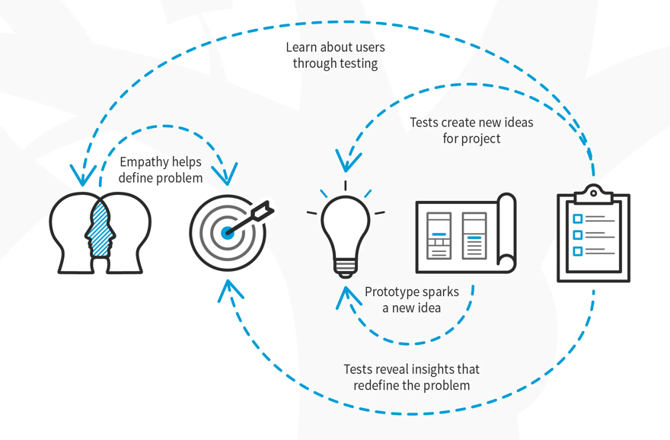
The 5 steps in Stanford’s Design Thinking Model
Empathize: Connect with and understand the users
Define: Identify (reframe?) the core problems
Ideate: Brainstorm lots of ideas
Prototype: Narrow down the ideas and build prototypes
Test: Use the results to support decision making
Process of creative problem solving
non-linear process
user- / human-centered
challenge assumptions
Check out the learners camp on unicampus!

Slide 3
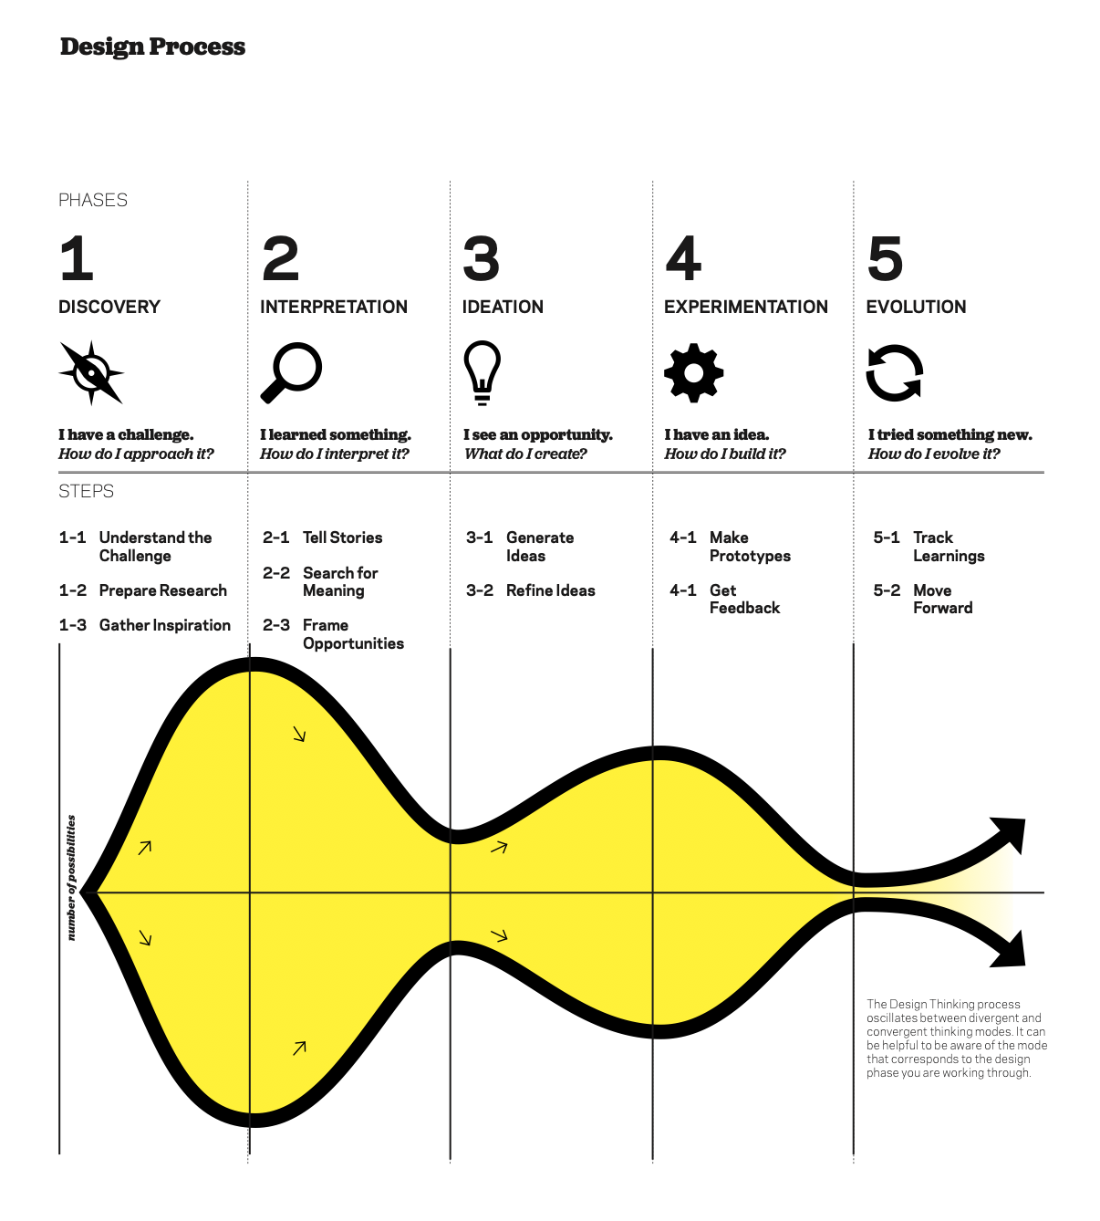
IDEO(2012): Design Thinking for Educators Toolkit
2012 IDEo LLC. All rights reserved. http:// designthinkingforeducators.com/

Slide 4
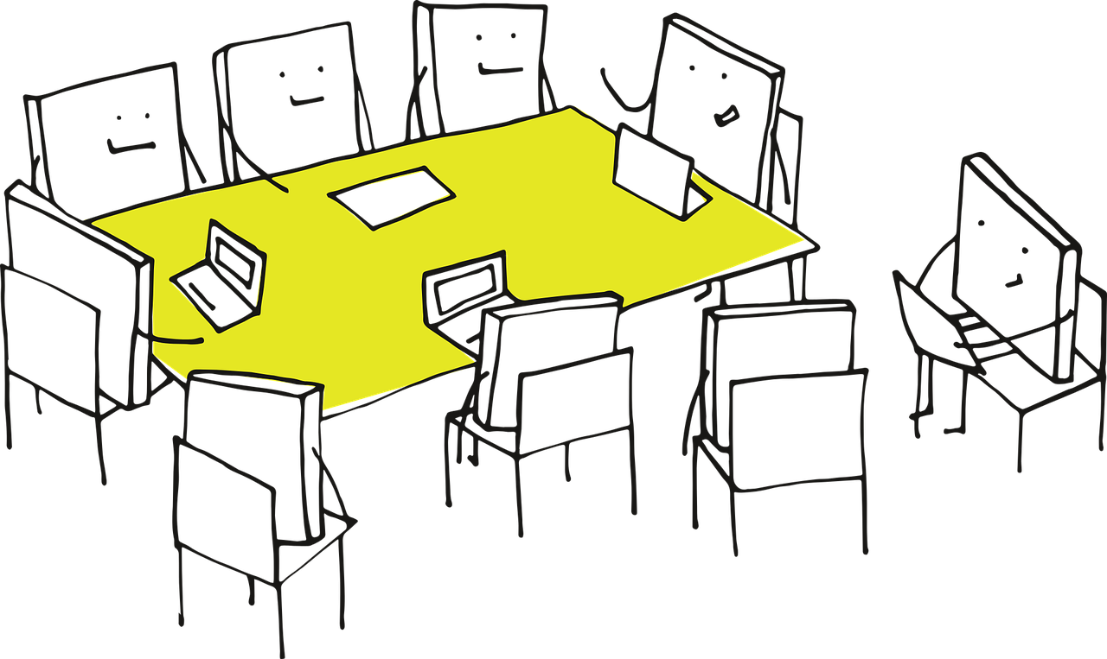
Our next meeting
Tuesday 9th of May 18:30 – 20:30 CET
And afterwards?
Session 5 (9/5): tutorial session
Session 6 (16/5): show us your video pitch and poster
Deadline for submission: 17/5
Session 7 (23/5): Meeting with Andi
Showdown: 30/5
Final portfolio: 22/5

Slide 5

Outcome Session 4:
More teamwork is needed (set dates / internal sessions)
Work together on the survey
Discuss results from the survey: what can we use / what can we drop?
Tell stories & show empathy for the user
→ How has the need been validated / proofed?
Problem, need and user defined clearly:
    What is the problem, why is it a problem, for whom is it a problem, where does it happen?
Reach out to EEs when something is unclear
Update the portfolio:
  - Desk research
  - Observation
  - Survey / empathy map / user stories
  - Solution ideas

Slide 6
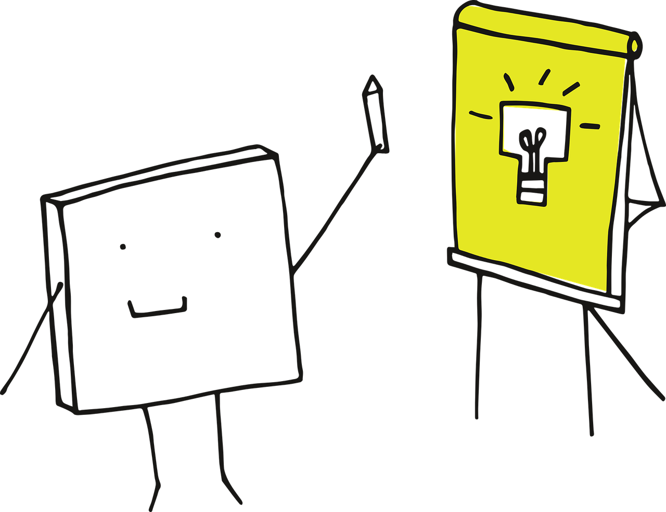
https://pixabay.com/vectors/idea-visualization-line-art-3976295/
https://pixabay.com/vectors/pixel-cells-video-recording-3976293/
https://pixabay.com/vectors/pixel-cells-tutor-master-3974190/
https://pixabay.com/vectors/pixel-cells-seminar-conference-3974170/
https://pixabay.com/vectors/pixel-pixel-cells-path-landscape-3699343/
https://pixabay.com/vectors/pixel-cells-pixel-to-learn-3674122/
https://www.interaction-design.org/literature/topics/design-thinking
IDEO(2012): Design Thinking for Educators Toolkit
2012 IDEo LLC. All rights reserved. http:// designthinkingforeducators.com/

