Slide 1
Mental Health and Seniors
David Duarte

Slide 2
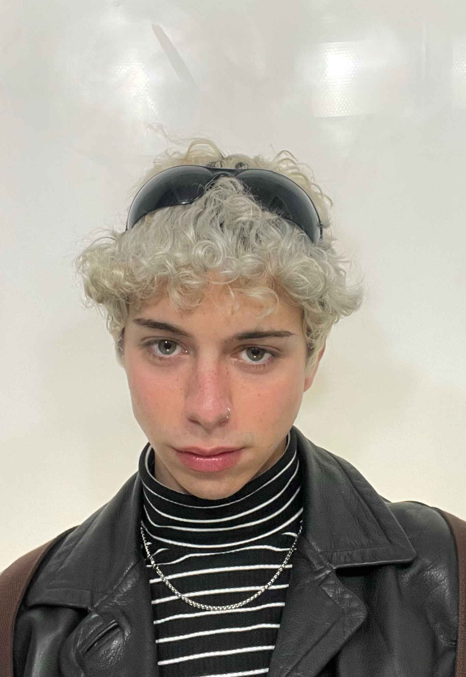
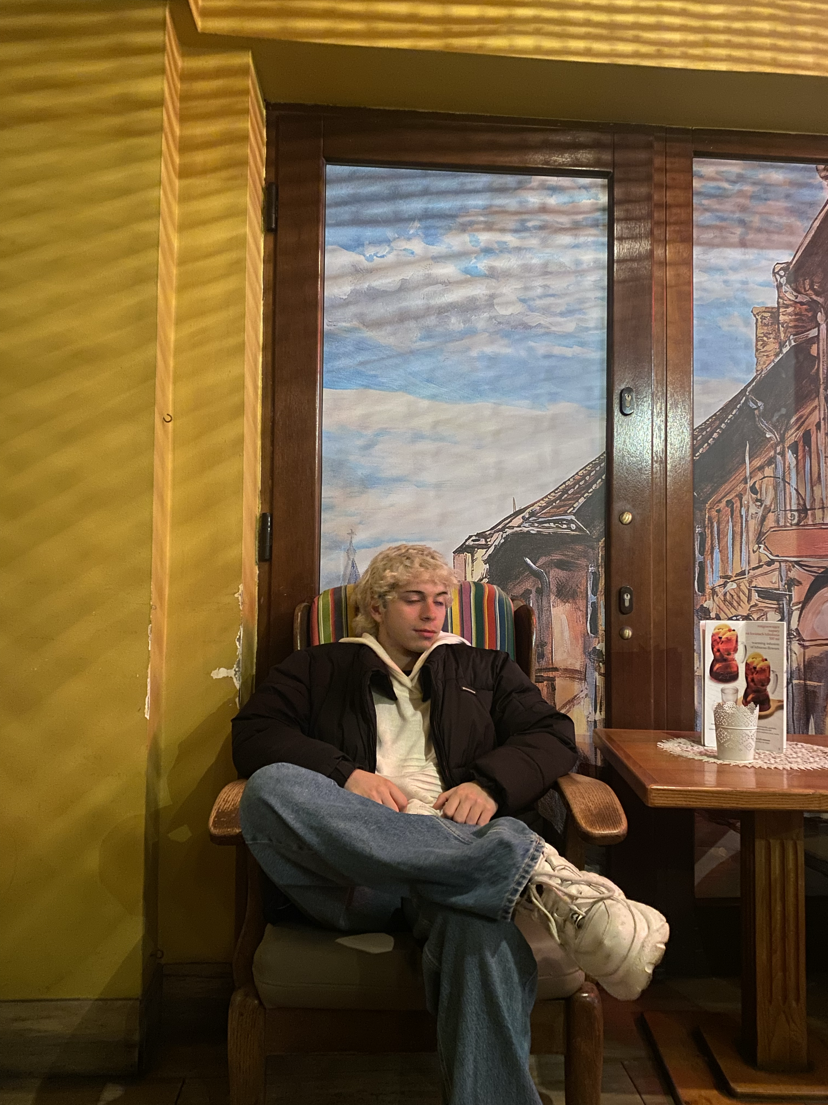
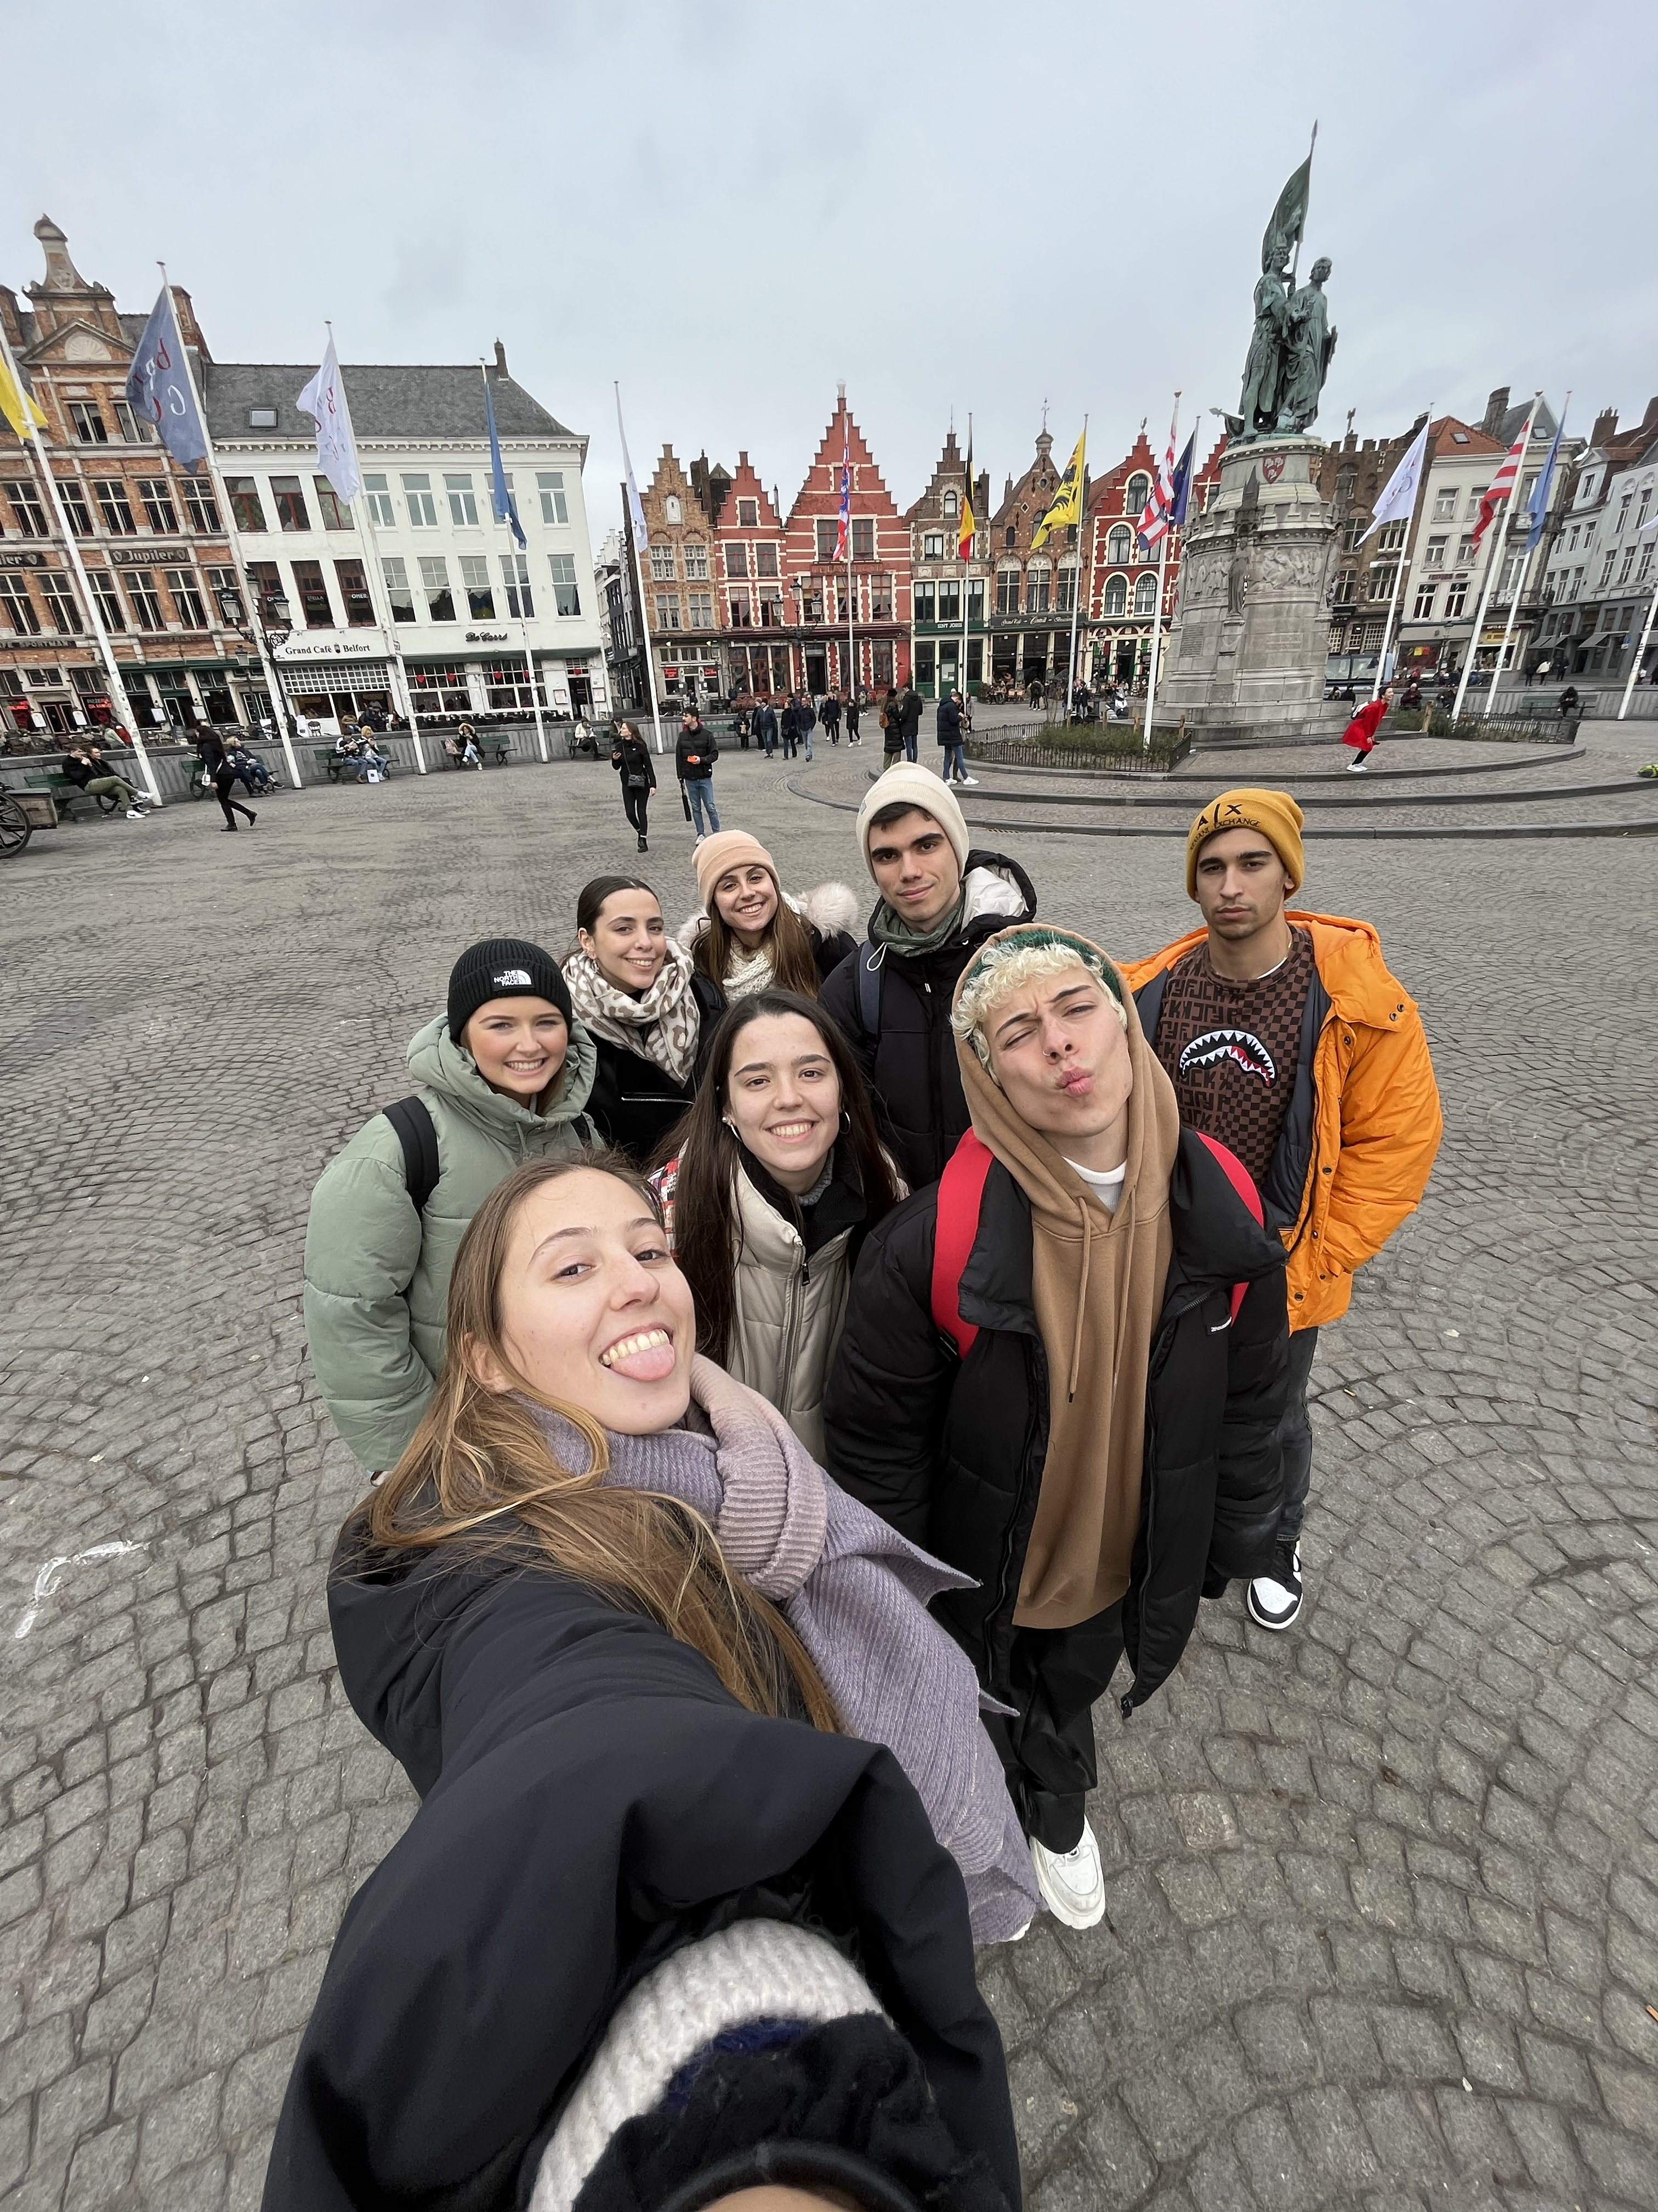
INFORMATION ABOUT ME
My name is David Duarte, I'm 20 years old and I'm from Spain, specifically from the north, from a city called Zaragoza. I study Social Work and I chose this career because I consider myself a person who empathises with people and who is aware of the problems that may arise in day to day life in society. This year I am doing my Erasmus in Belgium because I wanted to live the experience to learn to cope on my own in a country with a language different from my own. My hobbies include drawing, listening to music, and above all going out with my friends, although I consider myself a good cook and I love to prepare all kinds of dishes and desserts. Regarding my personality, I consider myself a cheerful, extrovert and fun person, and above all, I am open to live new experiences and start this living lab with a lot of enthusiasm.

Slide 3
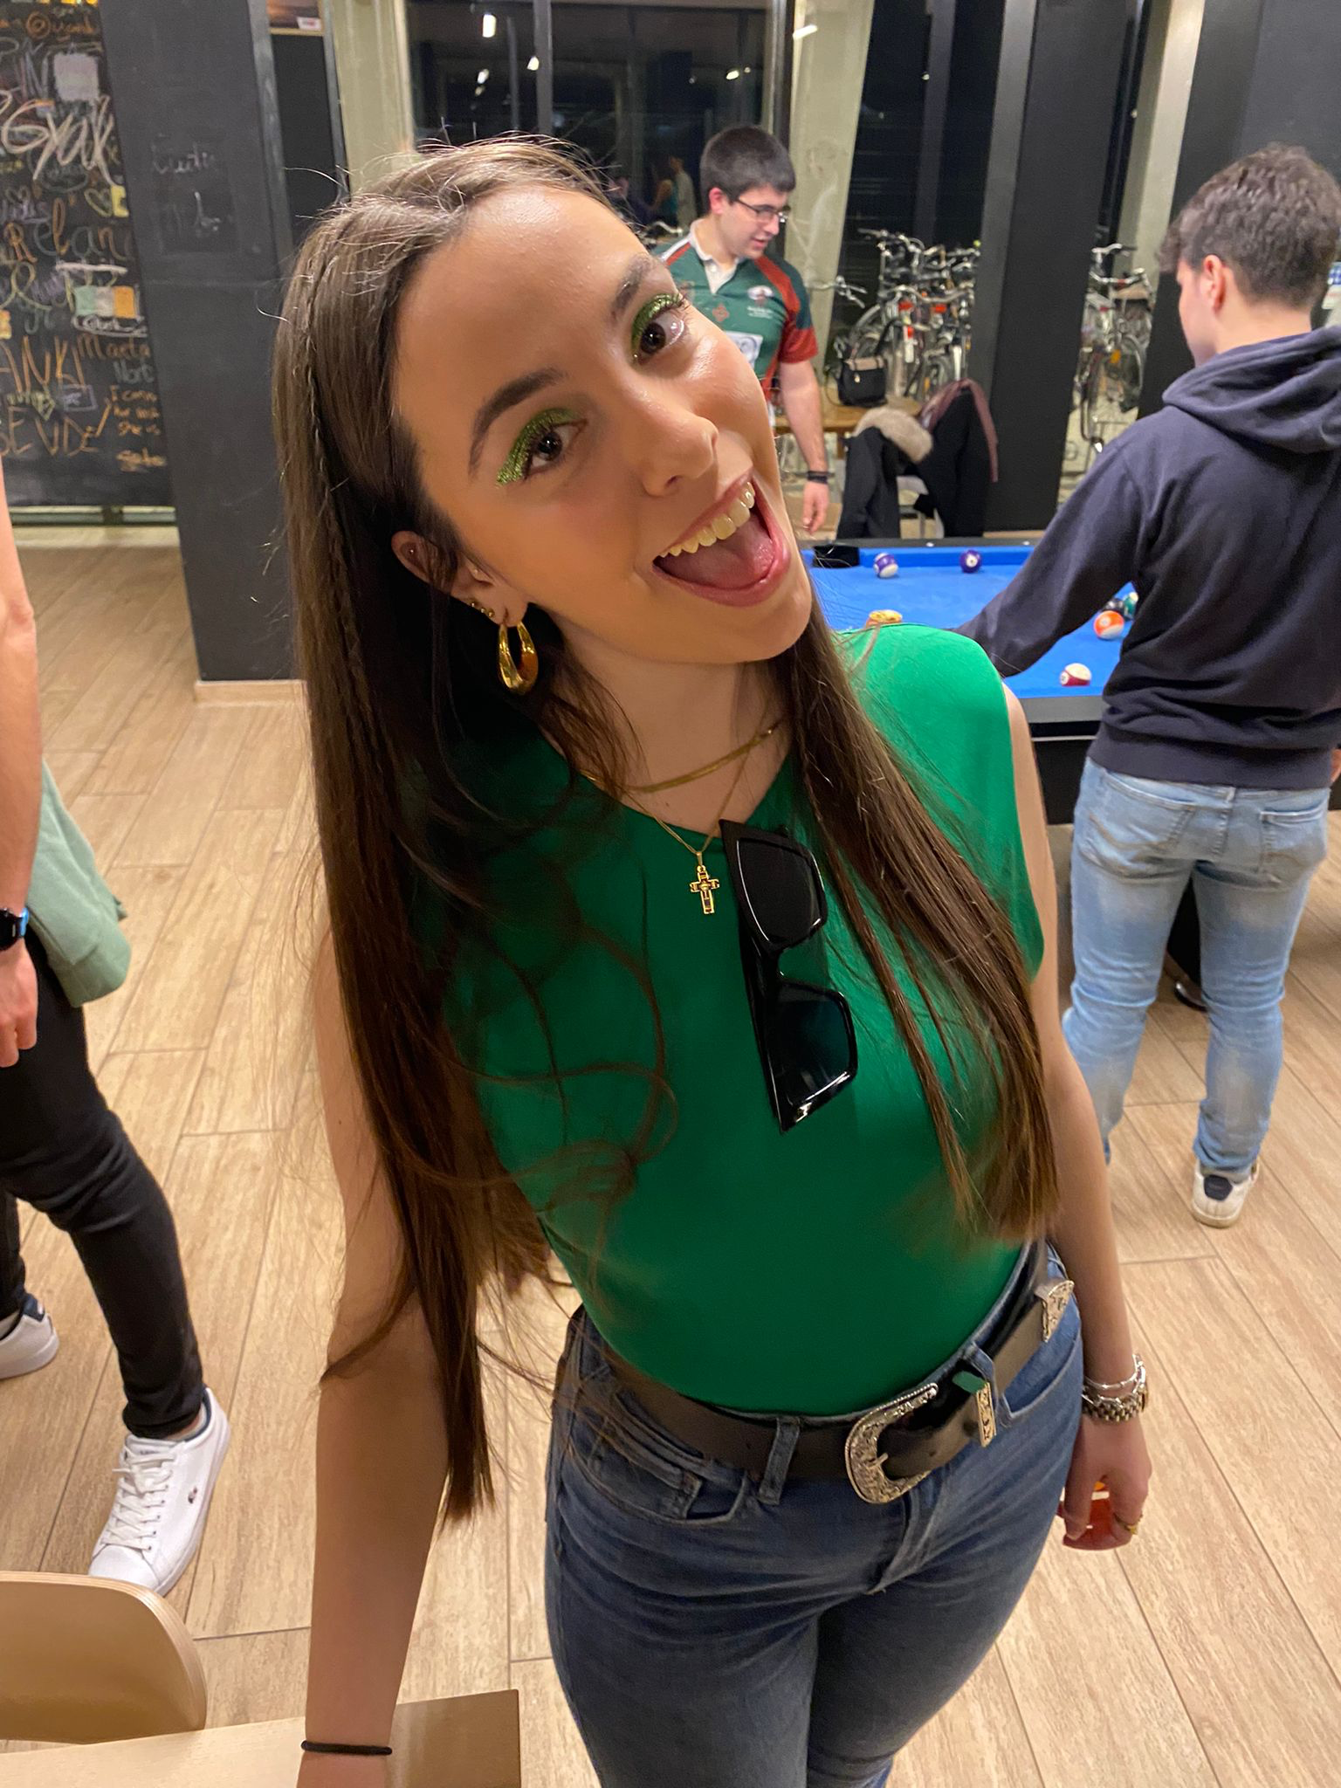
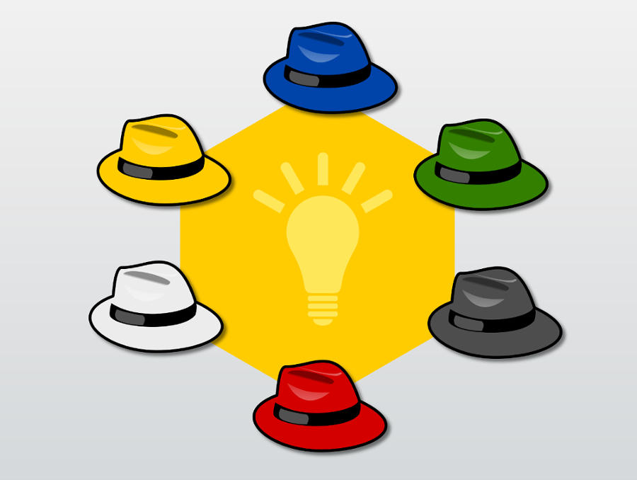
WEEK 1 & 2 RECAP
This first week has been really exciting for me because I have never done online classes in this format before. The first thing we did when we entered the class was to introduce ourselves, both the students and the teachers. After that, we chose our reflection partner, mine being Beatriz. I was glad to have her as a reflexion partner because she is doing erasmus in the same place as me so we have a lot of things in common. At first my feeling was a bit scared as I was shocked to see people from different places and I didn't know if we were going to work well together. However, everyone passed on the skills that each of the members are best at and I could see that all of us have participated in group work at some point, both as a leader and as a listener. In these two weeks we have learnt to work from the 6 hats technique, a useful technique to think with different perspectives when creating a project. My sparkling moment of the weeks was the presentation of our interviews with older people as I felt that I spoke very fluently and at the same time I was surprised at how comfortable I felt talking to the group about my personal and family situation. Moreover, from the portfolios of the other colleagues I could see that most of the situations of older people are really similar and from now on we are going to focus on working and learning more about the mental health of older people. Finally, I have learned a lot from the Miro tool, which is a platform where we insert all our tasks that we do during the week and I think it is very useful to work with it.
My reflection partner
6 hat technique

Slide 4
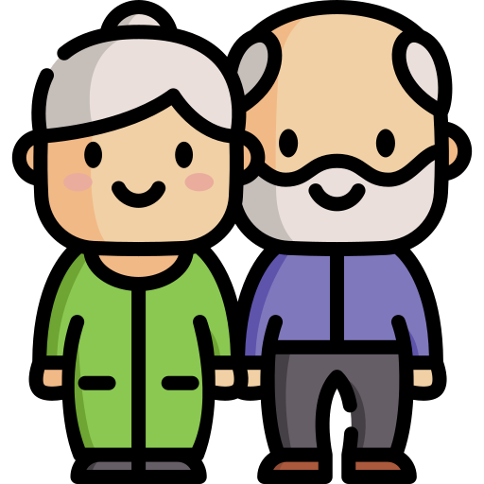
Interview with seniors
During Easter week I was able to conduct two interviews with my grandparents.
The first one was with my maternal grandparents who live in my village and very close to my home, so I have daily contact with them and know more about their lives. The second interview was with my paternal grandmother, who lives alone in a village of only 300 inhabitants and I see her much less than my other grandparents as the distance between the two municipalities is really far. The most interesting thing I found in these two interviews is the difference that exists, as my maternal grandparents are 66 and 69 years old while my paternal grandmother is 86.
Moreover, there is a big difference with respect to the municipality where they live, which affects the quality of life and the standard of living they have.

Slide 5
1st INTERVIEW
1-Technology: My maternal grandmother, being 66, uses the phone quite a lot, on a daily basis, and handles herself just as well as anyone else. What she uses the mobile phone most is for audiovisual content and for sending and receiving photos of family members. On the other hand, my grandfather is more distant from technology and although he has a smartphone, he hardly uses it and hardly knows how to use it. Regarding the question of whether they could improve their technology skills, they both answered yes, as they are not as agile as they would like to be.
2-Internet: My grandparents have easy access to the internet as they have had a wifi network in their house for quite a few years now, so we could say that they are quite familiar with technology, it is part of their lives and it is also a system that allows them to be in more contact with family, friends...
3-Loneliness: As I have said before, thanks to technology my maternal grandparents have easier access to phone calls and contact with family members, so they rarely feel lonely. Also, as they live in a large town like my whole family, we are almost always seeing each other.
4-Healthcare and hardest part of be older: In my grandparents' opinion, the hardest part of growing older is the physical degradation, as day-to-day activities such as picking up their grandchildren from school take more effort than they did several years ago, as they get more and more tired.
5-Medical devices: They use a lot of medical devices, for example to make appointments at the doctor's, as through the Spanish social security app they can select the day and date for a doctor's appointment. They are also quite familiar with medical devices as they have a digital blood pressure machine and know how to use it quite well. What they would like to see improved in digital health is the ease of making appointments, as sometimes the process is complicated for them.

Slide 6
2nd INTERVIEW
1-Technology: My paternal grandmother got a mobile phone last year as a result of my grandfather's death as we thought it could be a method of distraction as she was very sad. Although she has some understanding of WhatsApp she still has a lot of problems making and answering calls. For my grandmother, technology has made a certain change in her day to day life as she finds out more about the lives of her friends and family through messages, however my grandmother is not very involved in this type of service and always says that she doesn't like to use the phone because she doesn't know how to use it and gets overwhelmed.
2-Internet: She lives in a village of only 300 inhabitants and for the first time last year they set up an internet network in the whole village, so that from that moment on the houses in the village have been able to be better connected to society. However, my grandmother, although she has wifi in her house, she only uses it for WhatsApp, so the internet has not made a big change in her life.
3-Loneliness: Since the death of my grandfather my grandmother has felt very lonely, and living in a small village with so few inhabitants makes this feeling even worse. Most of the residences in the village are big old houses so my grandmother lives in one of them and that makes it a lot for her. Many weeks my aunts and uncles and my parents insist that she comes to spend a few days with us in the city so that she is not so lonely at home and has more distractions.
4-Healthcare and hardest part of be older: The worst part of getting older, according to her, is doing the chores of everyday life, because as time goes by and at that age she finds it difficult to do tasks such as cooking or cleaning the house. In addition, she always has to depend on someone to transport her to places as she cannot walk long distances on her own. In spite of everything, my grandmother is very well maintained and independent, considering that she is 86 years old.
5-Medical devices: My grandmother is not very familiar with medical devices and for example, to make a doctor's appointment she asks us, her grandchildren, to get her an appointment with the doctor and then she writes it down on paper.

Slide 7
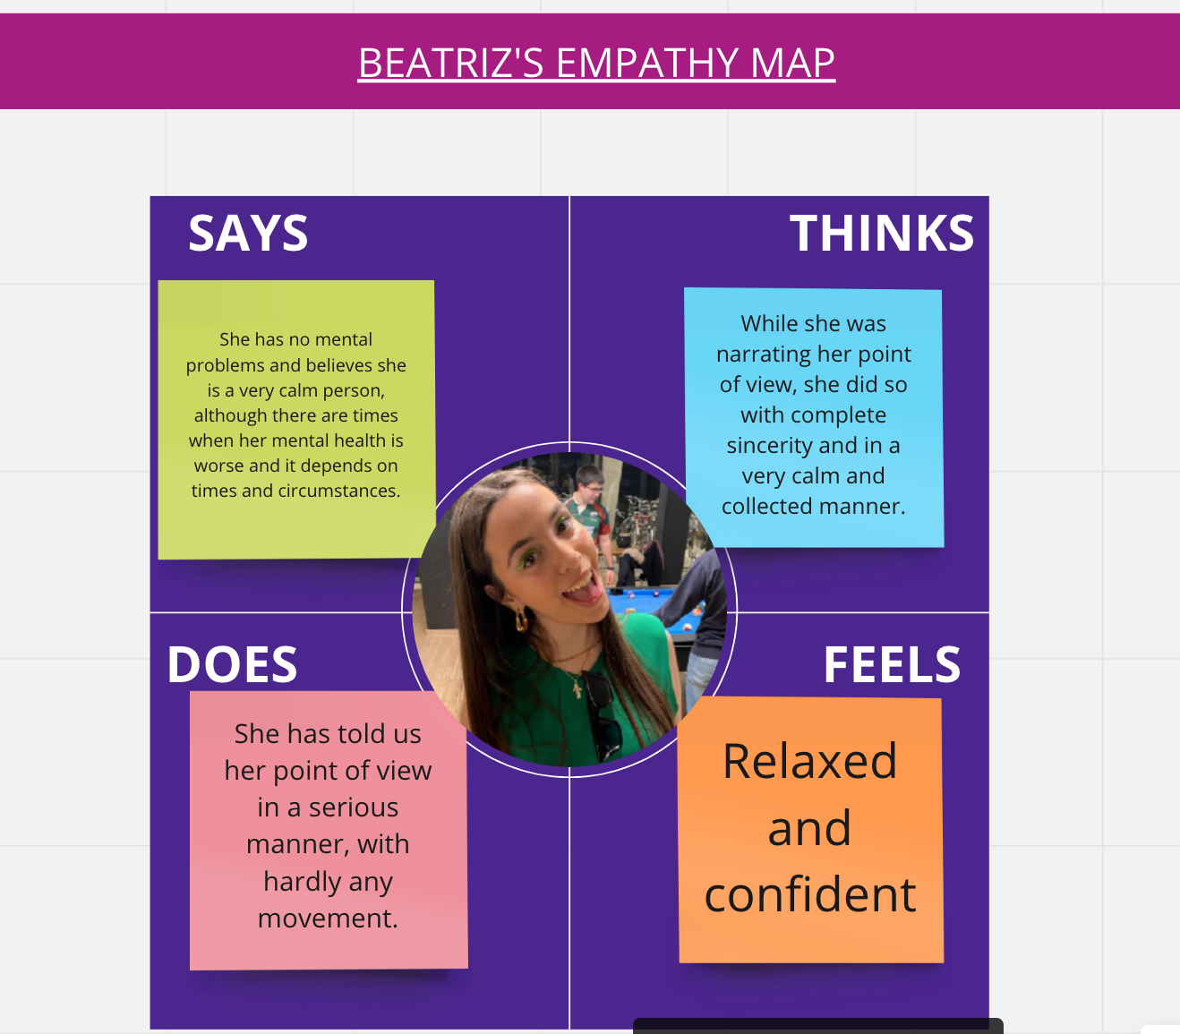
WEEK 3 RECAP
This week we were less integrated than usual but still worked very well together. Mihaela started by outlining the tasks we had to do for the day and explained how to make an empathy map. An empathy map helps you to identify with the thoughts, feelings and behaviours of a group member, and is made in four phases:
-Says: how it conveys the information that counts.
-Does: the way they tell us the information.
-Thinks: his or her point of view on the subject we are dealing with.
-Feels: the feelings when conveying the information.
The empathy map has helped me a lot because I have learnt to focus on other perspectives such as feelings or the sincerity with which people transmit the information on the subject we are dealing with. In addition, I consider that my sparkling moment was the sincerity with which I transmitted my mental health, which was the topic we were talking about and which was the focus of the living lab, which is why I was once again surprised by the comfort I feel every time I talk to the group.
The group is in a phase where it is much less difficult for us to talk and in the phase where we are acquiring the necessary competences to be able to achieve the objectives as a team.

Slide 8
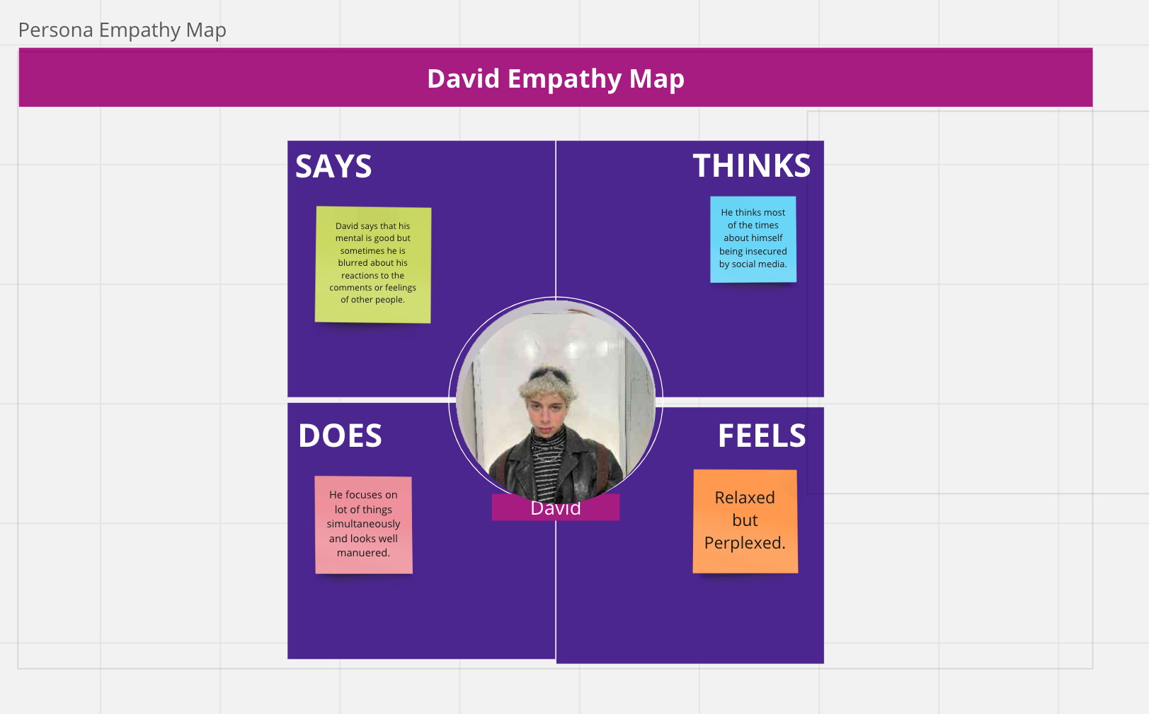

Slide 9
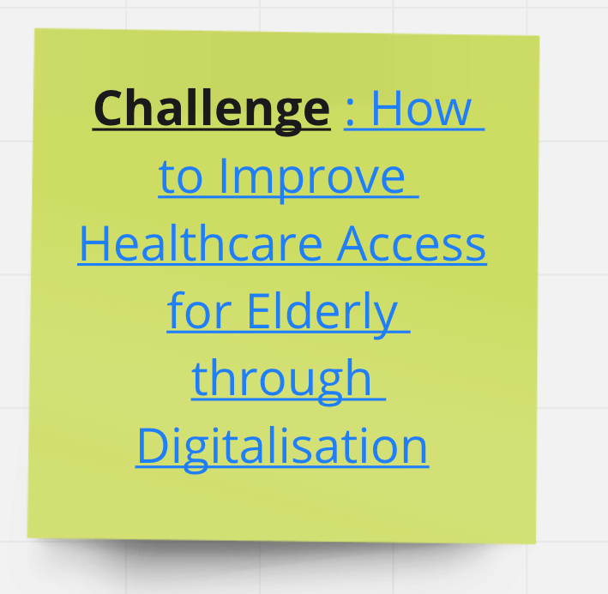
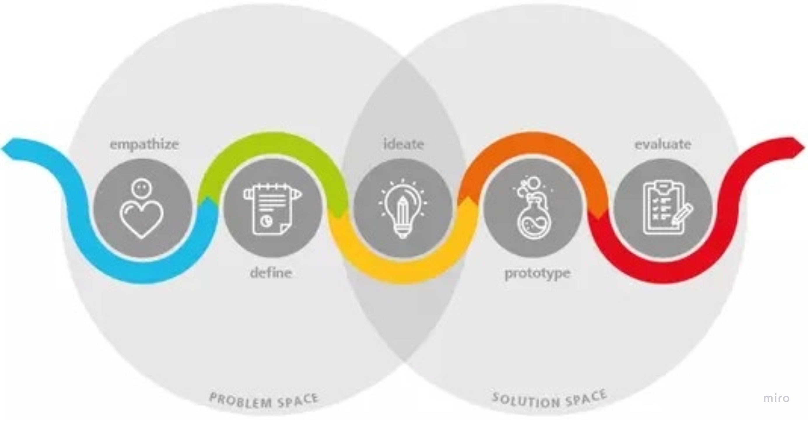
WEEK 4 RECAP
This week started with the explanation of the prototype definition phase, that the design of the prototype is the final goal to be realised by the whole group. The definition mode is like when you focus on a specific user group and their needs, and it happens after collecting a lot of information from many users. The goal is to find a specific problem that the team can work to solve. After this, we set out to brainstorm through four phases focusing on the topic of mental health of the elderly. Through a set of individual ideas, we came up with the final idea focused on promoting digitalisation in the lives of the elderly in order to facilitate their everyday life (promoting more daily help, facilitating access to medical records...), thus improving the quality of their mental health. Without a doubt this week I have learned to reach a final conclusion from small proposals that the group is making, so the progress as a team these weeks has improved a lot and we are already close to realize our final prototype. In addition, individually we have to think of a problem for the elderly and propose a solution, so that we can share it with the group next week.

Slide 10
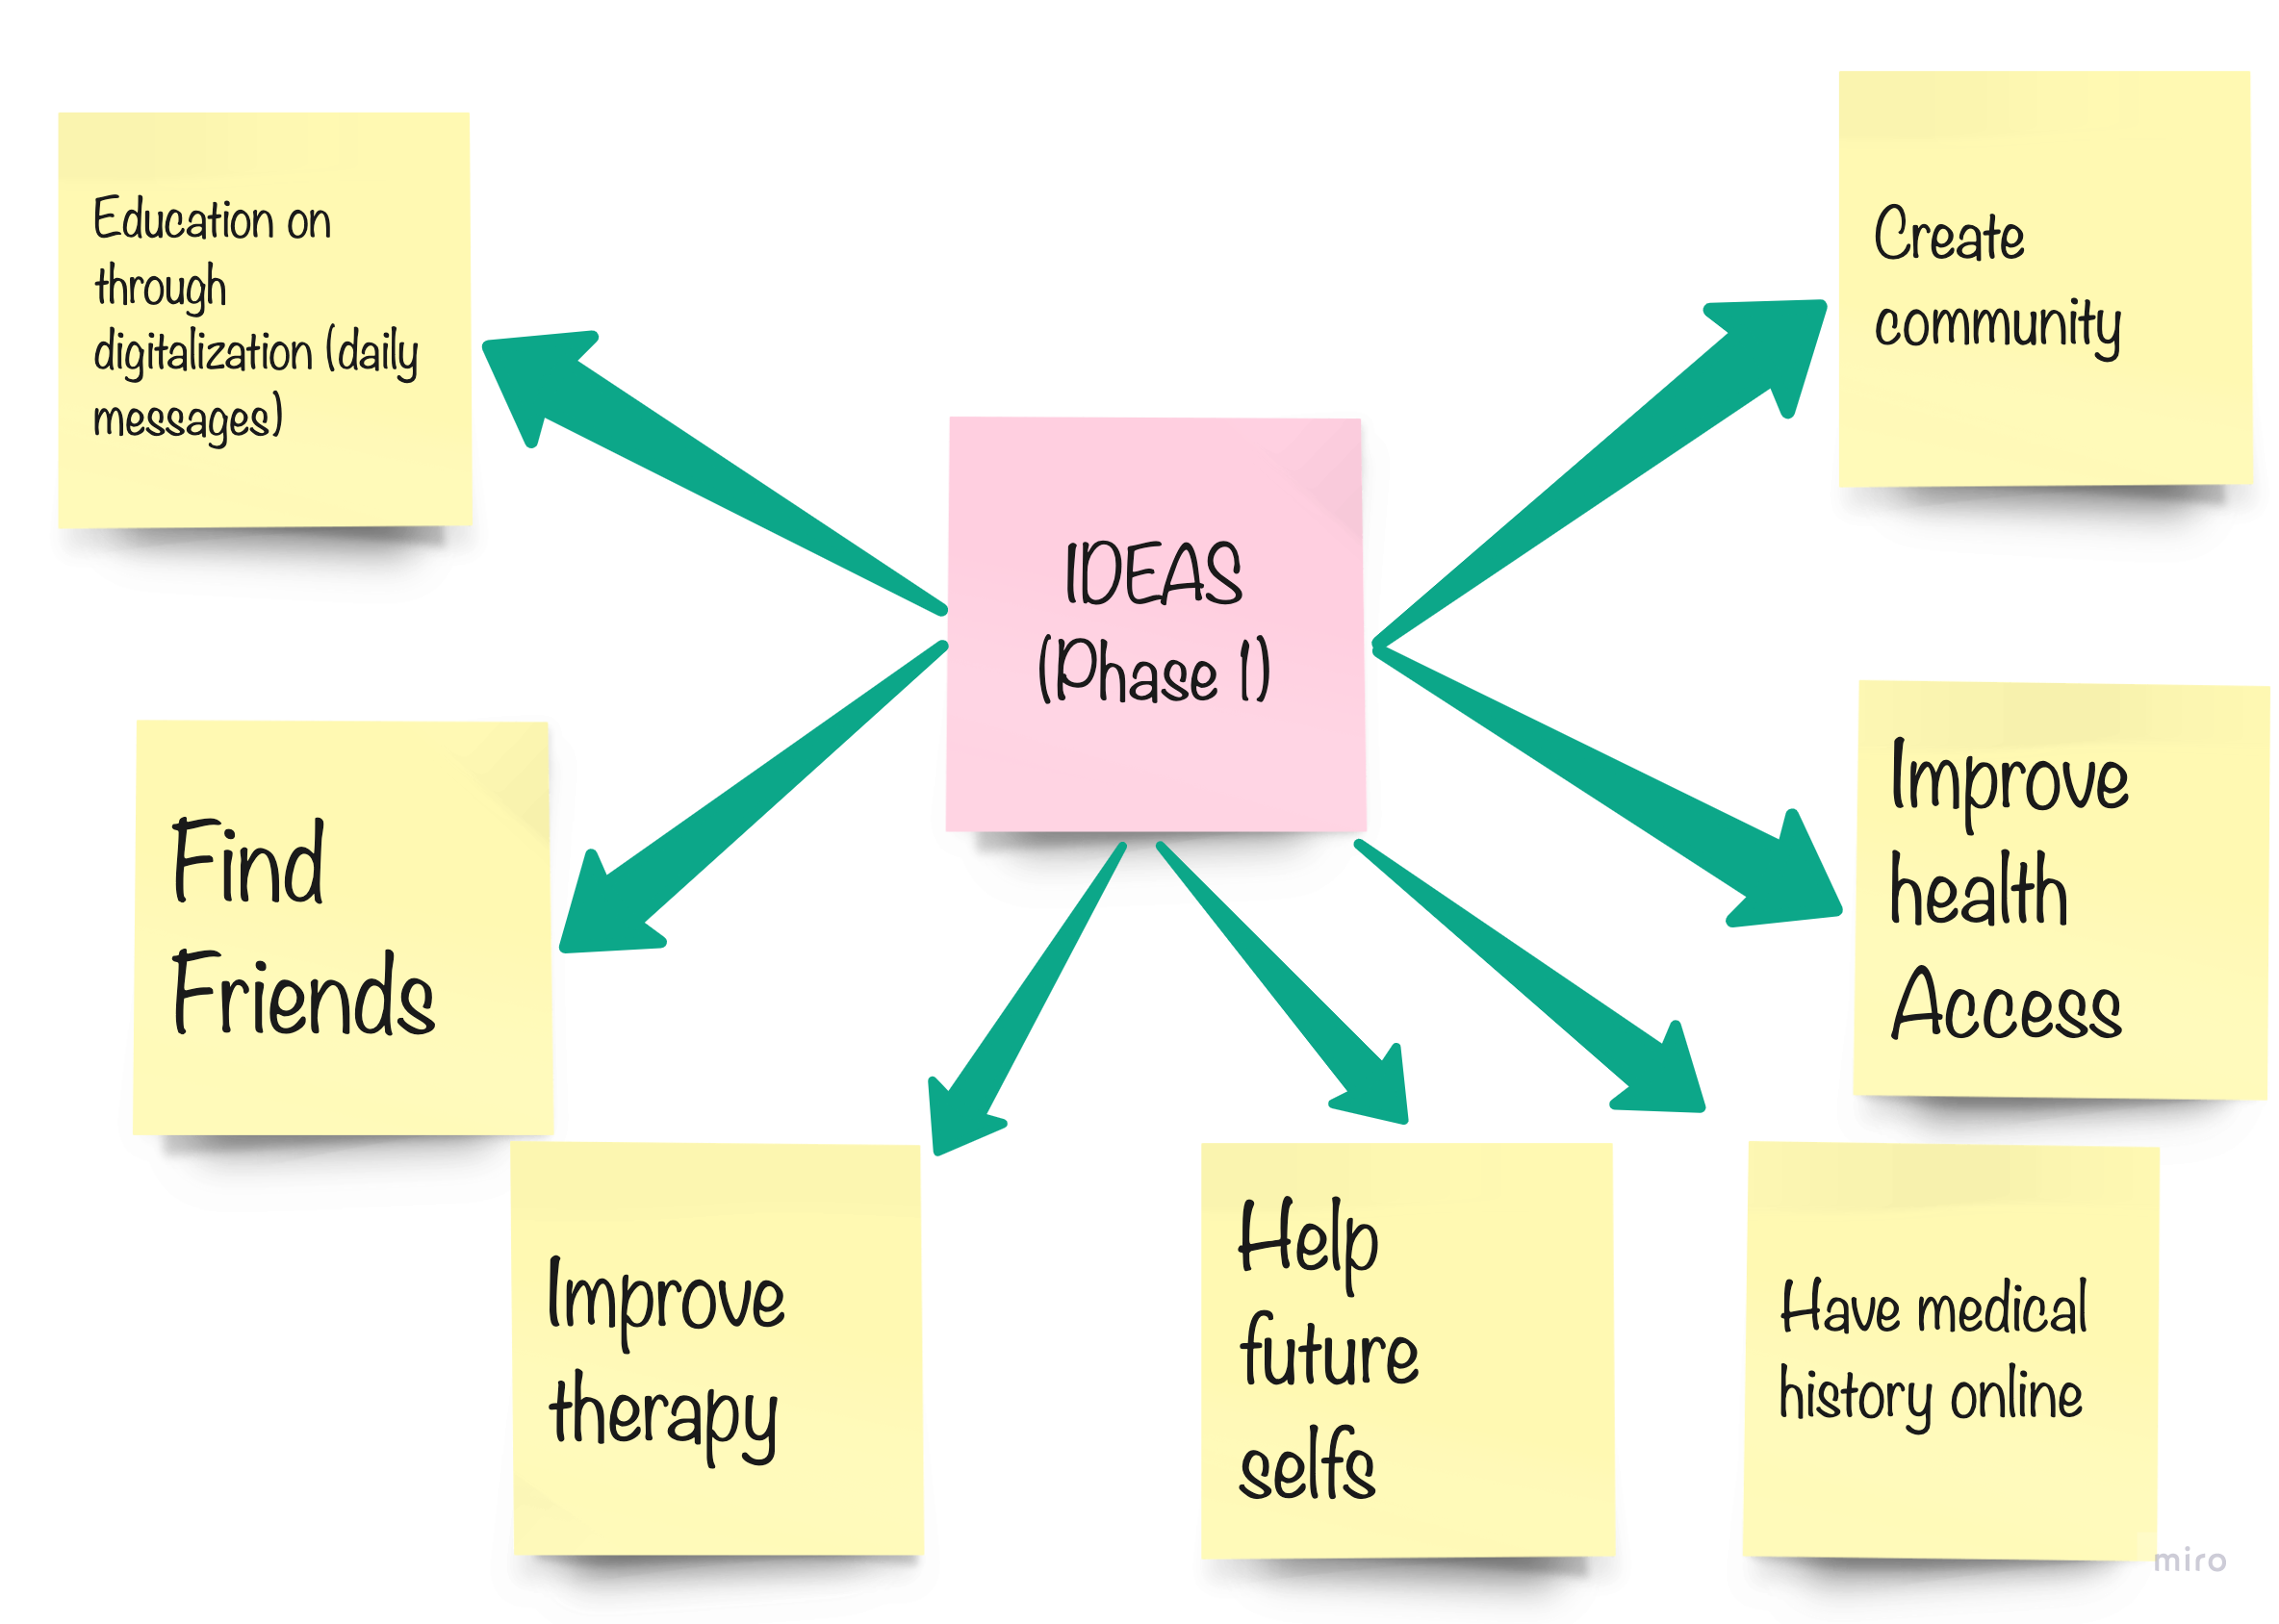
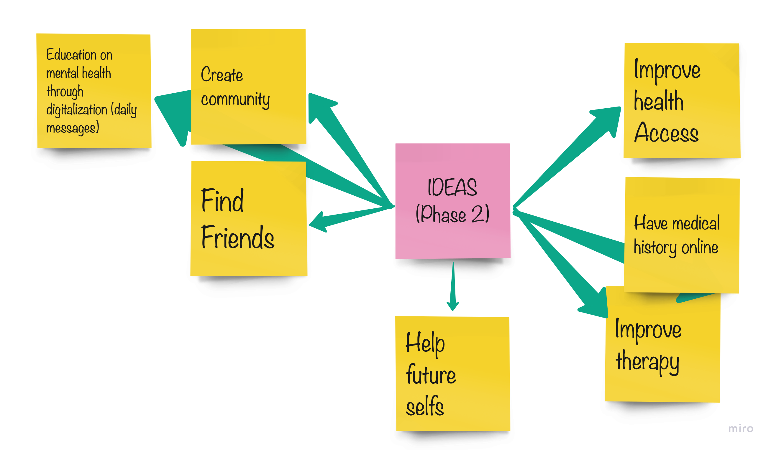
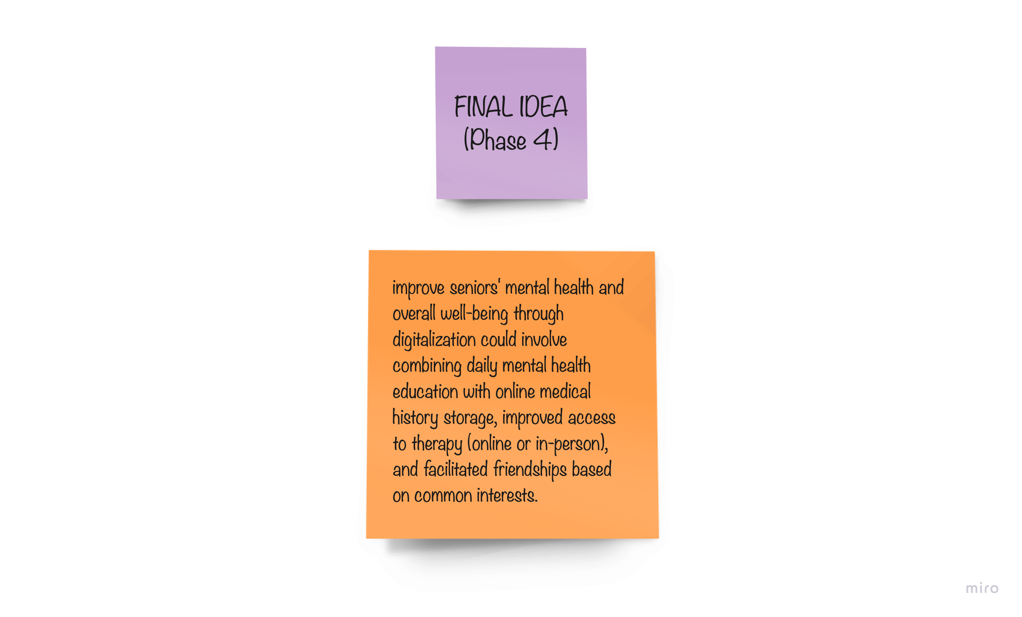
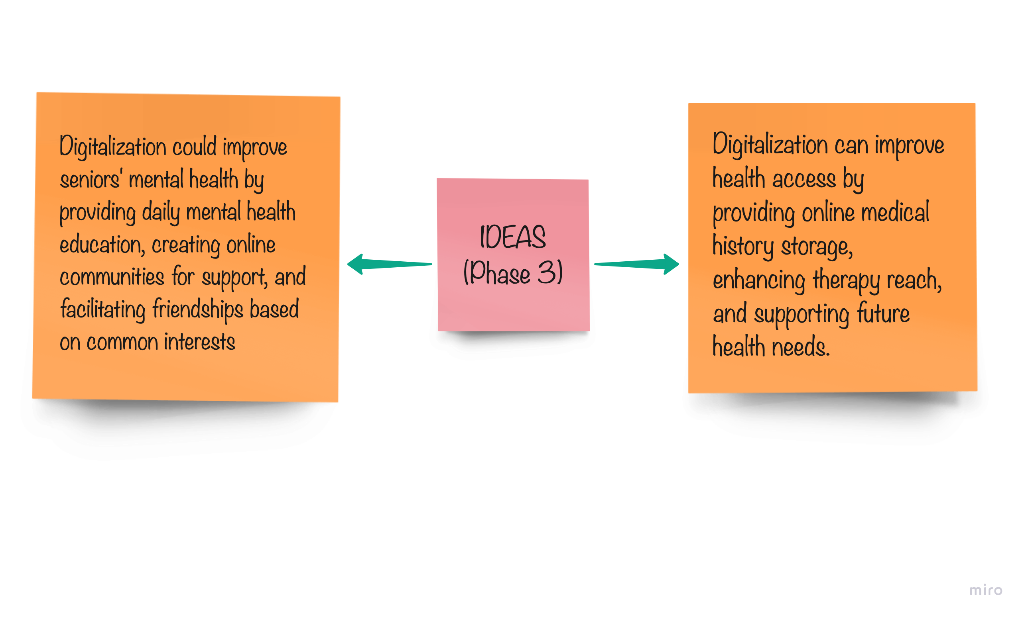
DEFINITION PHASE

Slide 11
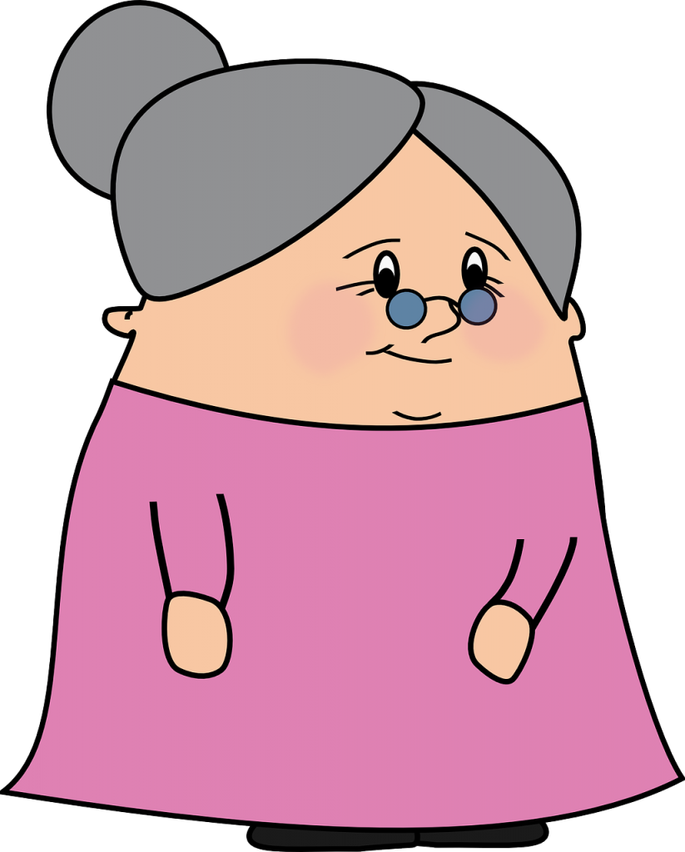
PROBLEMS EXPERIENCED BY OLDER PEOPLE
THEY DON'T HAVE THE STRENGTH TO DO CERTAIN THINGS THEY WANT TO DO
Through the interview I conducted with my oldest grandmother, she told me that the biggest problem she has is that she always sets out to do things she would like to do but cannot do them because old age prevents her from doing certain tasks, either due to lack of strength, cognitive problems or memory problems. For example, she always sets out to go to the village supermarket by herself or she always sets out to make a big meal for the whole family by herself, but these are tasks that she cannot do because of her old age.
Esta foto de Autor desconocido está bajo licencia CC BY-NC-ND

Slide 12
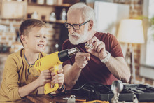
SOLUTION TO THE PROBLEM
VOLUNTEER NETWORK
In my opinion I think that most elderly people, and especially elderly people who live in small towns like my paternal grandmother, need a lot of help to do all the daily chores as they are not able to fend for themselves, so I propose to create a volunteer network where we as young people propose to go to the elderly people's homes to help them with their daily chores. In addition, we could also help them to carry out other tasks such as accompanying an elderly person to the supermarket to inform them of the products and their prices, as many of them do not have a good visual capacity to do their weekly shopping. This volunteering network would be carried out through an association related to elderly people and that would assign each volunteer to their respective places to take care of a specific case.

Slide 13

WEEK 5 RECAP
We started the day working as a group with the external skateholders, and the progress of teamwork is becoming more and more noticeable, as each one of us knows our qualities and what we can contribute to the group. That day we started to create our final prototype and we decided that we were going to create a website with different functions that would help the elderly in their daily lives. The website is divided into 6 sections and each one of them has a function (psychological care, 24 hour telephone service, whatsapp group for consultations, emergency service, frequent contacts and medical history...), as well as having a user that automatically opens when you enter the page. When elaborating the design we have focused on facilitating as much as possible these services to the elderly and thus introduce them little by little to the new technologies, final idea that we elaborated when we brainstormed last week. What I have learnt most from this class is that every person goes through all the roles when we’re working in a team and what surprised me most about myself is the leadership role that I acquired and which gave me so much self-confidence and trust in my team. For the next week, which is already the last one, we have organised ourselves and we have divided the tasks to be done in order to reinforce the design of the prototype of the web page and to elaborate a video and a poster explaining it.

Slide 14
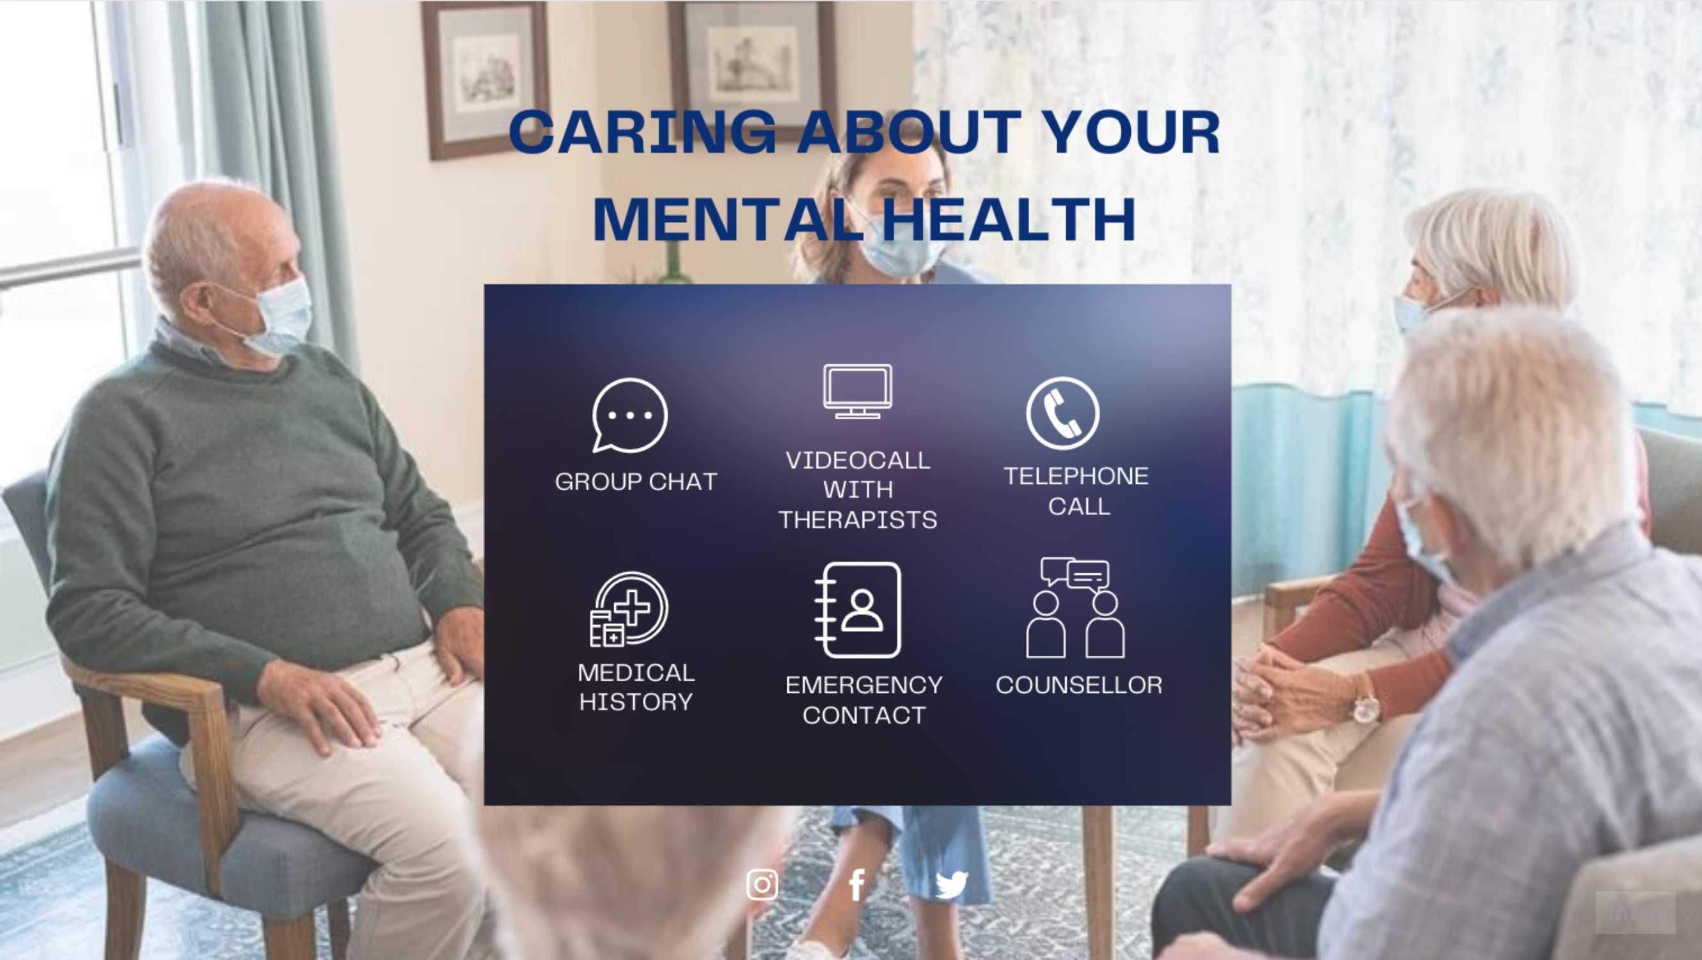

Slide 15
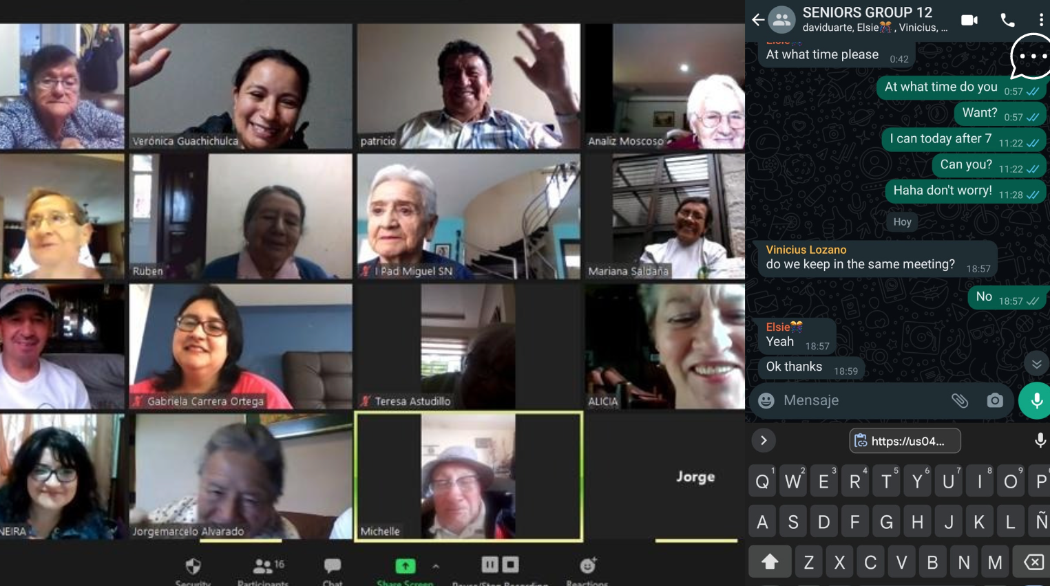
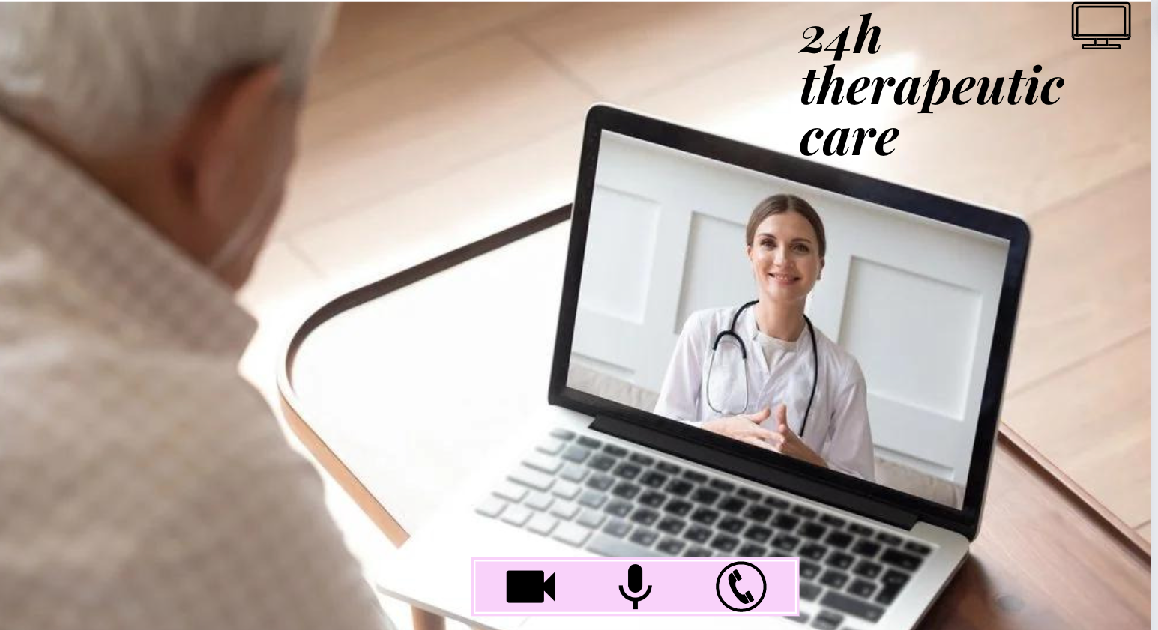
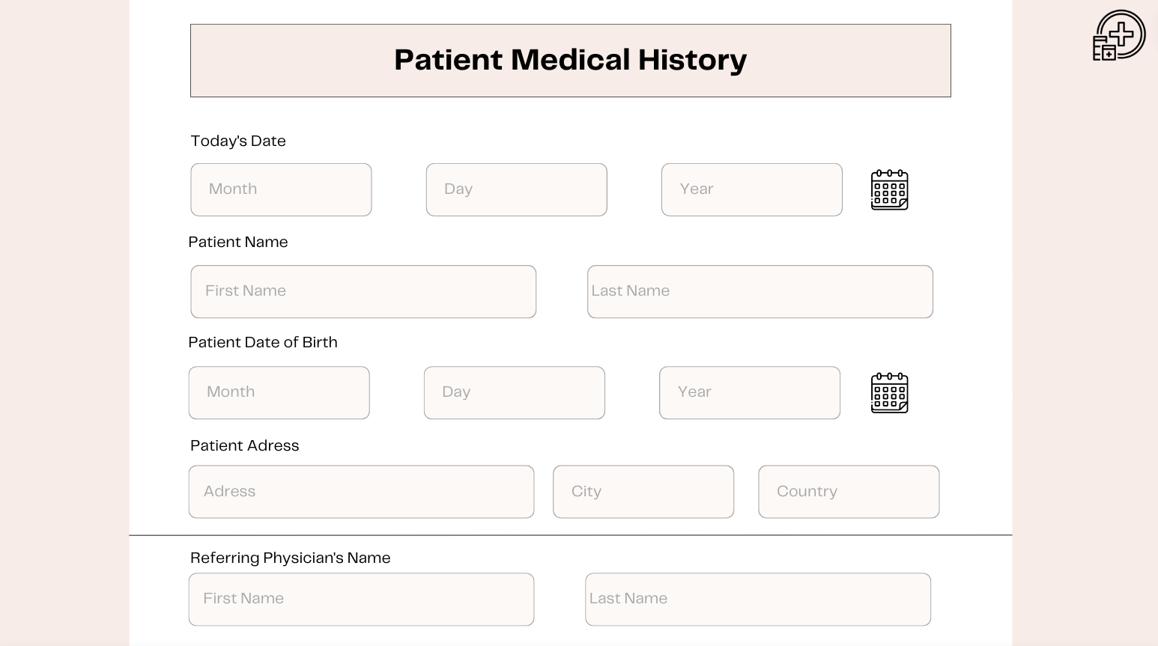
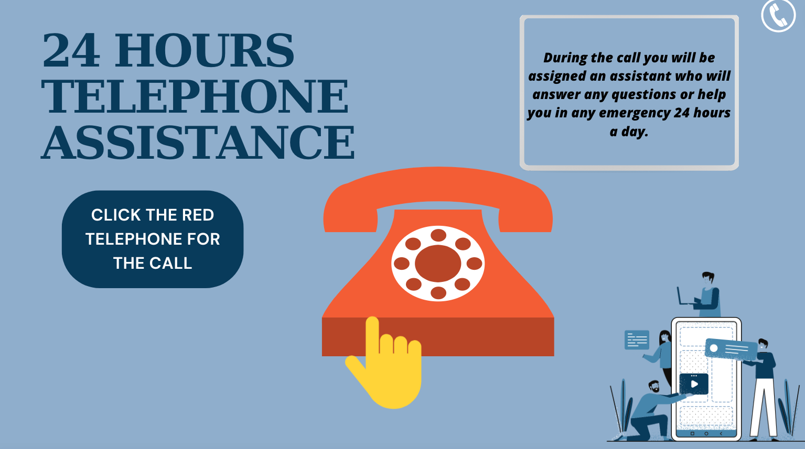
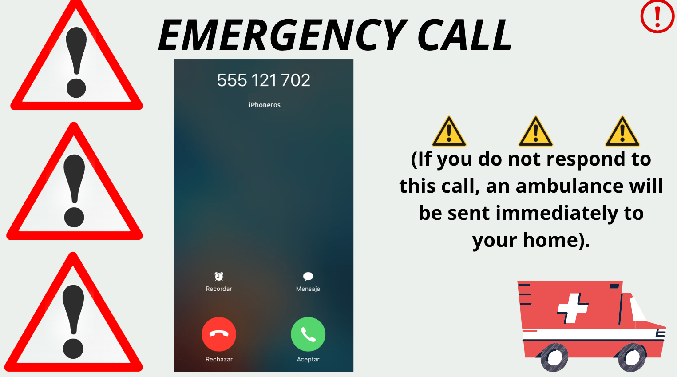
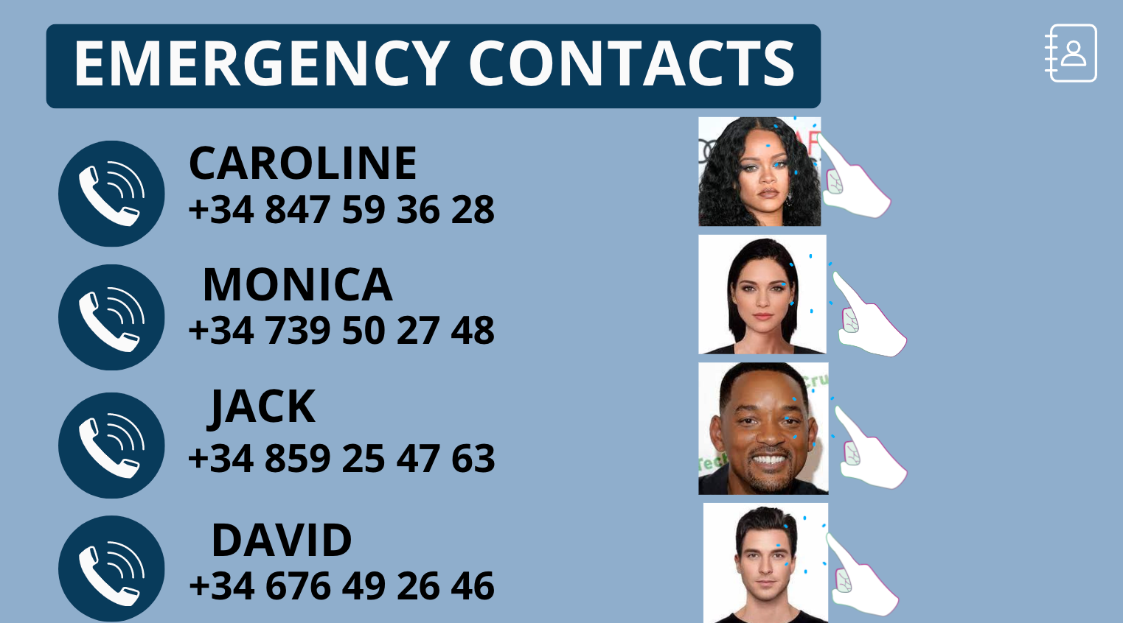

Slide 16

WEEK 6 RECAP
The last day was the day I felt most comfortable with the group as I feel that we all know each other a bit better and know how we can work. The most surprising thing about this ILL is the amount of skills and strenghts we have acquired by working as a team, among them; communication, listening, problem solving, collaboration and leadership among others. Also, another thing I have learned from this ILL is the importance of dealing with the mental health of the elderly and how important it is to try to make their lives easier because of the many difficulties that can arise in their daily lives. As I have already mentioned in previous weeks, it is amazing how well we have distributed the roles when it comes to working with each other, as each week one of us took on the role of leader, which greatly facilitated the progress of the final prototype. Finally, we divided the slides so that each one of us could explain them in the video and in my case it was my turn to comment on the telephone part and the emergency assistance that the participants would receive.

Slide 17
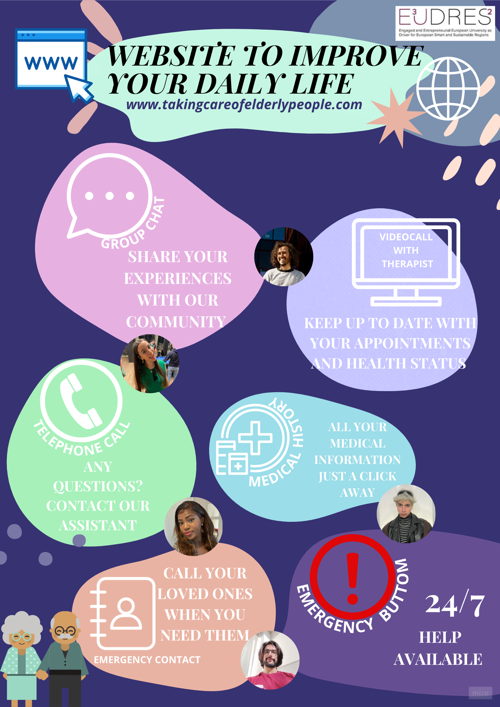

POSTER
VIDEO
https://drive.google.com/file/d/1HSvkmci0LEnVCZ0kFJwV-Qybrjedh9it/view?usp=share_link

Slide 18
THANKS FOR WATCHING☺

Slide 19
MENTAL HEALTH INFOGRAPHICS
Mercury
Saturn
Mercury is the closest planet to the Sun and the smallest one
It's composed of hydrogen and helium. It was named after a Roman god
Mars
Venus
Despite being red, Mars is actually a cold place. It’s full of iron oxide dust
Venus has a beautiful name and is the second planet from the Sun
Jupiter
Neptune
Jupiter is a gas giant and the biggest planet in the Solar System
Neptune is the farthest planet from the Sun and the fourth-largest

Slide 20
MENTAL HEALTH INFOGRAPHICS
Mercury
Mars
Mercury is the closest planet to the Sun and the smallest one
Despite being red, Mars is a cold place. It’s full of iron oxide dust
Venus
Jupiter
Venus has a beautiful name and is the second planet from the Sun
It’s a gas giant and the biggest planet in the Solar System
Saturn
Neptune
Saturn is the ringed one. It’s composed mostly of hydrogen and helium
Neptune is the farthest planet from the Sun and the fourth-largest

Slide 21
MENTAL HEALTH INFOGRAPHICS
Mercury is the closest planet to the Sun and the smallest one
Despite being red, Mars is a cold place. It’s full of iron dust
Earth is the third planet from the Sun and the one where we live on
Neptune is the fourth-largest planet in the Solar System
Saturn is the ringed one. It’s composed mostly of hydrogen and helium
It’s a gas giant and the biggest planet in the Solar System

Slide 22
MENTAL HEALTH INFOGRAPHICS
Mercury is the closest planet to the Sun and the smallest one in the Solar System
Despite being red, Mars is actually a cold place. It’s full of iron oxide dust
Venus has a beautiful name and is the second planet from the Sun
Jupiter is a gas giant, the fourth-brightest object in the sky and the biggest planet of them all
The planet’s name has nothing to do with the liquid metal since it was named after a Roman god

Slide 23
MENTAL HEALTH INFOGRAPHICS
Mercury is the closest planet to the Sun and the smallest
Despite being red, Mars is a cold place
Venus has a beautiful name and is the second planet
It’s a gas giant and the biggest planet in the Solar System
Saturn is a gas giant and has several rings
Neptune is the farthest planet from the Sun
Mars is a cold place

Slide 24
MENTAL HEALTH INFOGRAPHICS
Mercury
Mars
Mercury is the closest planet to the Sun
Despite being red, Mars is a really cold place
Venus
Jupiter
Venus has a beautiful name and is the second
It’s a gas giant and the biggest planet
Saturn
Neptune
Saturn is a gas giant and has several rings
Neptune is the farthest planet from the Sun

Slide 25
MENTAL HEALTH INFOGRAPHICS
Mercury is the smallest planet
01
04
Mars is actually a cold place
Venus has a beautiful name
02
05
It’s a gas giant and the biggest
Saturn is the ringed one
03
06
Neptune is the farthest planet

Slide 26
MENTAL HEALTH INFOGRAPHICS
Mercury
Saturn
Mercury is the smallest closest planet to the Sun
Saturn is a gas giant and has several rings
7.5
Neptune
Millions
Jupiter
Neptune is the farthest planet from the Sun
It’s a gas giant and the biggest planet

Slide 27
MENTAL HEALTH INFOGRAPHICS
Mercury
Saturn
Venus
Jupiter
Mercury is the closest planet to the Sun and the smallest one
This ringed planet is composed of hydrogen and helium
Venus has a beautiful name and is the second planet from the Sun
Jupiter is a gas giant and the fourth-brightest object in the sky

Slide 28
MENTAL HEALTH INFOGRAPHICS
Mars
Despite being red, Mars is actually a cold place. It's full of iron oxide dust, which gives the planet its reddish cast
100
Jupiter
75
Jupiter is a gas giant, the biggest planet in the Solar System and the fourth-brightest object in the sky
50
Venus
25
Venus has a beautiful name and is the second planet from the Sun. It’s terribly hot
Neptune
Neptune is the farthest planet from the Sun and the fourth-largest by diameter in the Solar System

Slide 29
MENTAL HEALTH INFOGRAPHICS
Mercury
Mars
Mercury is the closest planet to the Sun
Despite being red, Mars is a cold place
Venus
Jupiter
Venus has a beautiful name and is the second
It’s a gas giant and the biggest planet
Saturn
Neptune
Saturn is a gas giant and has rings
Neptune is the farthest planet from the Sun

Slide 30
MENTAL HEALTH INFOGRAPHICS
1
Mercury
3
Venus
5
Jupiter
Mercury is the closest planet to the Sun
Venus has a beautiful name and is the second
It’s a gas giant and the biggest planet of them all
Saturn is a gas giant and has several rings
Mars is actually a cold place. It’s full of iron oxide dust
2
Saturn
4
Mars

Slide 31
MENTAL HEALTH INFOGRAPHICS
75%
25%
Despite being red, Mars is actually a cold place. This planet is full of iron oxide dust
Jupiter is a gas giant, the biggest planet in the Solar System and the fourth-brightest
50%
15%
Venus has a beautiful name and is the second planet from the Sun. It’s terribly hot
Neptune is the farthest planet from the Sun and the fourth-largest by diameter in the Solar System

Slide 32
MENTAL HEALTH INFOGRAPHICS
Mercury
Mars
Saturn
Mercury is the closest planet to the Sun
Despite being red, Mars is a cold place
Saturn is a gas giant and has rings
Venus
Neptune
Jupiter
Venus is the second planet from the Sun
Neptune is the farthest planet from the Sun
It’s a gas giant and the biggest planet

Slide 33
MENTAL HEALTH INFOGRAPHICS
Despite being red, Mars is actually a cold place
Mercury is the closest planet to the Sun and the smallest
It’s a gas giant and the biggest planet in the Solar System
Venus has a beautiful name and is the second planet
Neptune is the farthest planet from the Sun

Slide 34
MENTAL HEALTH INFOGRAPHICS
1
2
3
4
Mercury is the closest planet to the Sun and the smallest one
Venus has a beautiful name and is the second planet from the Sun
Saturn, the ringed one, is composed mostly of hydrogen and helium
Neptune is the farthest planet from the Sun and the fourth-largest
MERCURY
VENUS
SATURN
NEPTUNE

Slide 35
MENTAL HEALTH INFOGRAPHICS
Mercury
Venus
Saturn
Neptune
Mars
Mercury is the smallest planet in the Solar System
Venus has a beautiful name and is the second planet
Saturn is a gas giant and has several rings
Neptune is the farthest planet from the Sun
Despite being red, Mars is actually a cold place

Slide 36
MENTAL HEALTH INFOGRAPHICS
Mercury
Mercury is the closest planet to the Sun and the smallest one in the Solar System
Venus
Venus has a beautiful name and is the second planet from the Sun. It's terribly hot, even hotter than Mercury
Saturn
Saturn is a gas giant and has several rings. It's composed mostly of hydrogen and helium
Mars
Despite being red, Mars is actually a cold place. It's full of iron oxide dust, which gives the planet its reddish cast

Slide 37
MENTAL HEALTH INFOGRAPHICS
Mercury
Venus
Saturn
Mars
Mercury is the closest planet to the Sun and the smallest one
Venus has a beautiful name and is the second planet from the Sun
Saturn, the ringed one, is composed of hydrogen and helium
Despite being red, Mars is actually a cold place. It's full of iron oxide dust

Slide 38
MENTAL HEALTH INFOGRAPHICS
Mercury is the closest planet to the Sun and the smallest
Venus has a beautiful name and is the second planet
Saturn is composed mostly of hydrogen and helium
It’s a gas giant and the biggest planet in the Solar System

Slide 39
MENTAL HEALTH INFOGRAPHICS
Mercury
Venus
Saturn
Mercury is the closest planet to the Sun and the smallest one in the Solar System
Venus has a beautiful name and is the second planet from the Sun. It's terribly hot
Saturn is a gas giant and has several rings. It's composed of hydrogen and helium

Slide 40
MENTAL HEALTH INFOGRAPHICS
Mercury
Mars
Mercury is the smallest planet
Despite being red, Mars is a cold place
Venus
Jupiter
Venus has a beautiful name
It’s a gas giant and the biggest planet
Saturn
Neptune
Saturn is a gas giant and has rings
Neptune is the farthest planet

Slide 41
MENTAL HEALTH INFOGRAPHICS
Mercury is the closest planet to the Sun and the smallest
Venus has a beautiful name and is the second planet
Saturn is composed mostly of hydrogen and helium
It’s a gas giant and the biggest planet in the Solar System

Slide 42
MENTAL HEALTH INFOGRAPHICS
25%
75%
15%
50%
Mercury is the closest planet to the Sun and the smallest one
Venus has a beautiful name, but also a poisonous atmosphere
Saturn, the ringed one, is composed of hydrogen and helium
It’s a gas giant and the biggest planet in the Solar System

Slide 43
MENTAL HEALTH INFOGRAPHICS
Mercury is the closest planet to the Sun and the smallest
Despite being red, Mars is a cold place full of iron oxide dust
Venus has a beautiful name and is the second planet
It’s a gas giant and the biggest planet in the Solar System
Saturn is composed mostly of hydrogen and helium
Neptune is the farthest planet from the Sun

Slide 44
MENTAL HEALTH INFOGRAPHICS
Despite being red, Mars is a cold place
Mars
Saturn is a gas giant and has rings
Saturn
Mercury is the closest planet to the Sun
Venus
Venus is the second planet from the Sun
Mercury

Slide 45
MENTAL HEALTH INFOGRAPHICS
Venus
Jupiter
Venus has a beautiful name and is the second planet from the Sun
Jupiter is a gas giant, the biggest planet in the Solar System
Mercury
Mars
Saturn
Mercury is the closest planet to the Sun and the smallest one
Despite being red, Mars is a cold place. It’s full of iron oxide dust
Saturn is composed mostly of hydrogen and helium

Slide 46
MENTAL HEALTH INFOGRAPHICS
Mercury is the closest planet to the Sun and the smallest one in the Solar System
Venus has a beautiful name and is the second planet from the Sun. It’s terribly hot
Despite being red, Mars is a cold place. It’s full of iron oxide dust
50%
75%
25%

Slide 47
MENTAL HEALTH INFOGRAPHICS
Despite being red, Mars is a cold place
Mercury is the closest planet to the Sun
Saturn is a gas giant and has rings
Venus is the second planet from the Sun
Neptune is the farthest planet
Yes, this is the ringed one. It’s a gas giant

Slide 48
Instructions for use (free users)
In order to use this template, you must credit Slidesgo by keeping the Thanks slide.
You are allowed to:
Modify this template.
Use it for both personal and commercial purposes.
You are not allowed to:
Sublicense, sell or rent any of Slidesgo Content (or a modified version of Slidesgo Content).
Distribute this Slidesgo Template (or a modified version of this Slidesgo Template) or include it in a database or in any other product or service that offers downloadable images, icons or presentations that may be subject to distribution or resale.
Use any of the elements that are part of this Slidesgo Template in an isolated and separated way from this Template.
Delete the “Thanks” or “Credits” slide.
Register any of the elements that are part of this template as a trademark or logo, or register it as a work in an intellectual property registry or similar.
For more information about editing slides, please read our FAQs or visit Slidesgo School:
https://slidesgo.com/faqs and https://slidesgo.com/slidesgo-school

Slide 49
Instructions for use (premium users)
In order to use this template, you must be a Premium user on Slidesgo.
You are allowed to:
Modify this template.
Use it for both personal and commercial purposes.
Hide or delete the “Thanks” slide and the mention to Slidesgo in the credits.
Share this template in an editable format with people who are not part of your team.
You are not allowed to:
Sublicense, sell or rent this Slidesgo Template (or a modified version of this Slidesgo Template).
Distribute this Slidesgo Template (or a modified version of this Slidesgo Template) or include it in a database or in any other product or service that offers downloadable images, icons or presentations that may be subject to distribution or resale.
Use any of the elements that are part of this Slidesgo Template in an isolated and separated way from this Template.
Register any of the elements that are part of this template as a trademark or logo, or register it as a work in an intellectual property registry or similar.
For more information about editing slides, please read our FAQs or visit Slidesgo School:
https://slidesgo.com/faqs and https://slidesgo.com/slidesgo-school

Slide 50
Infographics
You can add and edit some infographics to your presentation to show your data in a visual way.
Choose your favourite infographic and insert it in your presentation using Ctrl C + Ctrl V or Cmd C + Cmd V in Mac.
Select one of the parts and ungroup it by right-clicking and choosing “Ungroup”.
Change the color by clicking on the paint bucket.
Then resize the element by clicking and dragging one of the square-shaped points of its bounding box (the cursor should look like a double-headed arrow). Remember to hold Shift while dragging to keep the proportions.
Group the elements again by selecting them, right-clicking and choosing “Group”.
Repeat the steps above with the other parts and when you’re done editing, copy the end result and paste it into your presentation.
Remember to choose the “Keep source formatting” option so that it keeps the design. For more info, please visit Slidesgo School.

