Slide 1
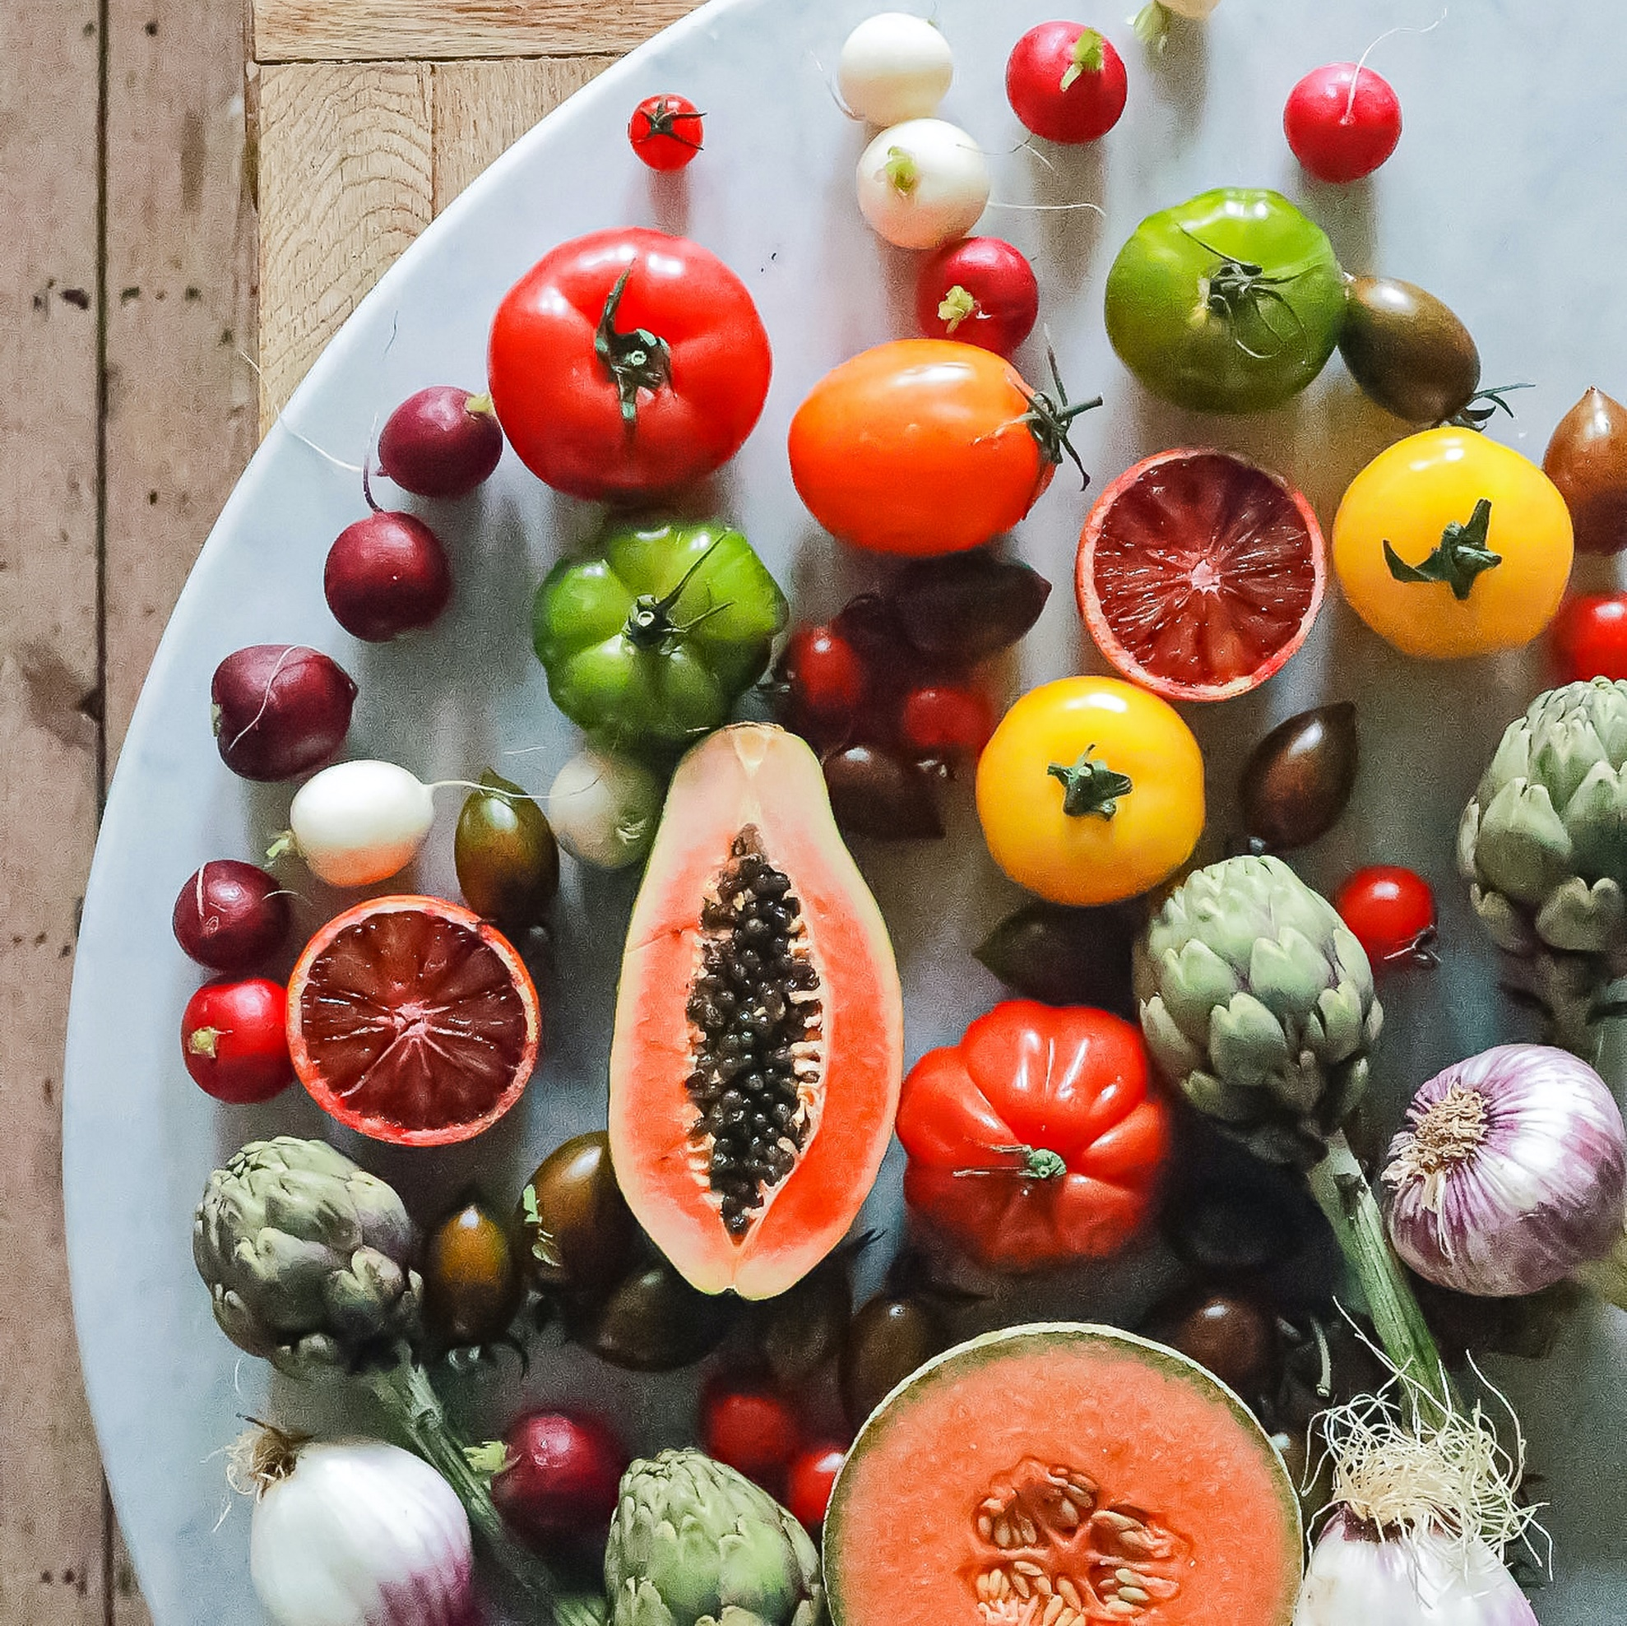
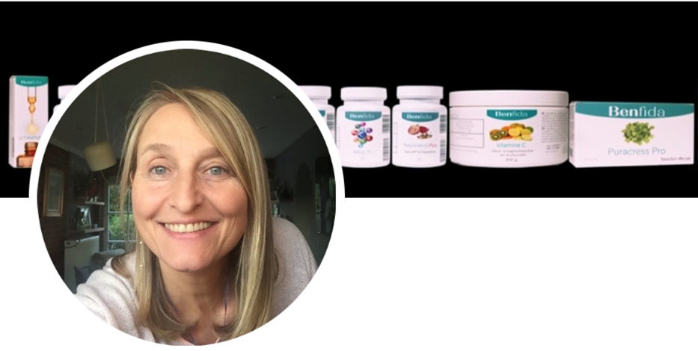
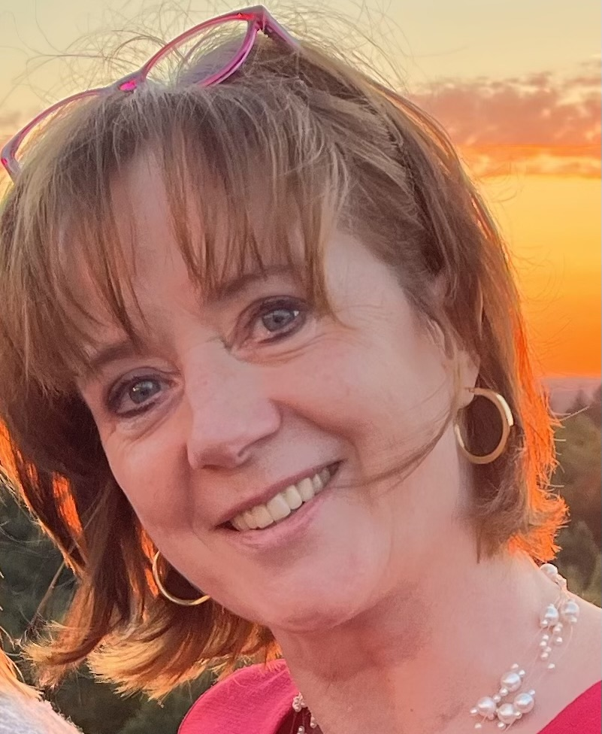
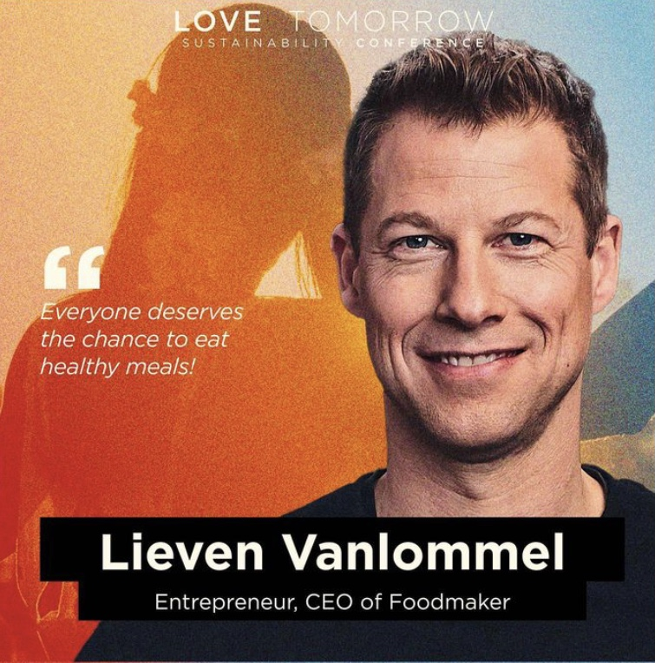
Challenge:
Challenge Owners:
Health & Nutrition Coach: Veerle Danneel
How might we use
SMART FOOD
to improve
HEALTHY AGING?
Coaches:
Miet
Vanstreels
CEO Foodmaker: Lieven Vanlommel
An Meermans
https://youtu.be/fofMSTih2Sw

Slide 2
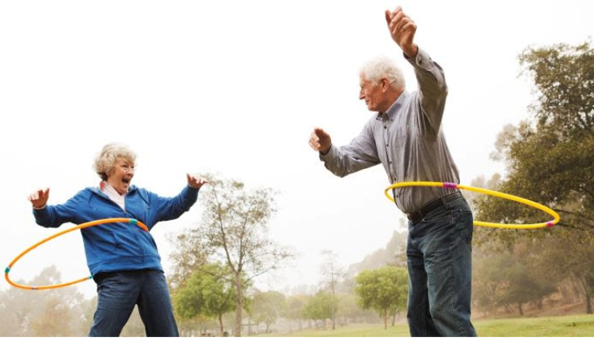
SMART HEALTH
How might we use SMART FOOD to improve HEALTHY AGING?
specific nutrients
DOs and DONTs
Healthy aging
Diseases (diabetes, cancer,..)
value of food supplements
......
......
->
https://youtu.be/fofMSTih2Sw

