Slide 1
NAME (alphabetic) | LAST NAME | Country | Email address | TEST BATTERY (personality) | Studies | E-portfolio ASAP | Presence
AYOUB | Ait Chcherki | BE | ayoub.aitchcherki@student.ucll.be | Connector |  | X | 15/3, 22/3, 19/4
DANG | Le Hong Anh | HU | Dang.Anh.Le.Hong@stud.uni-mate.hu | Planner |  | X | -- , 22/3, 19/4
ESMA/Aisma | Siali | BE | esma.siali@student.ucll.be | Connector | Orthopedagogie | X | 15/3, 22/3, -
HAMZA | Baraoui | HU | hamza.baraoui98@gmail.com | Planner |  |  | 15/3, 22/3, 19/4
JANNE | Geers | BE | janne.geers1@student.ucll.be | Thinker | XX Involved in soccer and basketball projects | X | 15/3, 22/3, 19/4
ZUZANA | Krizanova | AT | di221012@fhstp.ac.at | Planner | Dietetics | X | 15/3, 22/3, -
Meeting links
26/04/23
Click here to join the meeting
03/05/23
Click here to join the meeting
10/05/23
Click here to join the meeting

Slide 2
How can smart food support healthy aging
ILL 23: Homework -> 26/4
SMART FOOD
May we ask each student to propose 3 research questions for our IL,
to discuss during our next ILL-session on 26/4?
Please proceed as follows to identify a challenging research question (to repeat 3 times)
TOPIC? (diabetes, blue zone, specific nutrients, ...)
WHO? Think of a specific target group (+65 years, diabetes patients, students,..),
WHAT to achieve? (target, aim,.. )
HOW to achieve this? (with support, education,.. )
Formulate your research question containing the info above
Healthy aging
Meeting flow 26/4:
Each student to explain his/her 3 research questions
Everyone scores each research question (score on 10)
The winning research question will be explored/’solved’ in the upcoming ILL-sessions
Tasks will be divided between all students (students to decide on roles & responsibilities)

Slide 3
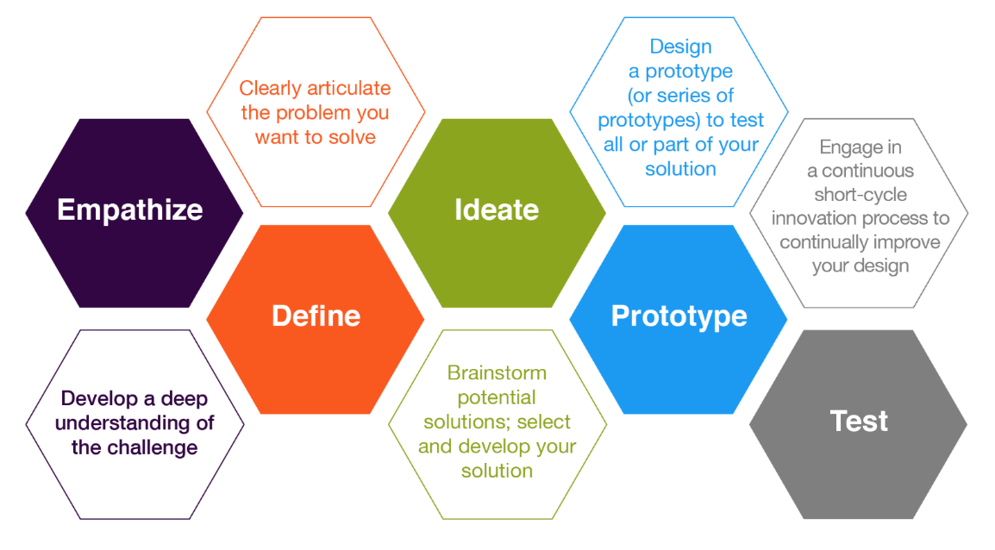
I Living Labs (6 weeks)
DESIGN THINKING
https://www.youtube.com/watch?v=HrerDSPBM44
Eudres video
May 17
May 31
SESSION 1-2-3
SESSION 4
SESSION 5
SESSION 6
No test phase
March 22, 29 – April 19
April 26
May 3, 10
SHOW DOWN
1 prototype
for the
whole group

