Slide 1
Welcome
ILL-23 : Smart Food Healthy aging
START Week 0 – 15/3
NAME (alphabetic) | LAST NAME | Country | Email address | TEST BATTERY (personality) | Studies | E-portfolio ASAP | Presence
AYOUB | Ait Chcherki | BE | ayoub.aitchcherki@student.ucll.be | Connector |  | X | 15/3, 22/3
DANG | Le Hong Anh | HU | Dang.Anh.Le.Hong@stud.uni-mate.hu | Planner |  | X | -- , 22/3
ESMA/Aisma | Siali | BE | esma.siali@student.ucll.be | Connector | Orthopedagogie | X | 15/3, 22/3
HAMZA | Baraoui | HU | hamza.baraoui98@gmail.com | Planner |  |  | 15/3, 22/3
JANNE | Geers | BE | janne.geers1@student.ucll.be | Thinker | XX Involved in soccer and basketball projects | X | 15/3, 22/3
ZUZANA | Krizanova | AT | di221012@fhstp.ac.at | Planner | Dietetics | X | 15/3, 22/3

Slide 2
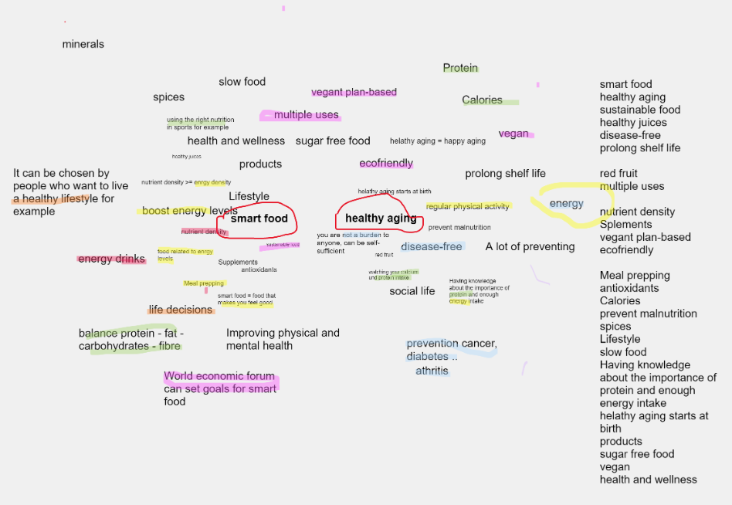
Brainstorming Whiteboard – March 22nd

Slide 3
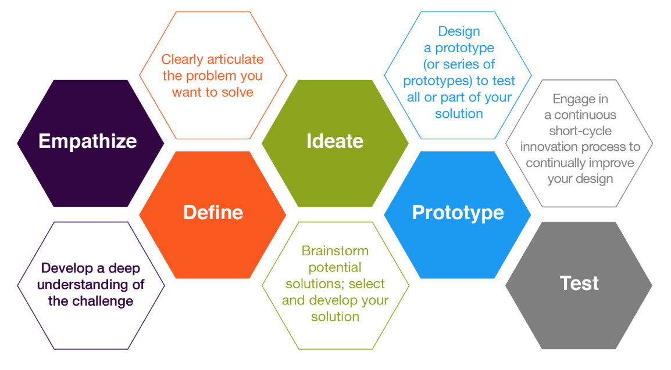
I Living Labs (6 weeks)
DESIGN THINKING
https://www.youtube.com/watch?v=HrerDSPBM44
Eudres video
May 17
May 31
SESSION 1-2-3
SESSION 4
SESSION 5
SESSION 6
No test phase
March 22, 29 – April 19
April 26
May 3, 10
SHOW DOWN
1 prototype
for the
whole group

Slide 4
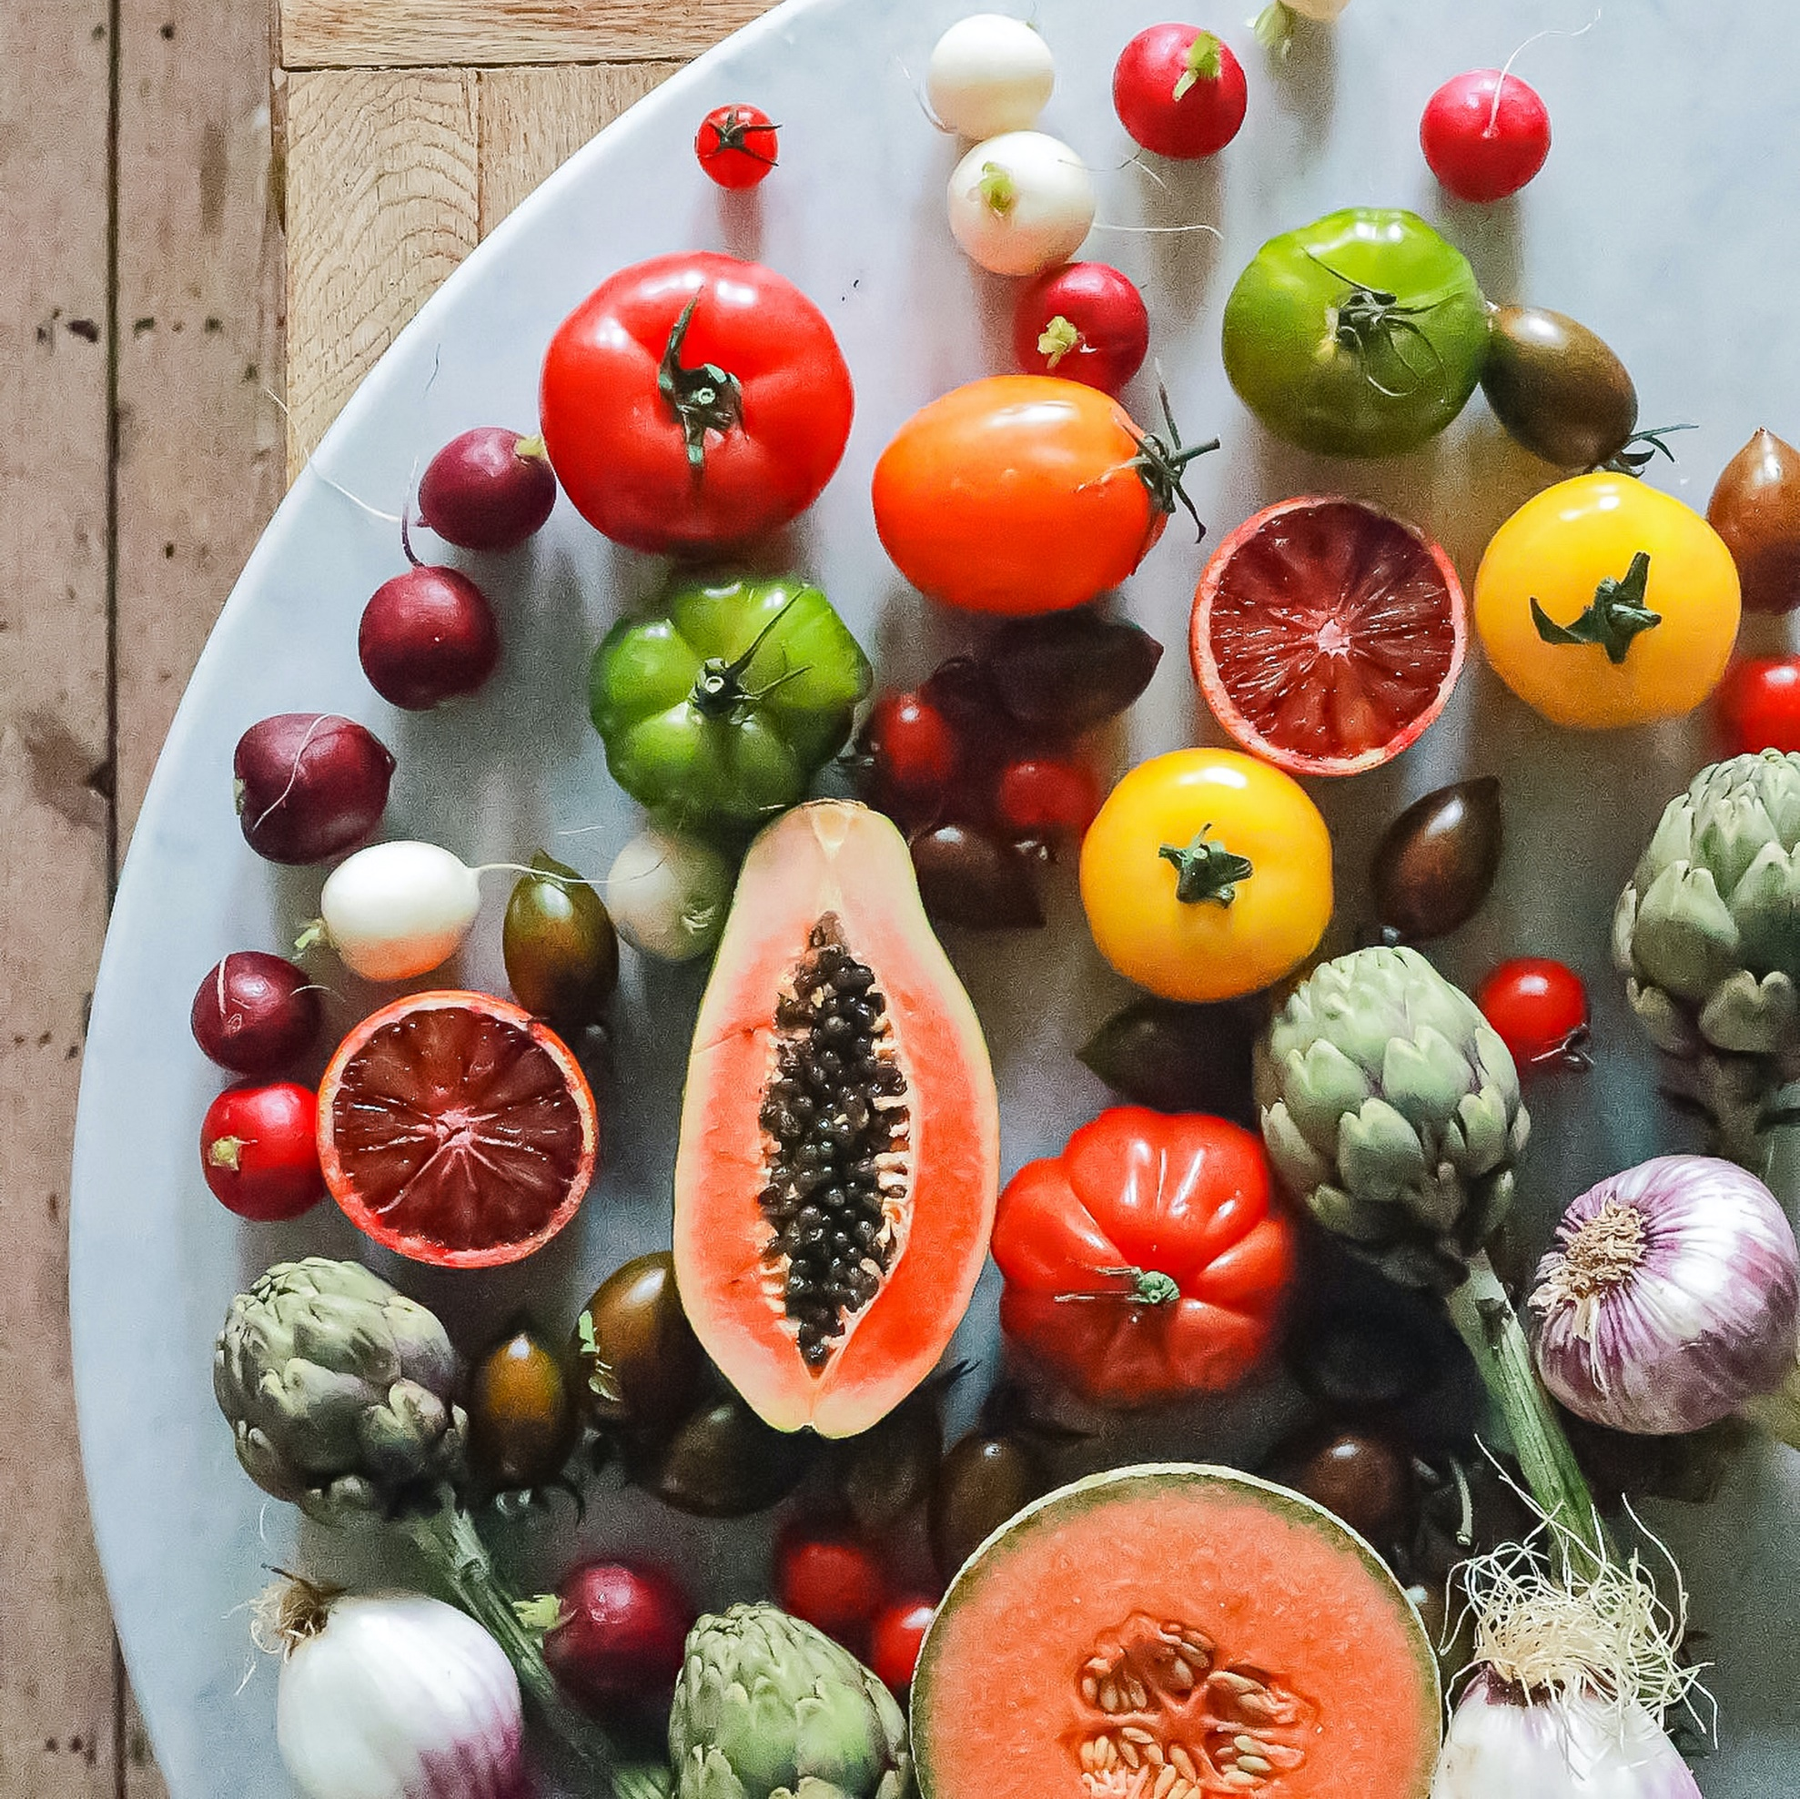
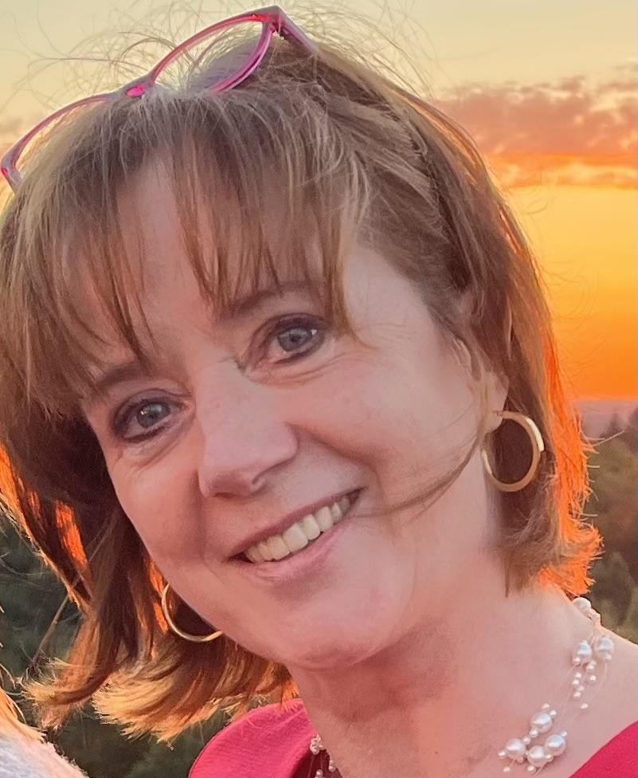
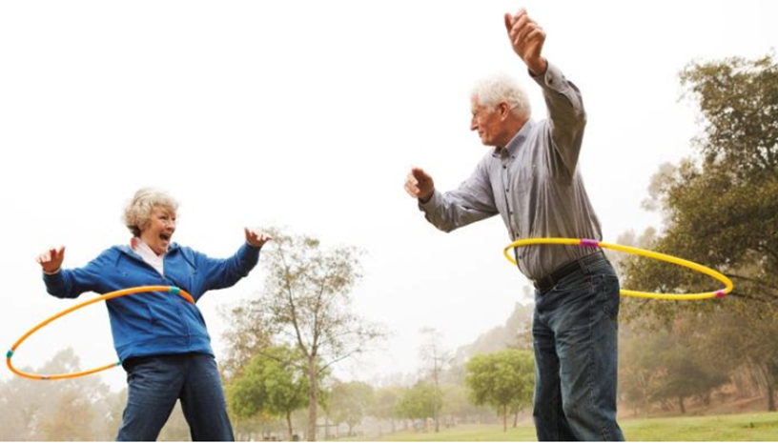
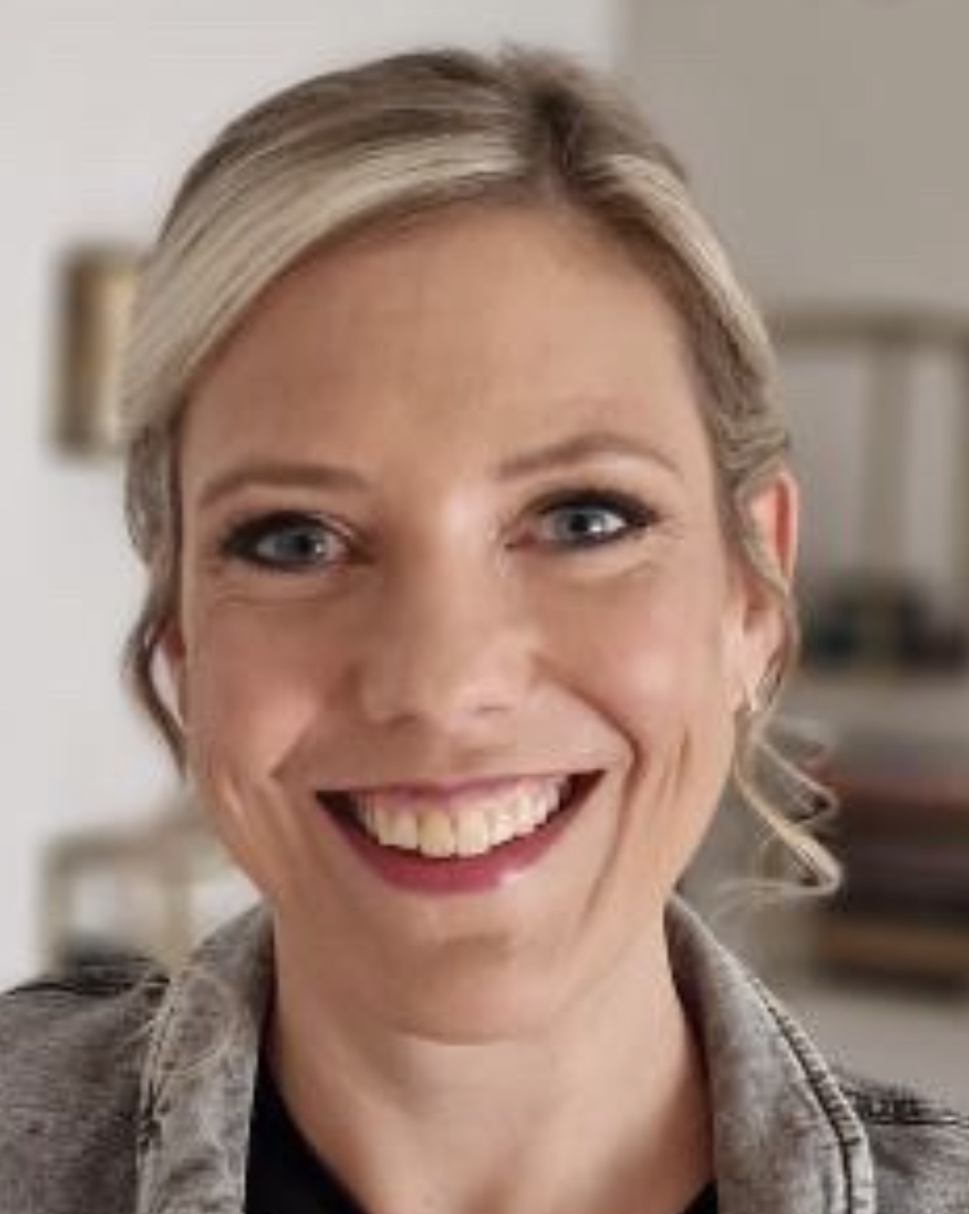
SMART HEALTH
How might we use SMART FOOD to improve HEALTHY AGING?
Welcome
in I Living Lab 23
Miet
Vanstreels
An Meermans
->
https://youtu.be/fofMSTih2Sw

Slide 5
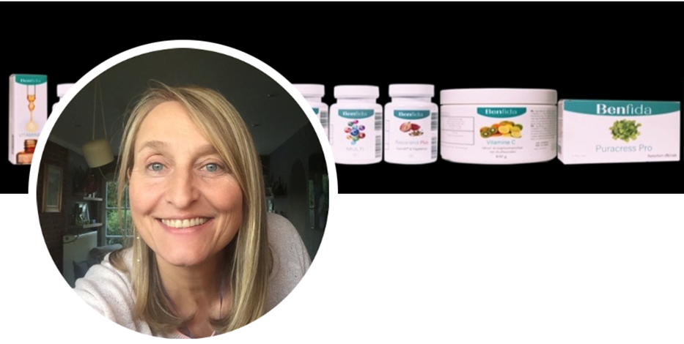



Challenge:
Challenge Owners:
Health & Nutrition Coach: Veerle Danneel
How might we use
SMART FOOD
to improve
HEALTHY AGING?
Coaches:
Miet
Vanstreels
CEO Foodmaker: Lieven Vanlommel
An Meermans
https://youtu.be/fofMSTih2Sw

Slide 6
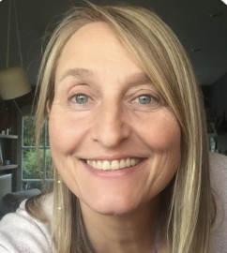
SMART HEALTH
How might we use SMART FOOD to improve HEALTHY AGING?
specific nutrients
DOs and DONTs
Healthy aging
Diseases (diabetes, cancer,..)
value of food supplements
......
......
->
https://youtu.be/fofMSTih2Sw

Slide 7

ILL work sessions (6 weeks) (+ 2 weeks Easter holidays) | Monday March 20th – Thursday May 15th
Students: submission results (1 page poster + 90 sec video to send to UCLL contact person via ‘wetransfer’) | By Thu May 25th tbc
Show down (including video viewing outcomes ILLs) | Wednesday May 31st (18:30-20:00 tbc)
Finalize portfolio for an individual evaluation meeting with your coach(es) -> EEs: submission scores (A-E) | By May 31st tbc

Slide 8
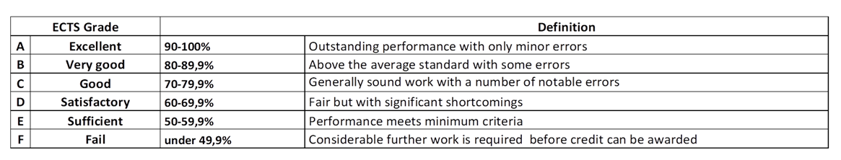

Slide 9
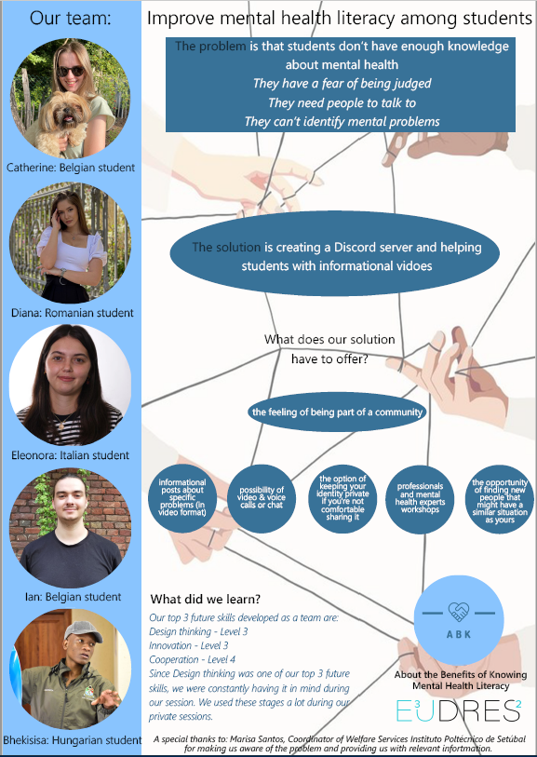
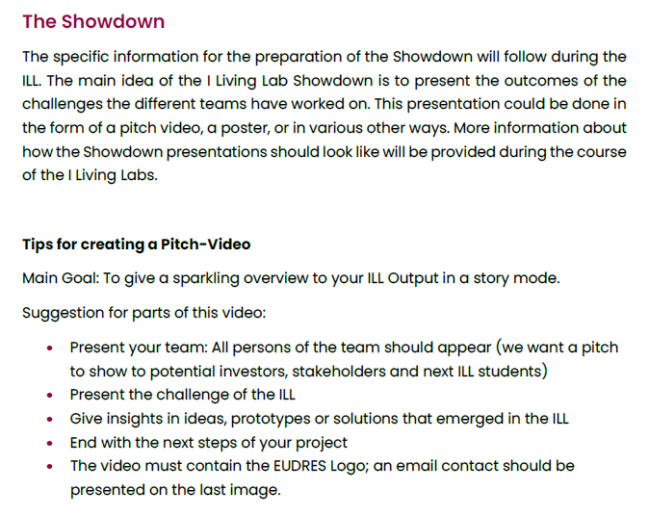

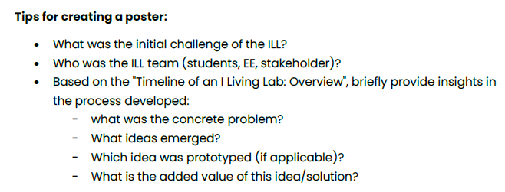
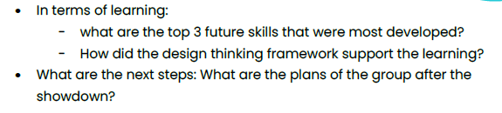
TEAM evaluation
90 sec

Slide 10
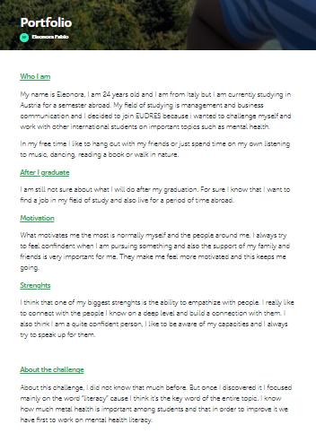
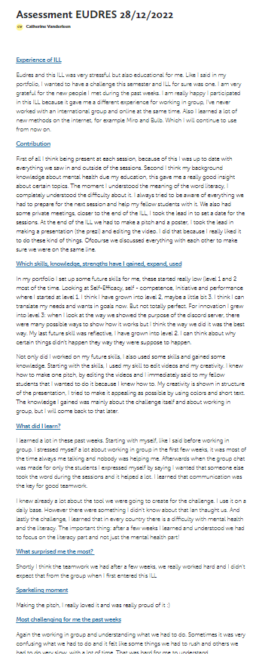
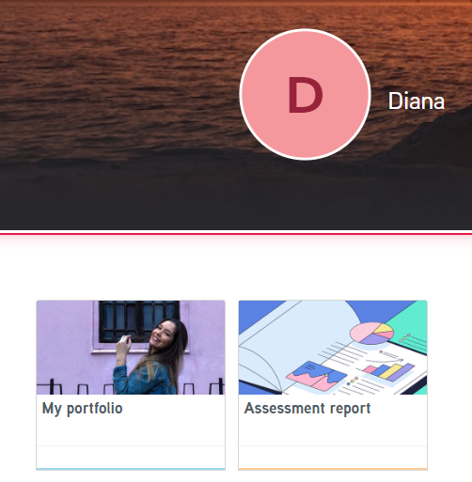
Individual evaluation - example
https://www.bulbapp.com/

Slide 11
I Living Labs (6 weeks)
DESIGN THINKING
SESSION 1-2-3
SESSION 4
SESSION 5
SESSION 6
No test phase
SHOW DOWN
1 prototype
for the
whole group

