Slide 1
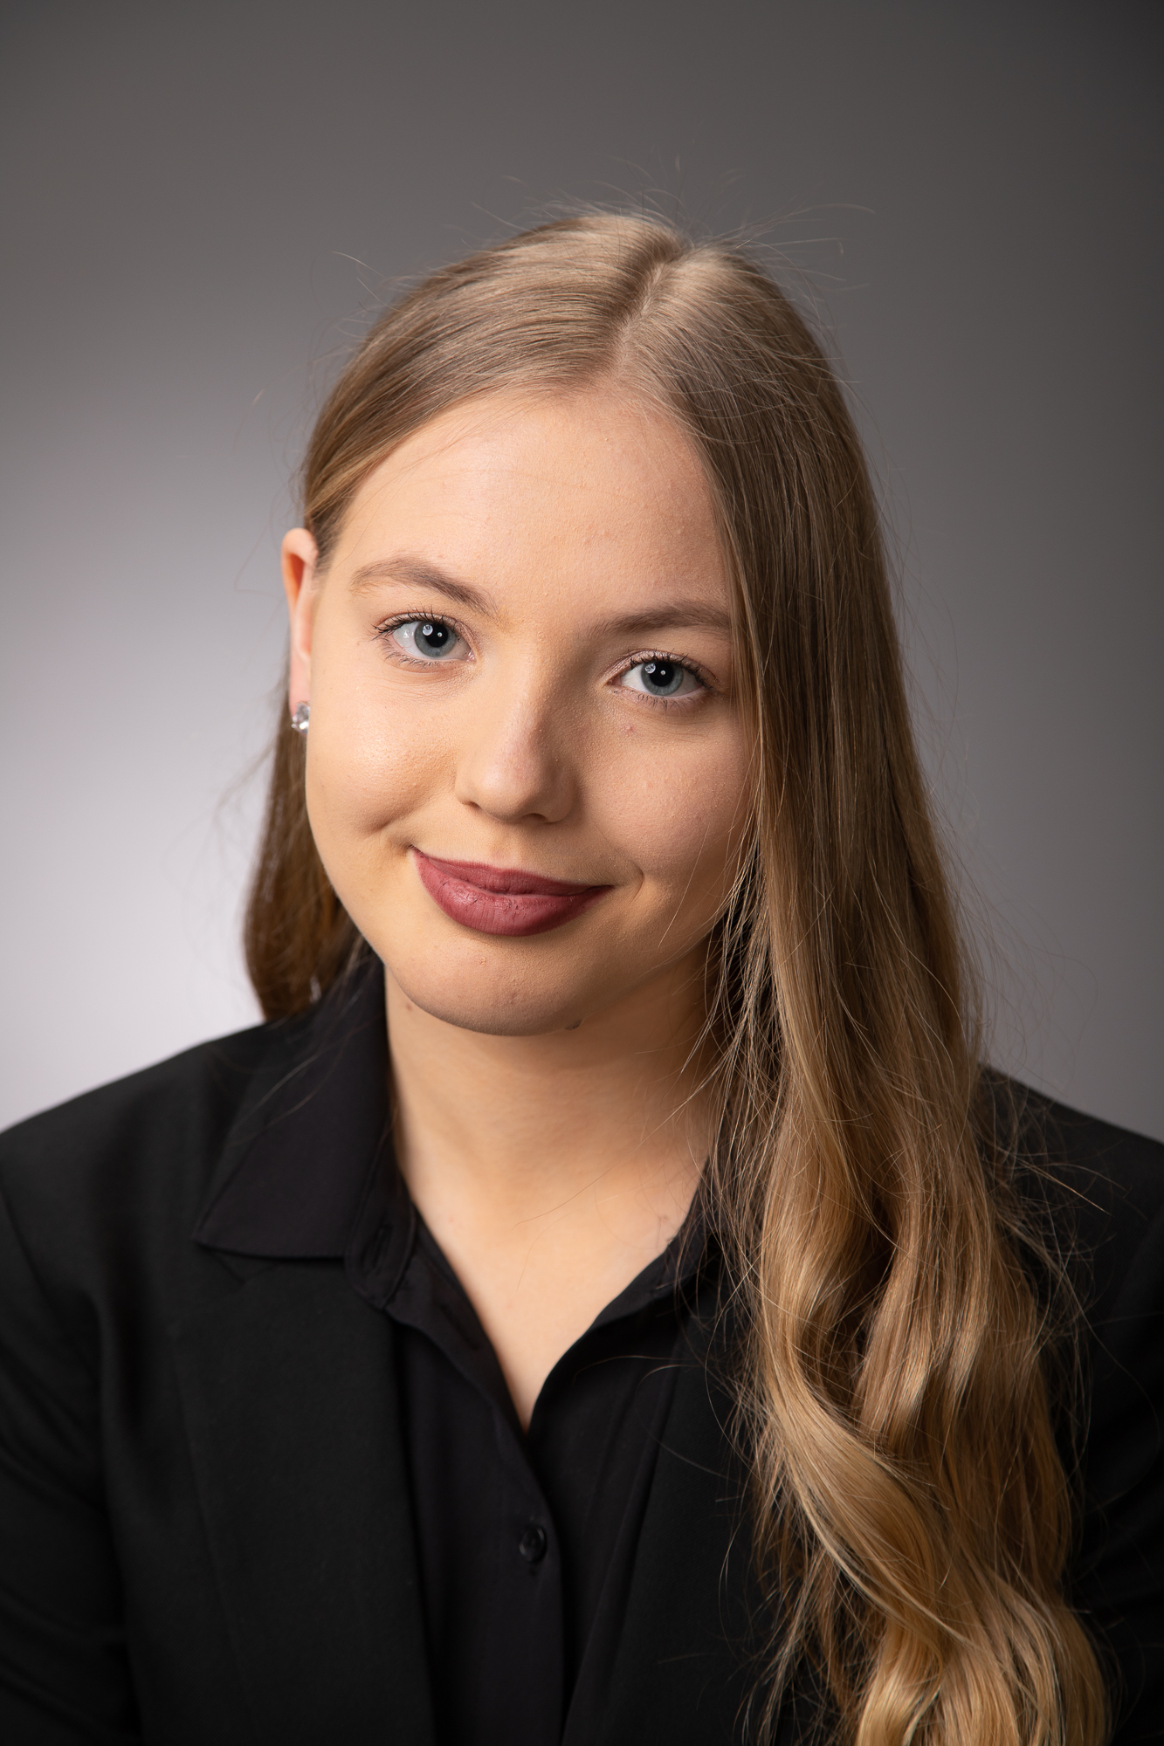
Blended I living lab
Bianka`s Portfolio

Slide 2
About me
Hi,
My name is Bianka Anita Daróczi and I’m one of the enthusiastic participants.
When I found this opportunity I didn’t know what to expect, but I felt this curiosity and thought: “What could go wrong? Maybe I’ll have an experience I will remember my whole life and even do something good to this world.” So I went for it and so far it’s very new and exciting. Everybody is nice too.

Slide 3
Studies
I am currently studying at the Hungarian Agriculture and Life sciences University in Budapest.
I study biochemical engineering.
It’s a very useful and interesting degree especially nowadays and in the eyes of healthcare.
After finishing my studies I plan on working with animals and looking for a better solution to their healthcare and overall working for a better life to animals and humans alike.

Slide 4
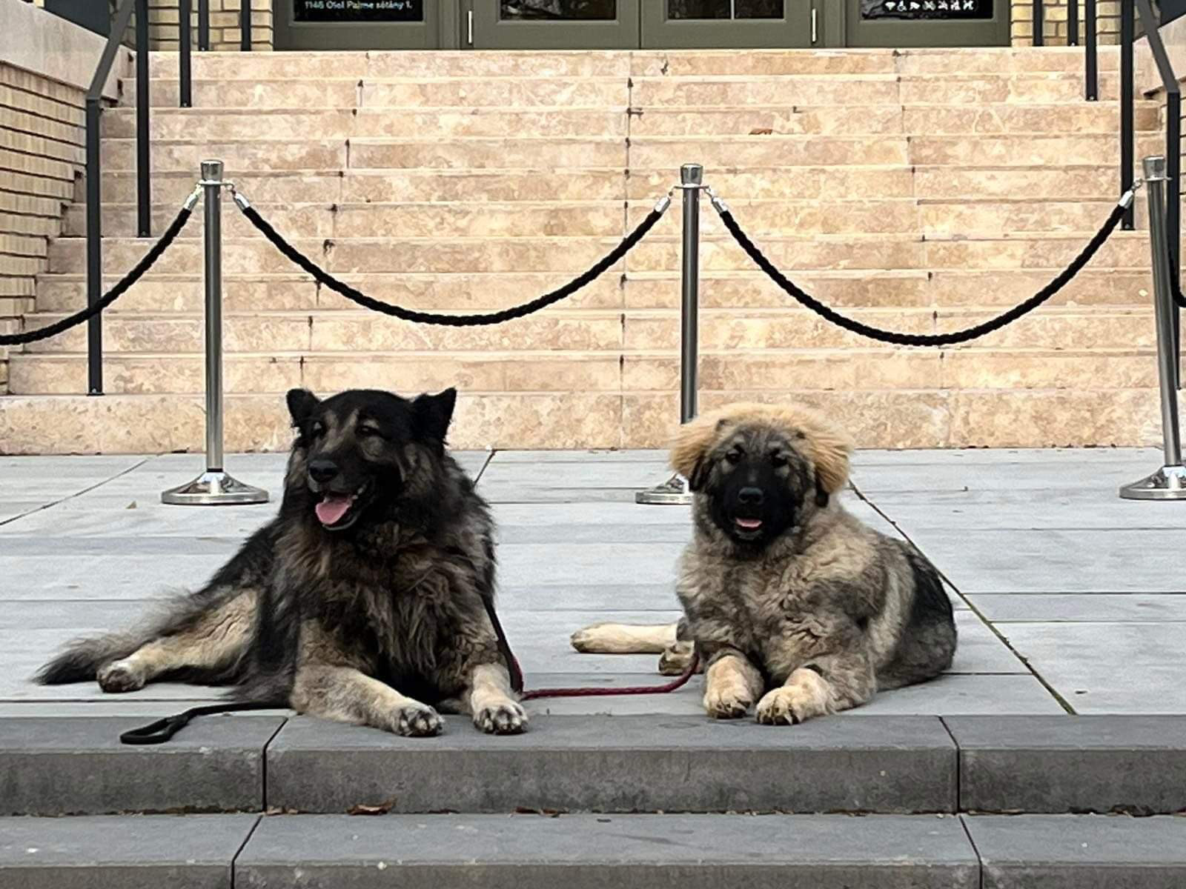
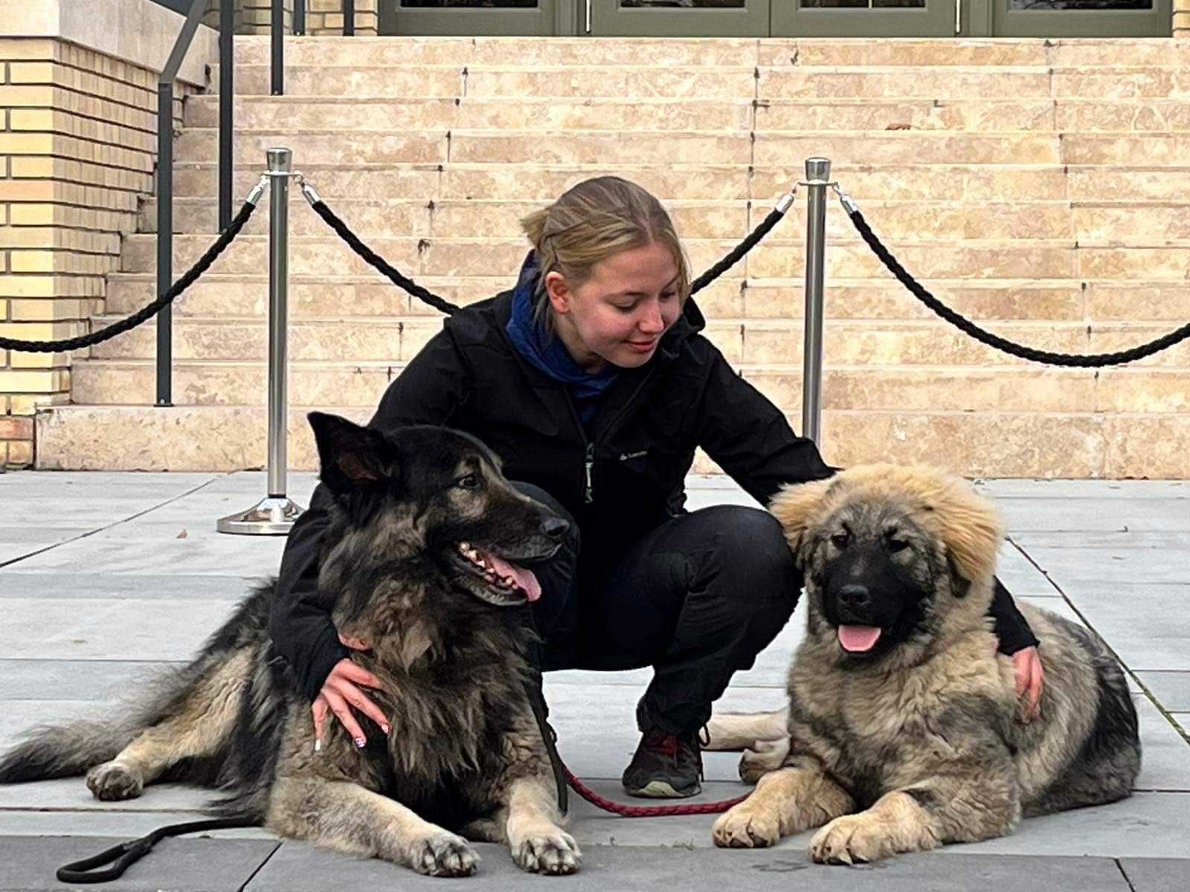
Motivation
My family, friends and pets are my biggest motivators of all time. Although the greater purpose plays a big role too.
I have 5 pets at home (2 sharplaninac dogs and 3 cats) and have many friends which I’m very proud of.

Slide 5
Interests
I am very passionate about:
Doing sports
Healthcare
Learning new languages
Learning new things/skills
Training my cats and dogs.
In my free time (when I’m not studying or working) I like to watch Netflix, play with my dogs or play chess.

Slide 6
My strengths
I am very talkative and energetic most of the time, but also very hardworking and focused on the goal.
I can easily connect with people and I have a good english and german knowledge. I like to help others if I can so I consider myself helpful and sometimes maybe even a little bit too honest.

Slide 7
Challenge topic: Re-Think Healthcare
I already know that it will be challenging, but also very interesting and I will learn so much about many things that can even help and be useful for the future.
We already met each other with the group during zoom with the others and I’m looking forward to achieve something great.

